Slide 1
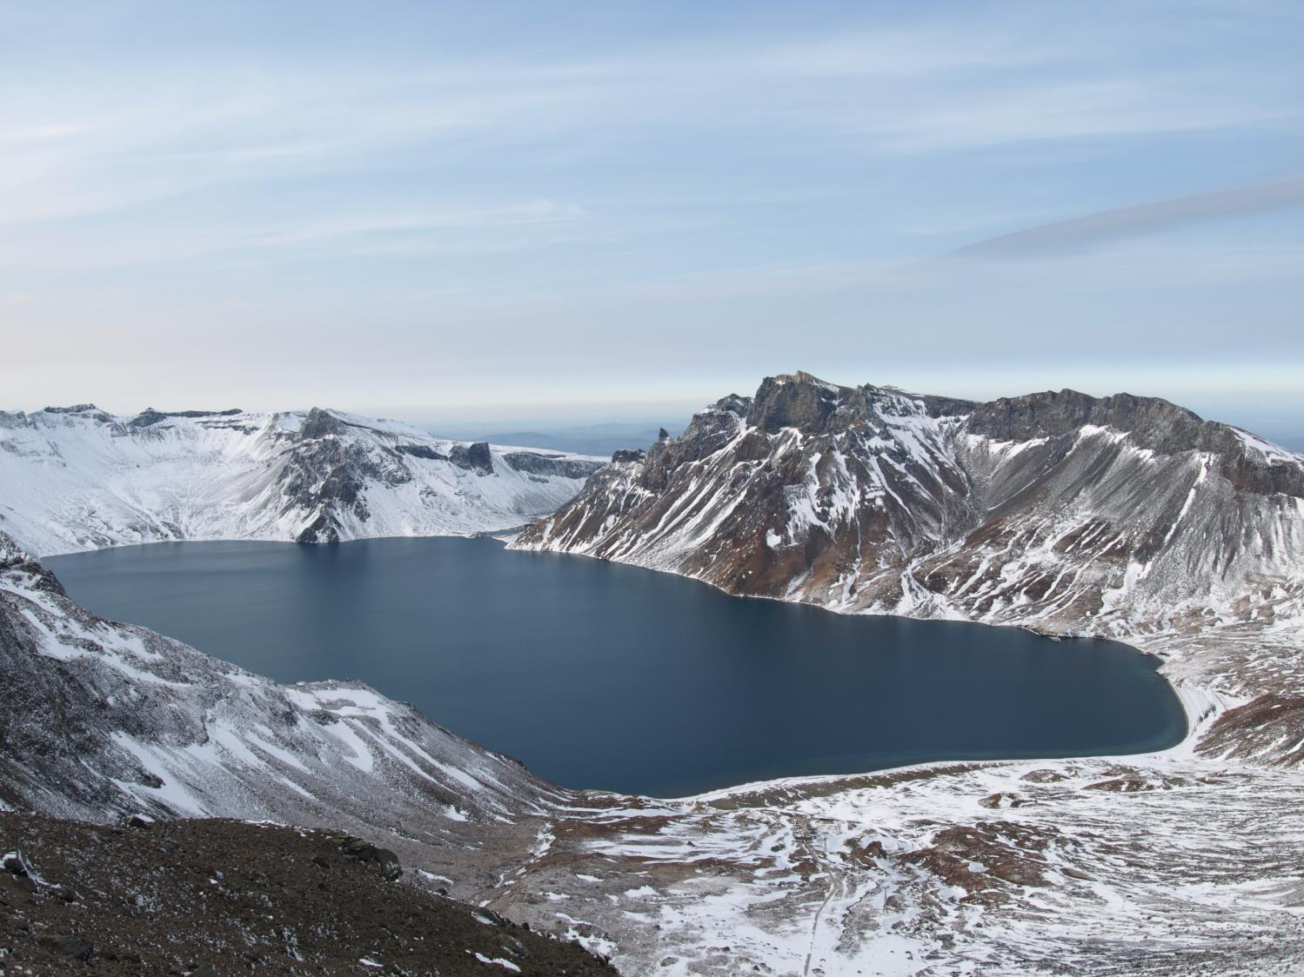









Evidence for partial melt in the crust beneath Mt. Paektu (Changbaishan), Democratic People’s Republic of Korea and China
Yun Young Gun
Park Gil Jong
Kim Ju Song
Ri Kyong Song Earthquake Administration, DPRK
Ko Chol Nam
Kim Hyok
Ri Chong Song
Ri Kuk Hun State Academy of Science, DPRK
James Hammond Birkbeck, University of London
Clive Oppenheimer University of Cambridge
Amy Donovan Kings College London
Kayla Iacovino USGS
Bruno Scaillet CNRS-ISTO
Norman Neureiter AAAS
Rich Stone AAAS
Kosima Weber Liu EEMP
Ryu Kum Ran
Ri Song PIINTEC
Kim Song Hyok
Sir Martyn Poliakoff
Ben Koppelman
Tracey Elliot The Royal Society
Luke Clarke
Caroline Dynes
Earthquake Bureau,
DPRK
State Academy of Science,
DPRK

Slide 2
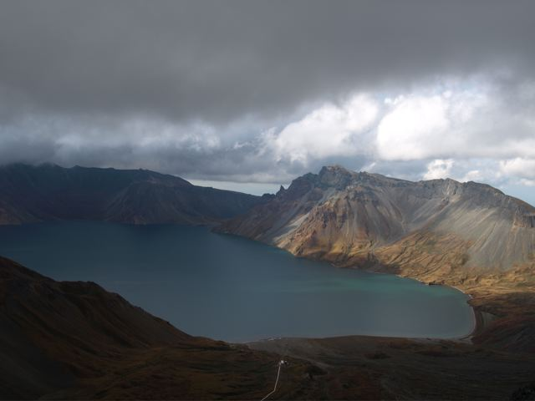
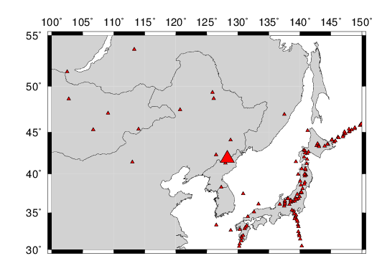

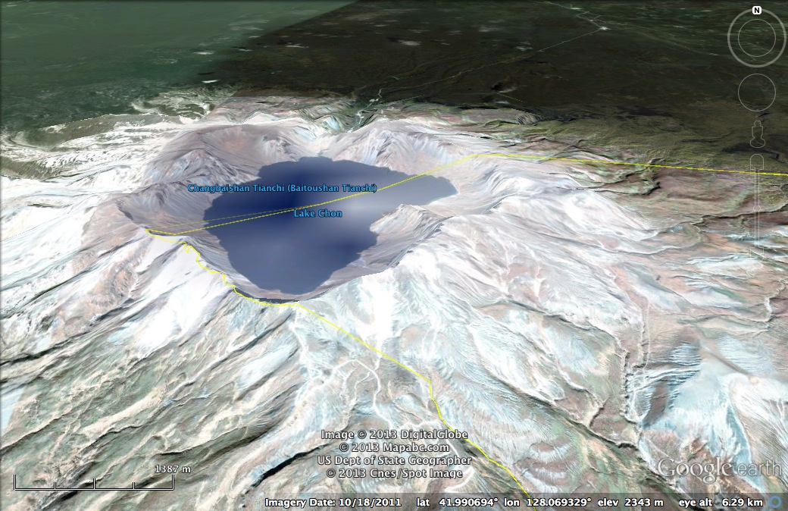
Mt. Paektu volcano is located on the China/DPRK (North Korea) border
Also known as Changbaishan (China) and Baekdusan (Republic of Korea (South Korea))
Last major eruption in 946 AD – the ‘Millennium Eruption’
  Comparable in size to Tambora, 1816
Russia
Mongolia
DPRK
Japan
ROK
China

Slide 3
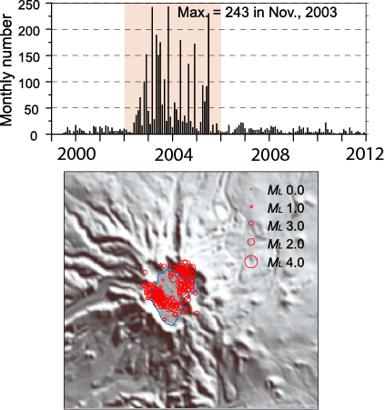
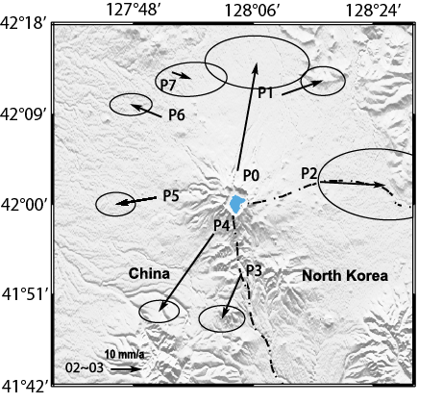
Why study Mt. Paektu/Changbaishan now?
Recent signs of unrest at the volcano:
  Increase in number of earthquakes (2002-2006)
  Volcano deformation
  Increase in volcanic gases
Number of earthquakes
Xu et al., 2012

Slide 4
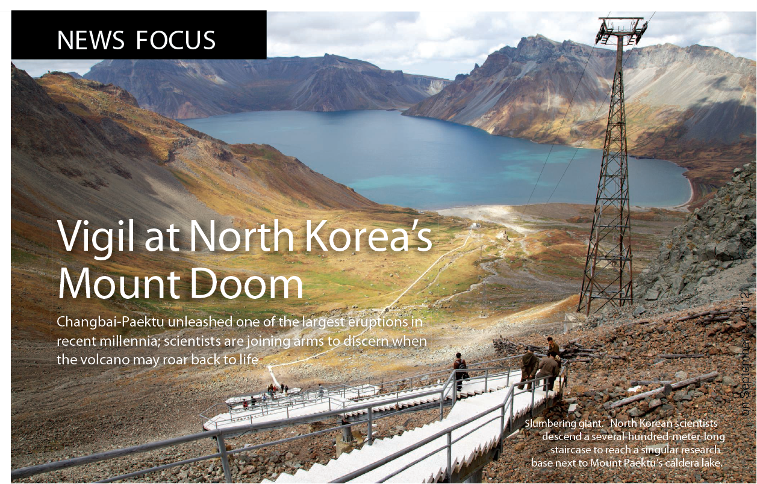
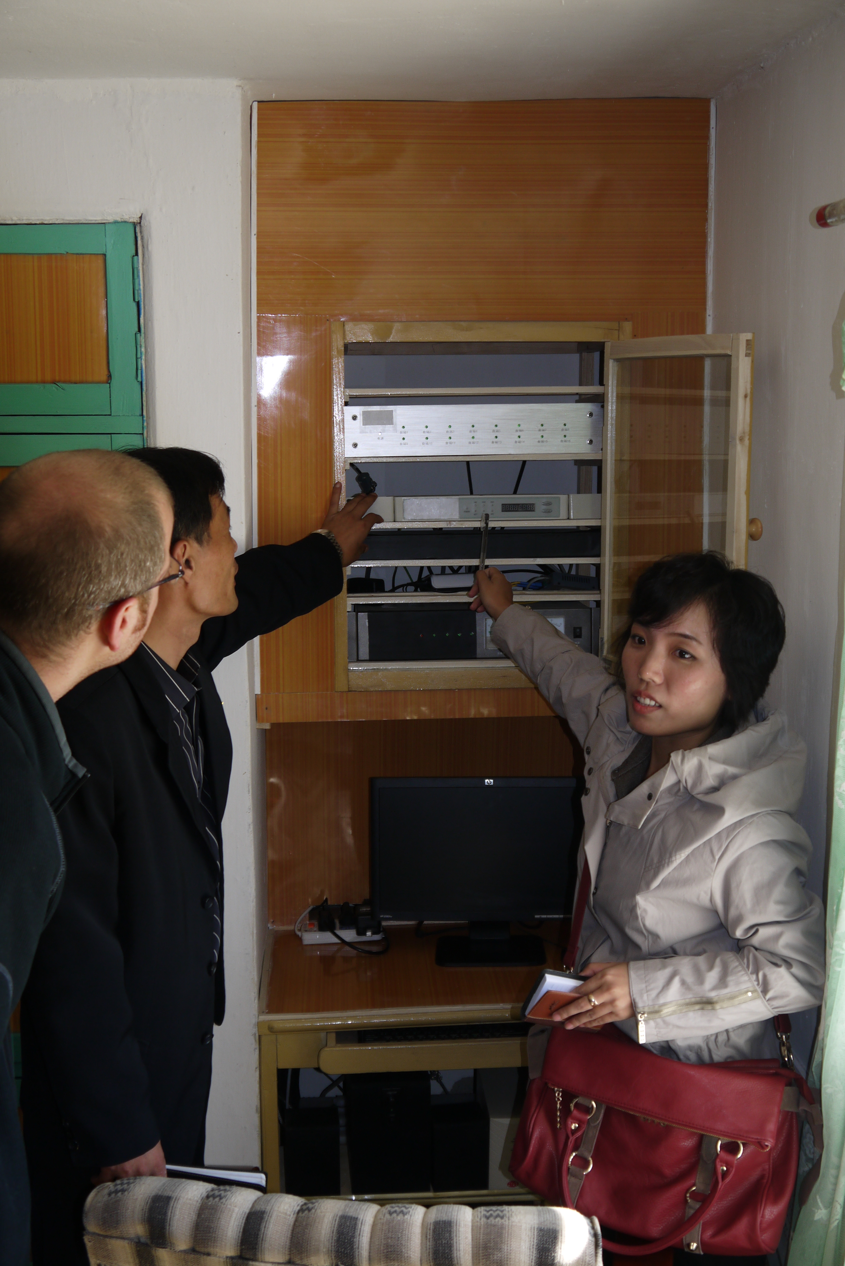
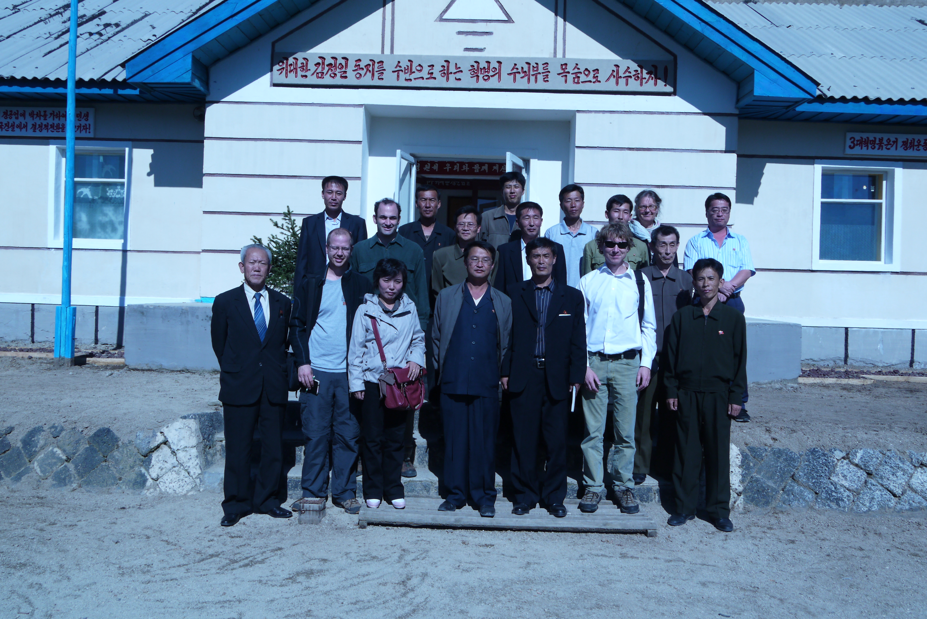
September 2011 – Clive Oppenheimer and I invited to DPRK to discuss Mt. Paektu volcano
First western scientists to visit the volcano observatory
Developed plans to
  Image beneath the volcano geophysically
  Study Millennium Eruption petrologically

Slide 5
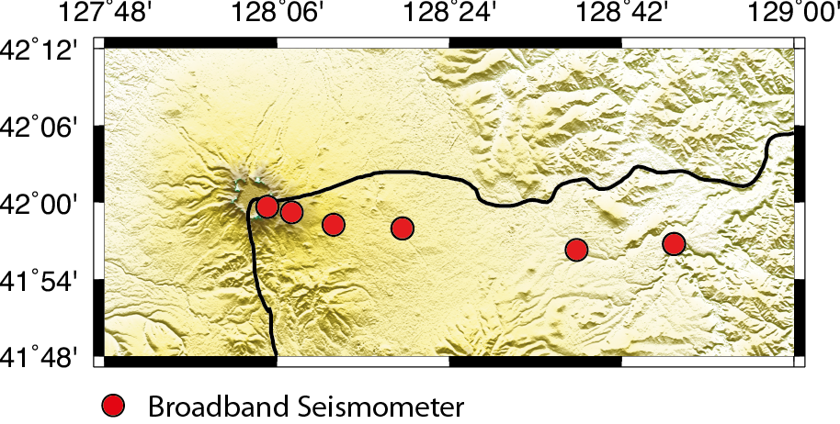
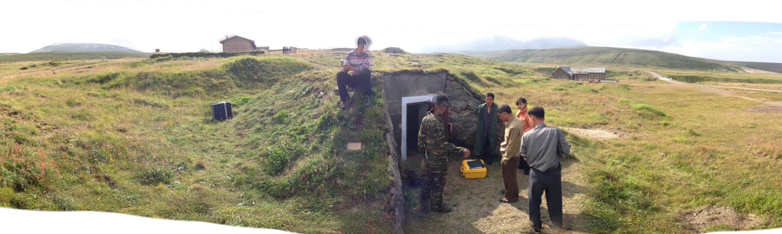
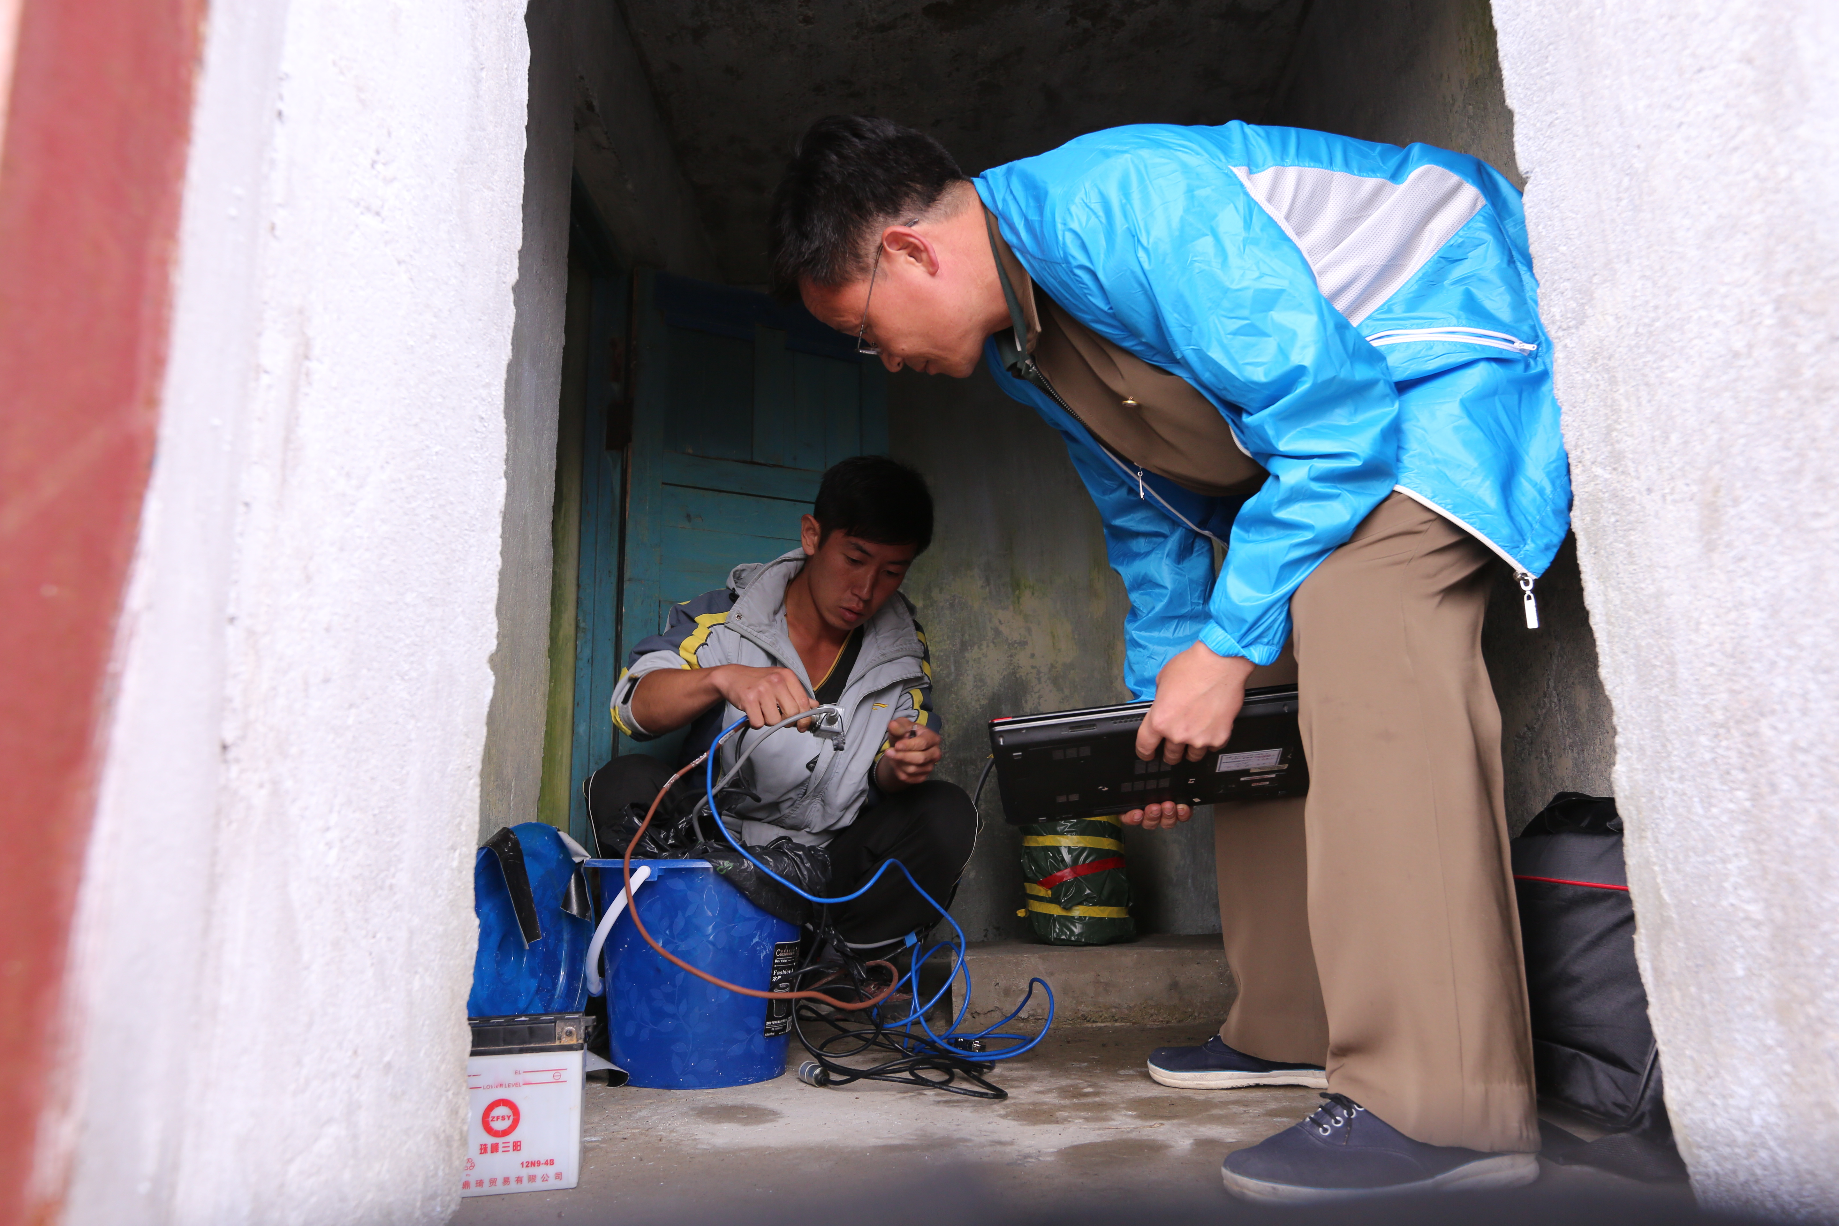
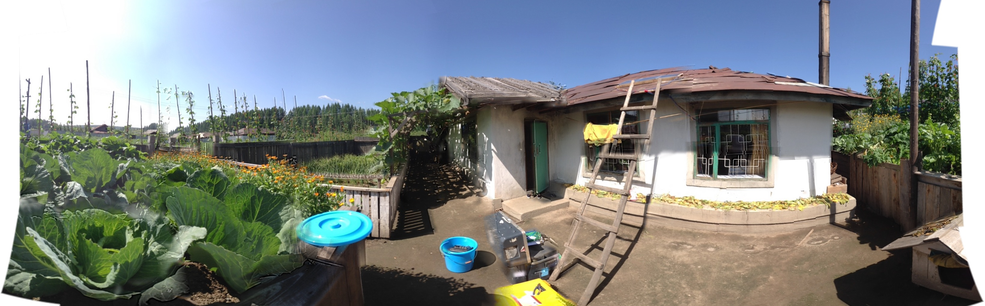
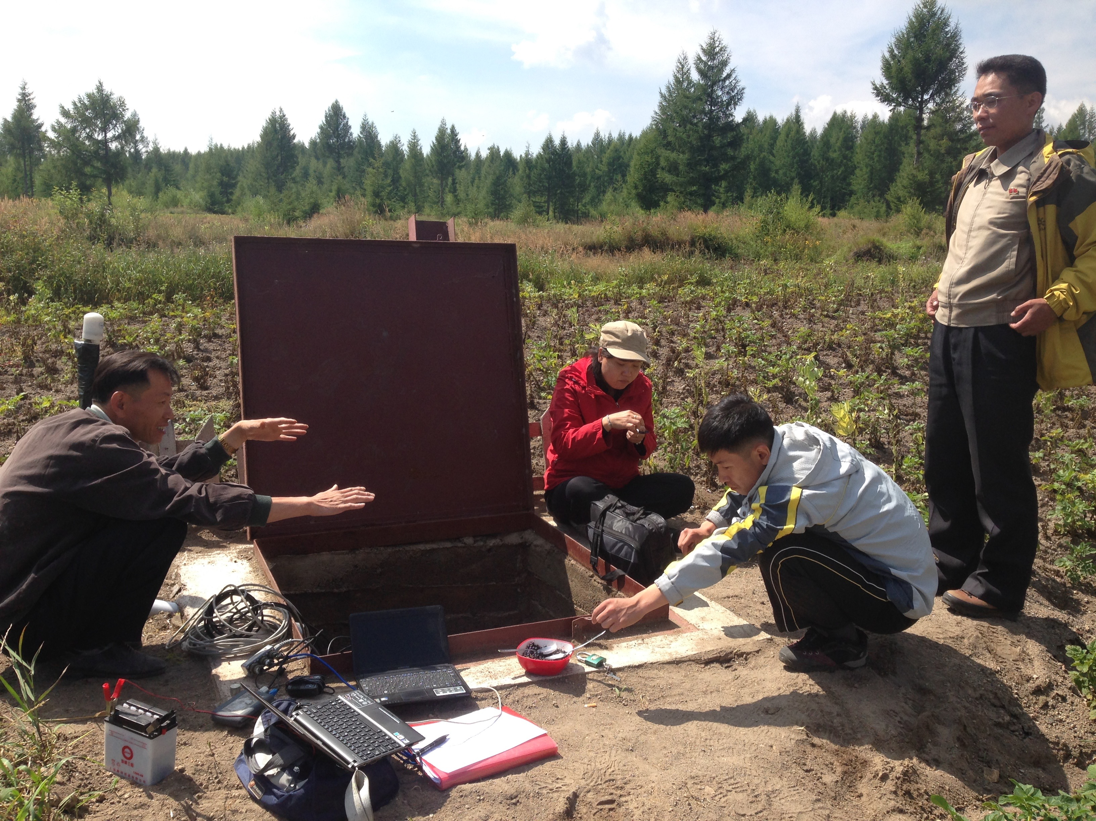
Joint DPRK – UK – US collaboration
Deployed 6 broadband seismometers in DPRK
First broadband seismometers in DPRK

Slide 6
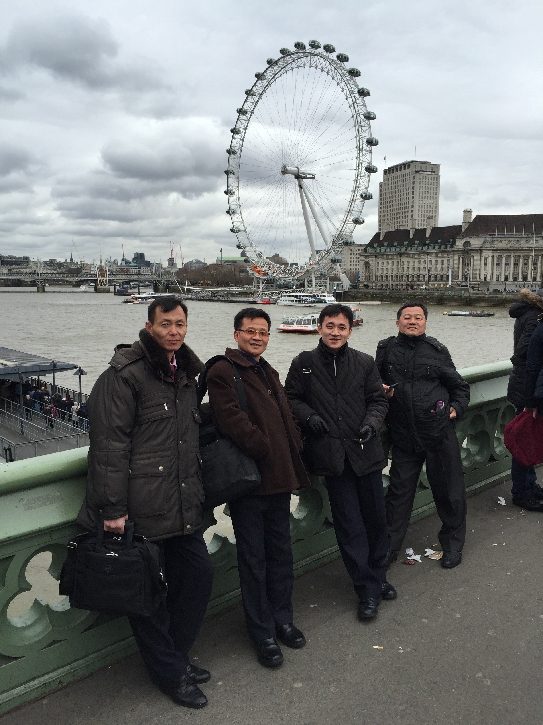
Joint DPRK – UK – US collaboration
Deployed 6 broadband seismometers in DPRK
Work led by DPRK scientists during visit to UK

Slide 7
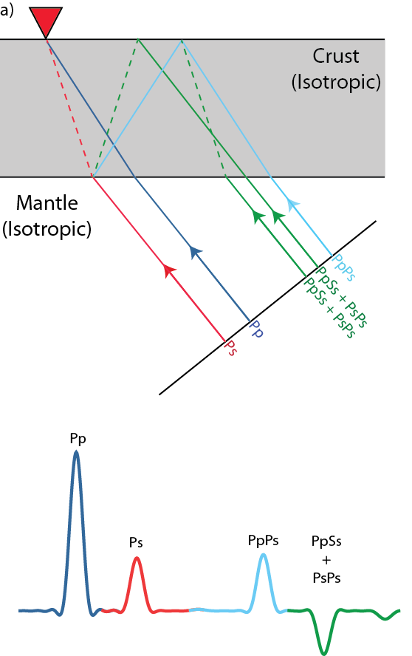
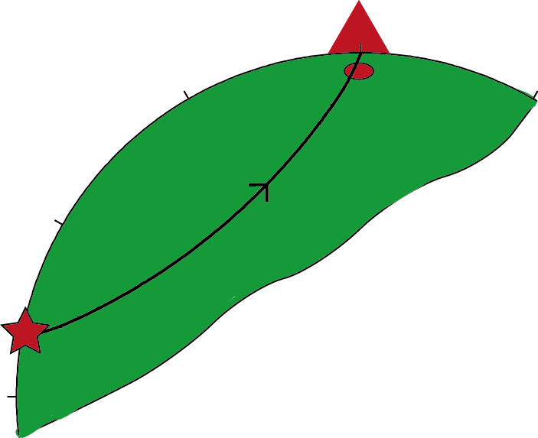
Receiver Functions
Use H-κ stacking
  Bulk crustal Vp/Vs and thickness
Use RF migration
  Internal crustal structure

Slide 8
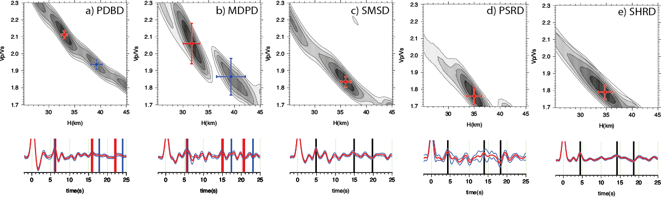
Vp/Vs
Vp/Vs
Vp/Vs
Crustal thickness (km)
Crustal thickness (km)
Crustal thickness (km)
Vp/Vs
Crustal thickness (km)
Kyong-Song et al., 2016

Slide 9
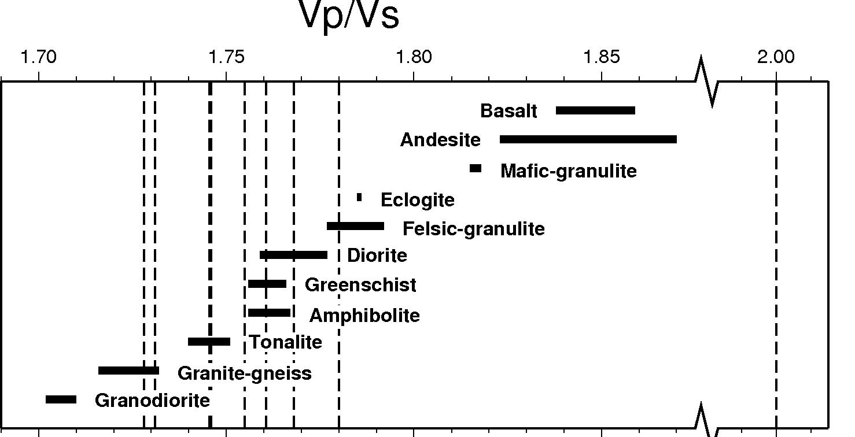
Thompson et al., 2011
Kyong-Song et al., 2016
Far from volcano similar to Sino-Korean craton
Close to volcano – very high Vp/Vs
  Partial melt
Mafic
Granite

Slide 10
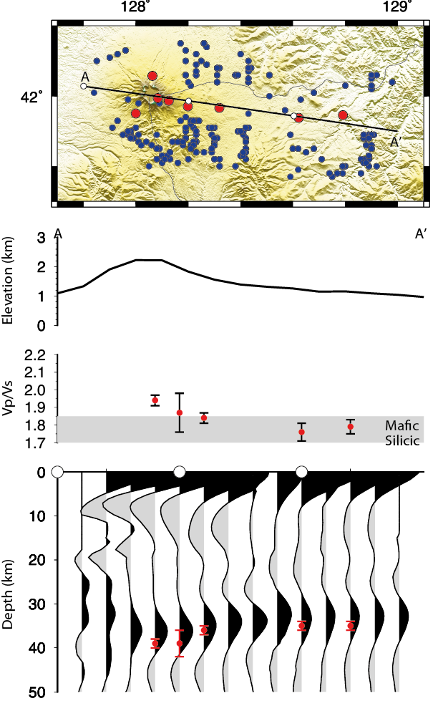
Chinese controlled source study supports results (Zhang et al., 2001, Liu et al., 2004)
Evidence for crustal thickening
Poissons ratio < 0.3 equivalent to Vp/Vs of 1.88
Liu et al., 2004

Slide 11
Kyong-Song et al., 2016
Study using DPRK stations shows:
  Significant melt present beneath the volcano today
  Mafic crust present up to 20 km from volcano
  Evidence of velocity reduction with depth at 10 km

Slide 12
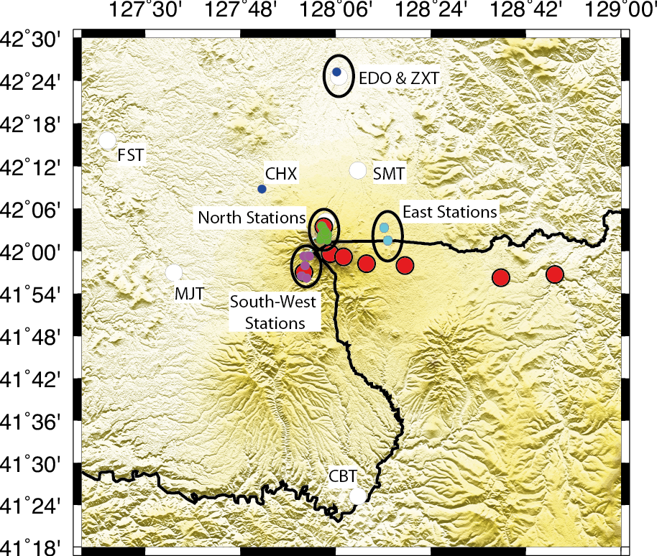
Independently perform same analysis on Chinese stations (with CEA)
5 permanent stations (2 years data)
28 temporary stations (deployed in response to Paektu unrest)

Slide 13
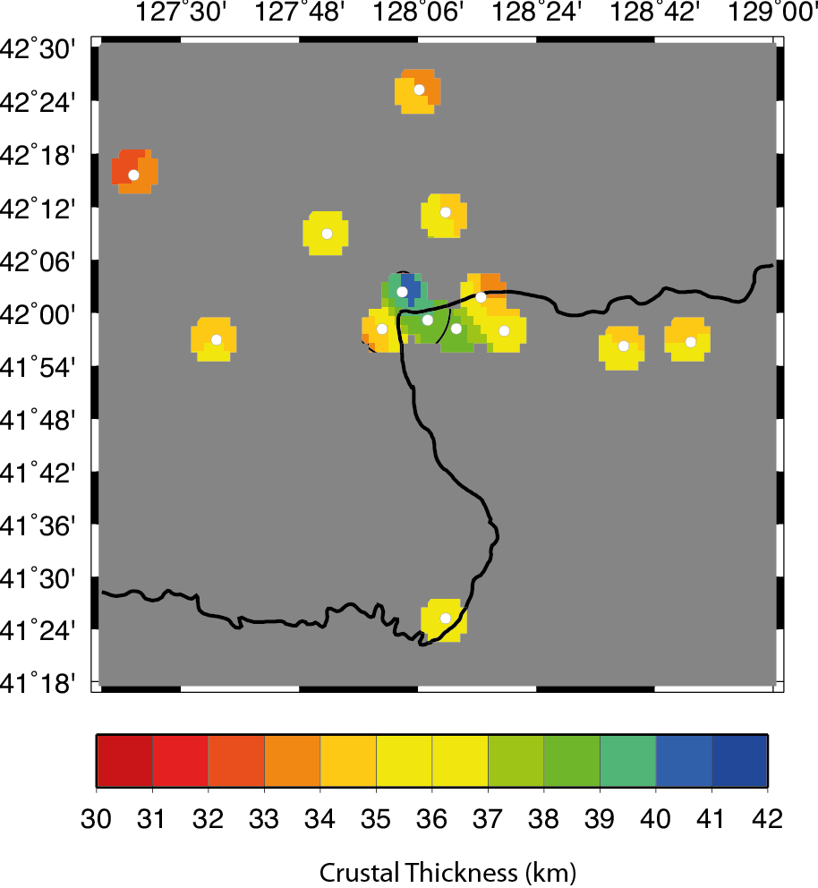
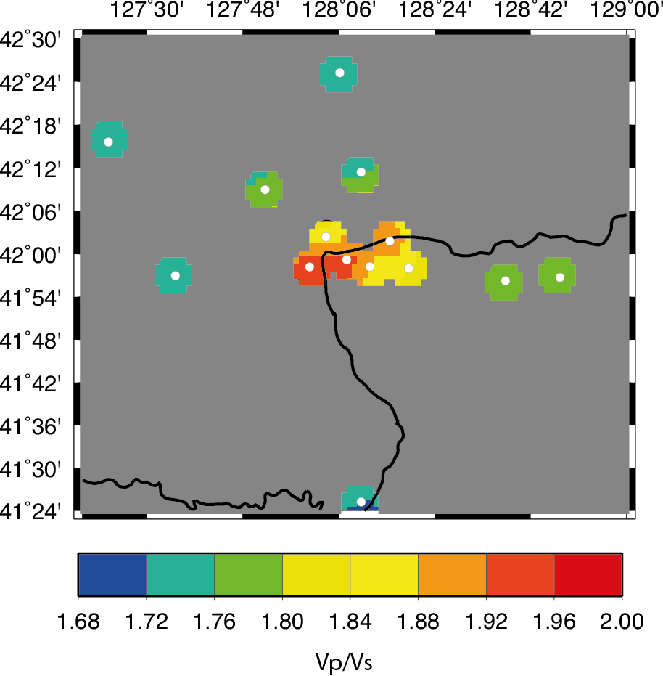
Thick crust and High Vp/Vs directly beneath Mt Paektu
Seems localised to volcano, but lacking details

Slide 14
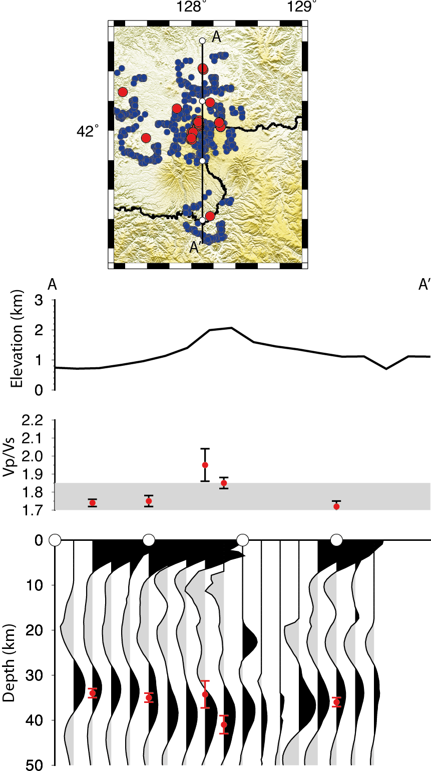
Future Work
Currently combining datasets in first cross-border study (images currently confidential)
First maps of crust structure
Detail presence of low velocity layer
Developing new cross-border deployments
Image crust and mantle beneath northern DPRK and NE China
Understand long history of volcanism in the area
DPRK data
Chinese data

