Slide 1
A history of macroseismology in the UK
RMW Musson

Slide 2
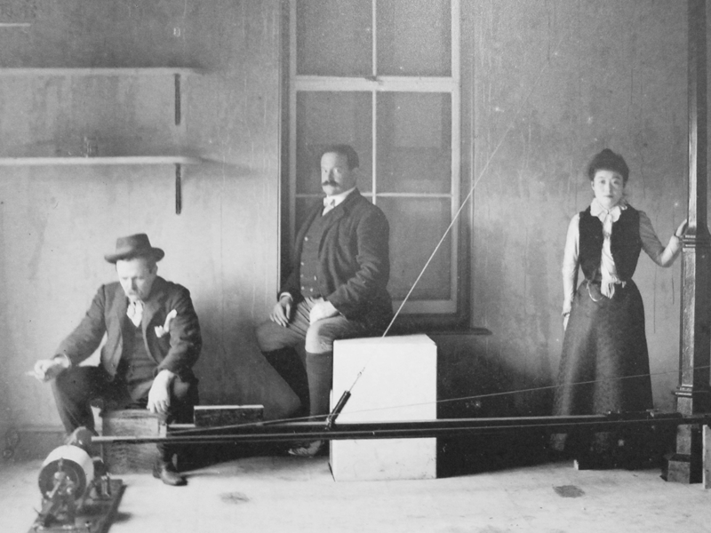

Slide 3
Macroseismology
The study of the observed effects of earthquakes
Or:
Seismology you can do with paper, pencil and a wastepaper basket

Slide 4
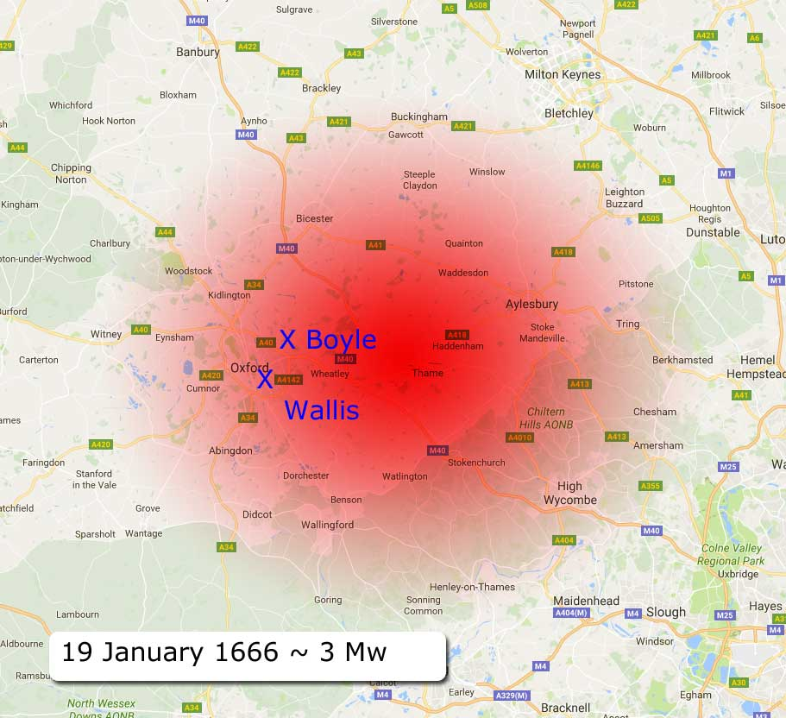
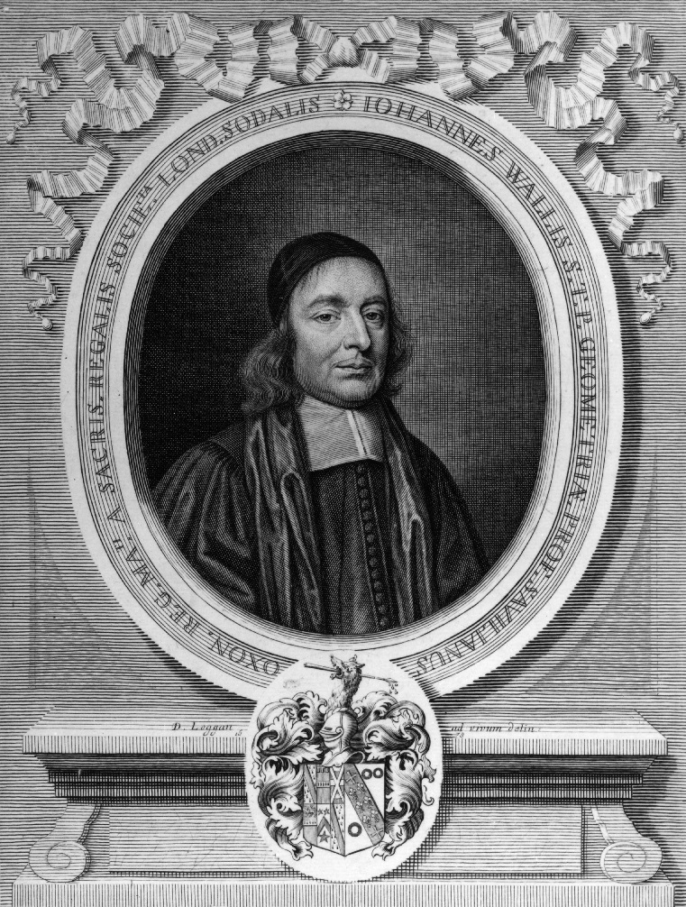

Slide 5
Charles Davison (1858-1940)

Slide 6
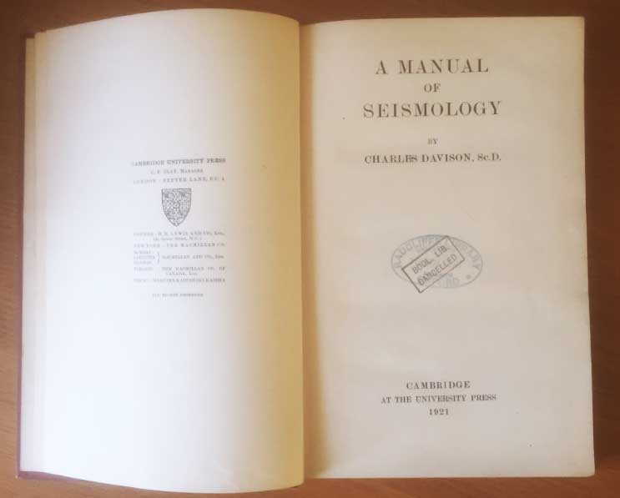

Slide 7
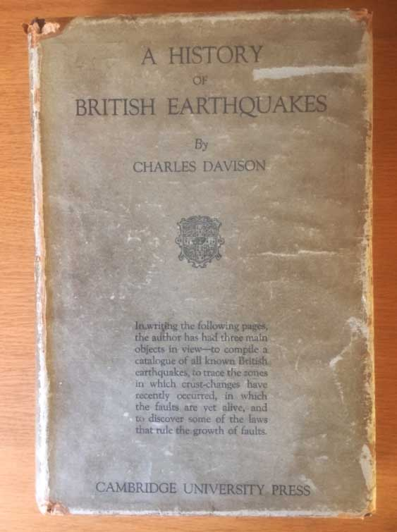

Slide 8
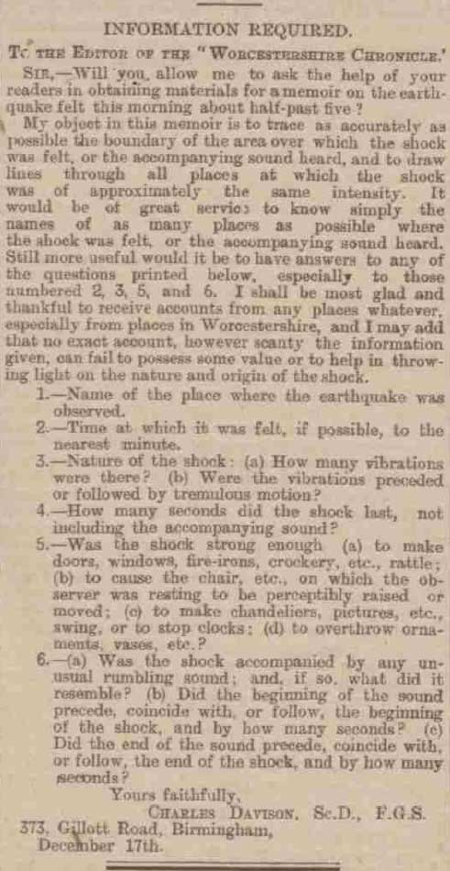
Felt effects

Slide 9
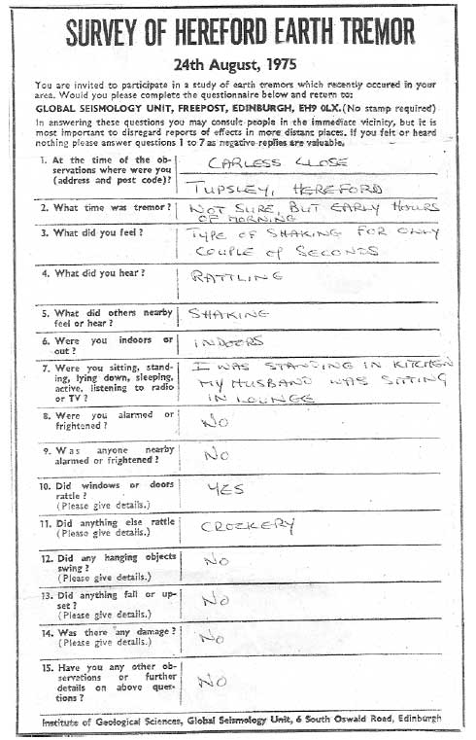
… plus ça change …

Slide 10
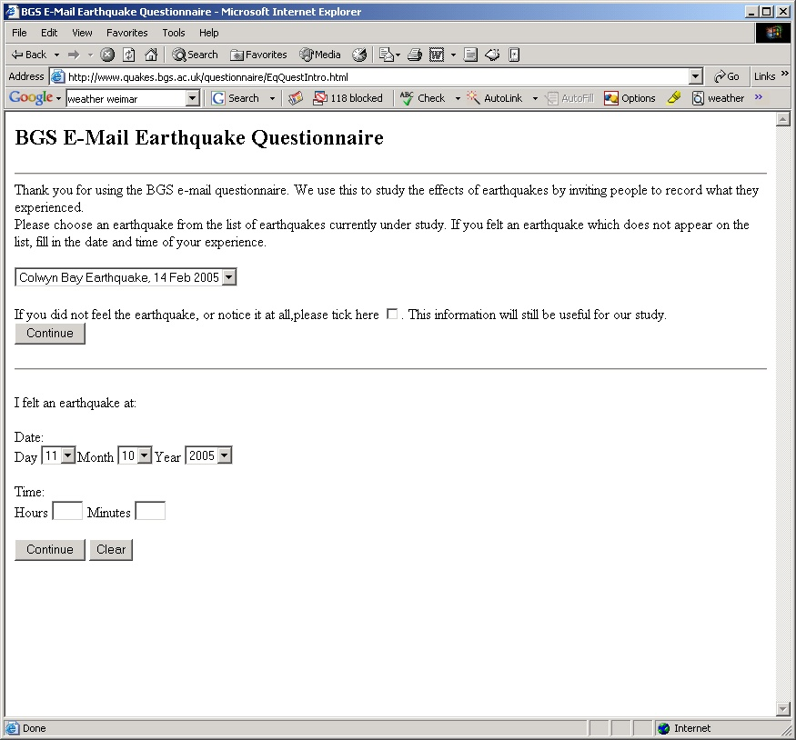
… plus c'est la même chose …

Slide 11
European Macroseismic Scale
1 = Not felt
2 = Very weak
3 = Weak
4 = Moderate (windows rattle)
5 = Strong (ornaments fall)
6 = Slight damage (chimney pots fall)
… etc.
Log of the area of intensity 3 ≈ magnitude (ML)

Slide 12
A modern earthquake

Slide 13
A historical earthquake

