Slide 1


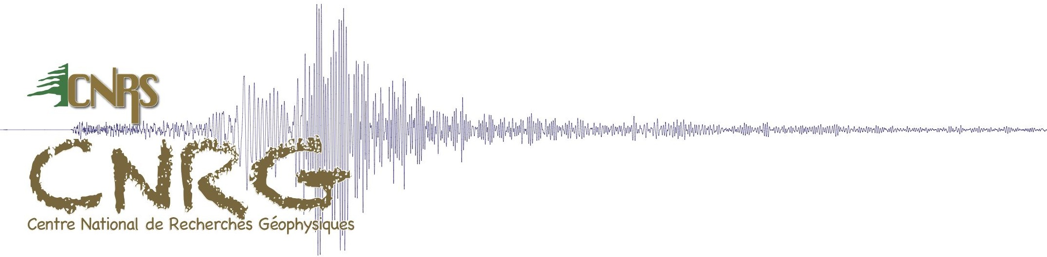


An earthquake catalog for seismic hazard assessment in Lebanon
Marleine Brax, Paola Albini, Céline Beauval, Rachid Jomaa, Alexandre Sursock
CNRS, Beyrouth
ISTerre, Grenoble
INGV, Milan

Slide 2
Where is Lebanon ?

Slide 3
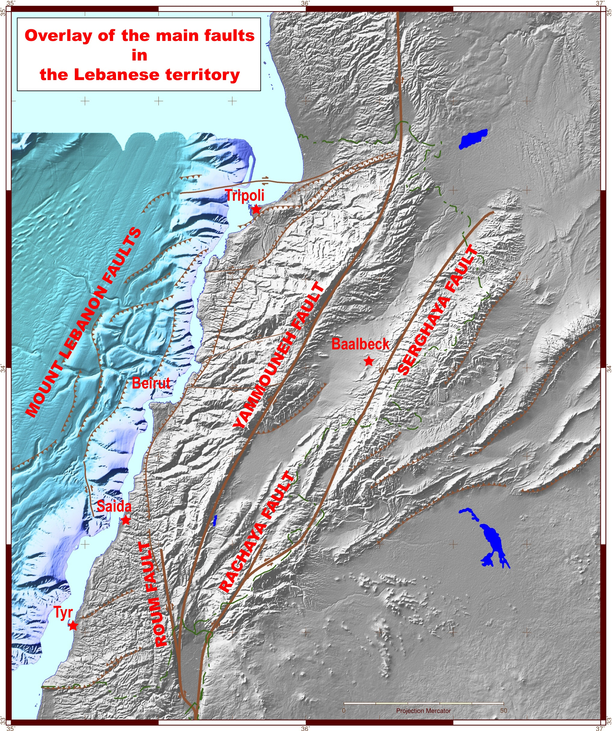
Daeron 2005
6 July 551, Offshore fault, M7.8
30 000 known people died (Beirut).
Tsunami.
Large fire (2 months)
20 May 1202, Yammouneh fault, M7.6
Tens of thousands of casualties in the eastern Mediterranean region.
Collapse of 31 columns (out of 40) of the Jupiter temple in Baalbeck.
Lebanon
Levant fault
30 october 1759, Rachaya fault, M6.6
2000 died.
Geophysical Research center – CNRS Lebanon
25 november 1759, Serghaya fault, M7.5
Africa
Arabia
More than 40.000 people died
Collapse of 3 columns (out of 9) of the Jupiter Heliopolitanus temple in Baalbeck. Felt in Egypt.
earthquake.usgs.gov
50 km
0

Slide 4
Building the earthquake catalog
For estimating seismic hazard: the longest time window available is required
Historical part (2000 years)
Instrumental part (120 years)
31 BC
1900
Present time
historical data: Eastern Mediterranean region has the longest catalog in the world

Slide 5
Building the instrumental earthquake catalog
1900-2012 M_{w} ≥ 4
Earthquakes M ≥ 4
For each earthquake
  - identify the reliable catalogs reporting it
  - selection of the best location and best magnitude from available solutions
Final catalog : earthquakes described by different magnitudes (mb, M_{S}, M_{w})
=> homogenization in magnitude (proxy M_{w})

Slide 6
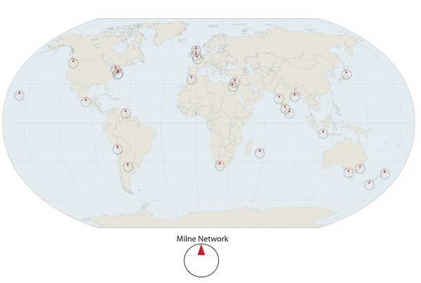
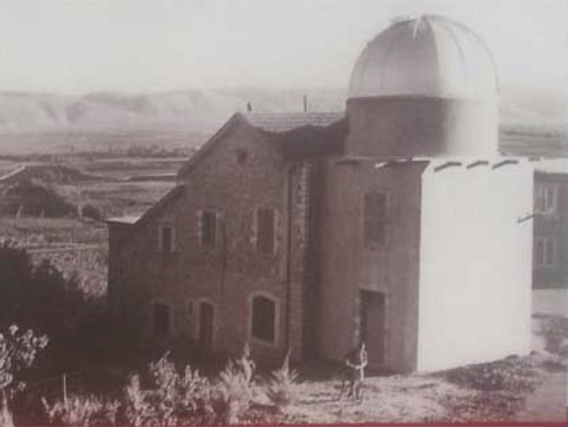
Building the instrumental earthquake catalog
1st half of the century
John Milne observatories/ Jesuit network
1910-1960
M_{w} ≥ 4
Edinburgh
Toronto
Ksara
Cairo
Calcutta
Tokyo
Honolulu
Mexico
Trinidad
Arequipa
Cordova
Mauritius
Melbourne
Ksara
Only largest magnitude reported,
large uncertainties
Anderson et al. AGU 2007

Slide 7
Building the instrumental earthquake catalog
1910-1963 : 23 events
M_{w} ≥ 4
Selected solutions from :
ISC-GEM (version 3.0): 15
ISC: 5
Ambraseys 2001: 1
Plassard & Kogoj (1981) : 2
Only largest magnitude reported,
large uncertainties

Slide 8
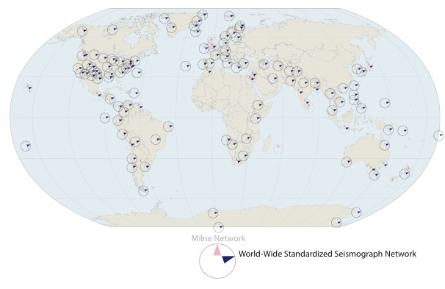
Building the instrumental earthquake catalog
2nd half of the century
World-Wide Standardized Seismograph Network (WWSSN) – 1960s
M_{w} ≥ 4
Much denser station network,
magnitudes down to 4 are recorded
Anderson et al. AGU 2007

Slide 9
Building the instrumental earthquake catalog
1964-2012 : 411 events
Location
ISC-GEM: 2 %
EHB: 23 %
ISC: 75 %
M_{w} ≥ 4
Magnitude
ISC-GEM (Mw): 5 %
GCMT (Mw): 4 %
ISC (MS) : 8 %
ISC (mb) : 65 %
IPRG (mb): 12 %
GII (mb): 4 %
NIC (mb): 2 %
specific conversion equations
Much denser station network,
magnitudes down to 4 are recorded

Slide 10
Earthquake catalog - Lebanon
Instrumental catalog
Seismicity in Lebanon:
2012

Slide 11
Earthquake catalog - Lebanon
Instrumental catalog + historical catalog
Seismicity in Lebanon:
2012
the last 120 years = quiescent period, with respect to the last 2000 years

Slide 12
How to derive a historical catalog building on existing studies?
In the last 30 yrs: plenty of studies, different authors and solutions
Many authors rely on previously published studies (errors propagated), sometimes omitting to cite the sources
Some authors publish new material and interpretation which sometimes contradict their own earlier study
Not all studies are reliable
Need for a historical seismicity expertise, relying on a deep knowledge of historical material, to sort out studies
Tempting to use as they are unreliable published lists of earthquakes

Slide 13
Historical catalog: strategy followed
Listing all published catalogues or papers proposing intensities and solutions for earthquakes
Analyze this material, especially the sources used to derive the study (are they contemporary)? Was the historical context analyzed?
Sort out the studies, in terms of soundness and reliability (Albini et al. 2014, world-wide catalog GHEA)
Select the “best solution(s)” and provide criteria applied
Some events are “easy”: overall consensus
Most events are complex: several studies which do not agree

Slide 14
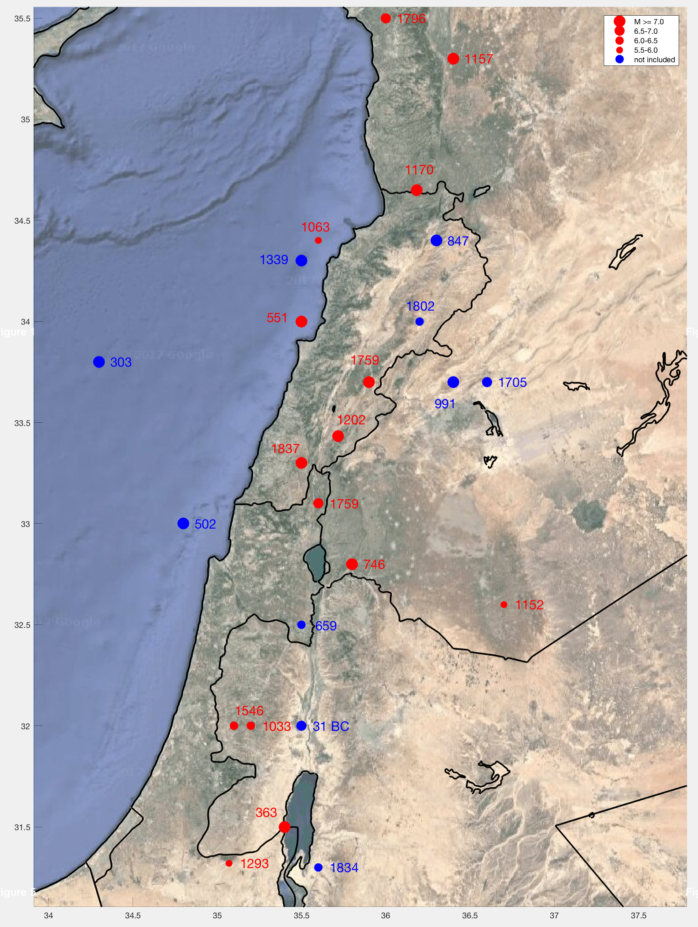
Historical catalog: earthquakes considered
Period covered: 31 BC – 1837
1st and last earthquakes included, written historical material
Events included
Events not included (for most of them the existence of the earthquake is not questioned, but reliable studies do not provide EQ parameters)
for 6.5<M<7.7,
~ 20 to 150 km rupture length
coordinates ⬄barycenter of epicentral region

Slide 15
Example: 746/749 January 18th event
Described by many sources but interpretation still difficult
1 huge earthquake (destruction from Egyptian littoral to NE Syria)
ML 7.3-8.0
Amiran (1950)
Russell (1985)
Ben Menahem 1991
Guidoboni et al. 1994
Marco et al. 2003 (relying on above papers + paleoseismology)
At least 2 events, 3 yrs apart and hundreds km apart, with lower magnitude (7.0)
Karcz 2004
Ambraseys 2005, 2006, 2009
Issues:
confusion created by the use of different dating systems in the ancient texts => all felt reports associated to the same EQ
contemporary sources and sources written centuries after given the same level of reliability.

Slide 16
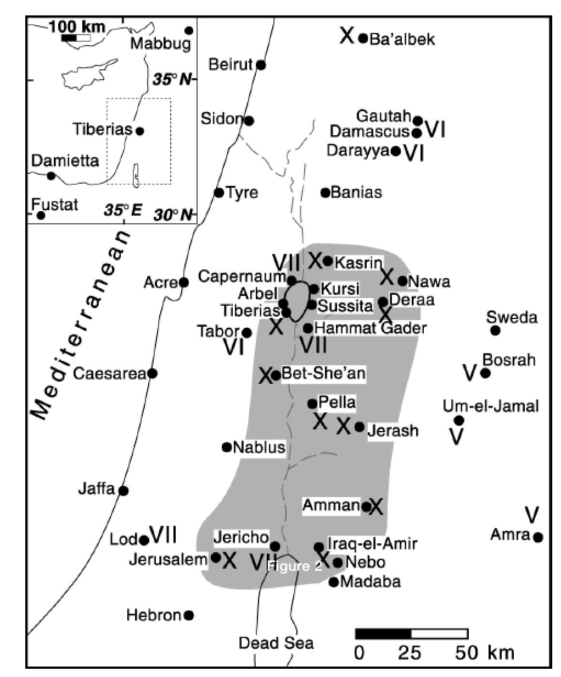
Example: 746/749 January 18th event
Described by many sources but interpretation still difficult
1 huge earthquake (destruction from Egyptian littoral to NE Syria)
ML 7.3-8.0
At least 2 events, 3 yrs apart and hundreds km apart, with lower magnitude (7.0)
749 EQ
Marco et al. 2003

Slide 17
Example: 746/749 January 18th event
Described by many sources but interpretation still difficult
1 huge earthquake (destruction from Egyptian littoral to NE Syria)
ML 7.3-8.0
At least 2 events, 3 yrs apart and hundreds km apart, with lower magnitude (7.0)
Ambraseys 2009
746 EQ
749 EQ
757 EQ
Marco et al. 2003

Slide 18
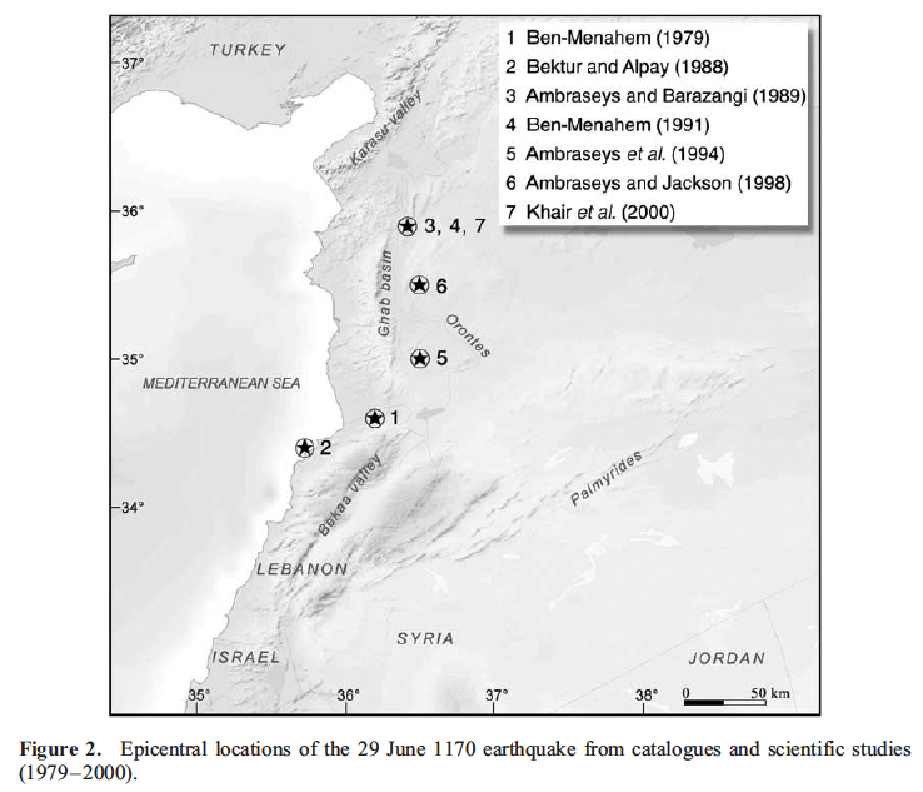
Example: 1170 June 29th event
One of the most highly documented events in the Medieval Mediterranean – several detailed accounts by eye-witness, unanimity on the date
Overall agreement on the size of the earthquake (7.3-7.7)
New study by Hough and Avni (2010), applying recent method for determining location/magnitude, indicate a lower magnitude 6.6
Ben Menahem 1991 7.7
Ambraseys & Jackson 1998 7.4
Guidoboni et al. 2004 7.7
Sbeinati et al. 2005 7.7
Ambraseys 2006, 2009 7.3
(using intensities from Ambraseys 2009, applying Bakun & Wentworth method)
Guidoboni et al. 2004

Slide 19
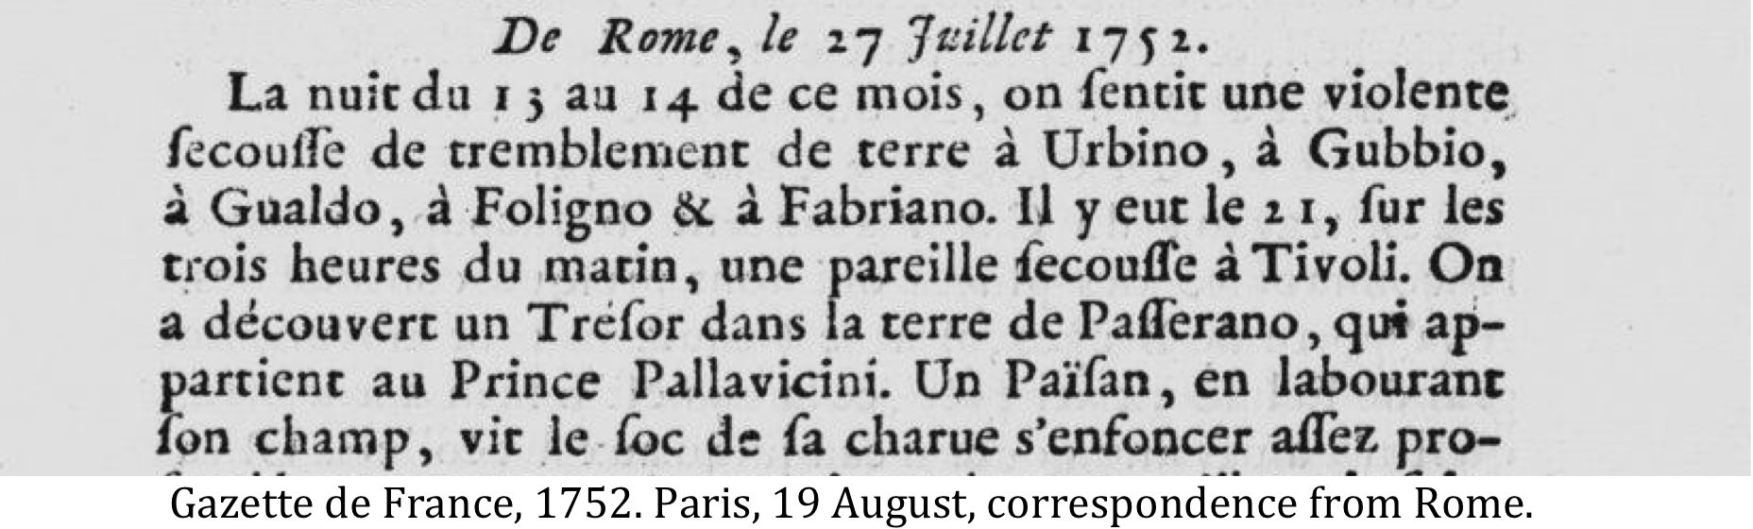
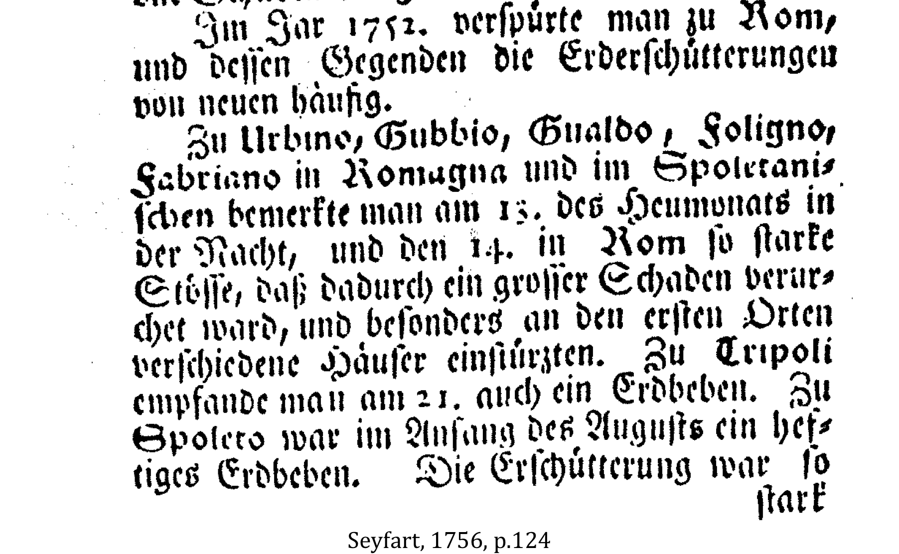
Example of gross errors which propagated
1656 EQ, M 7, reported in several catalogs: wrong location, Sieberg (1932) confused Tripoli in Libya with Tripoli in Lebanon (Ambraseys 2009)
1752 July 21 EQ, reported in several catalogs: fake destructive event (20,000 victims on the Syrian and Palestinian littorals)
Ambraseys (2009) explains that Seyfart (1756) misread the original text, confusing Tivoli city in Italy with Tripoli city in Lebanon
21 July 1752, EQ felt in Tivoli close to Rome
EQ felt in Tripoli … used by later writters

Slide 20
Conclusions & future work
Earthquake catalog ready to be used.
Seismic record since 1900 is not representative of the high seismic potential in the country
the last ~120 years = quiescent period, with respect to the last 2000 years, can we use it to estimate long-term earthquake activity?
Classical PSHA with earthquake recurrence relying on catalog : should be discarded in Lebanon, instrumental seismicity is not representative of long-term seismicity
All efforts should be put on the fault model to derive a mean seismic hazard map for Lebanon representative of the seismic potential of the country

Slide 21
Thank you for your attention

