Slide 1
Difficulty of the determination of hypocenters in early 20 century
Y. Ishikawa
Geological Survey of Japan, AIST

Slide 2
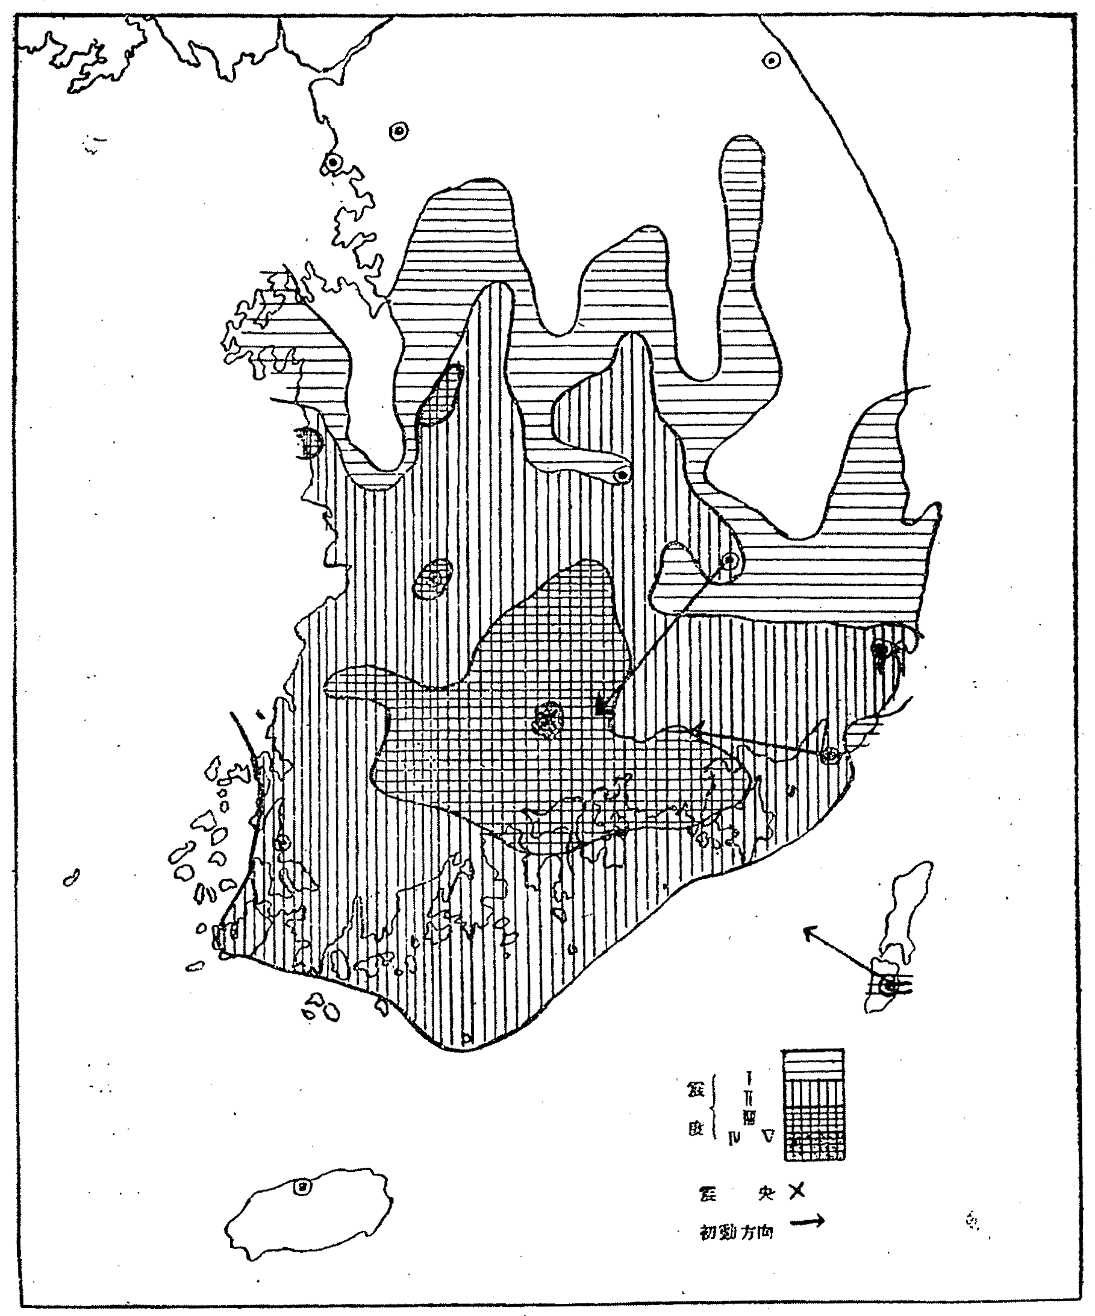
Intensity distribution and directions of first motions
1936 Chirisan,
Korea
Earthquake
Mj5.3,Mw5.1

Slide 3
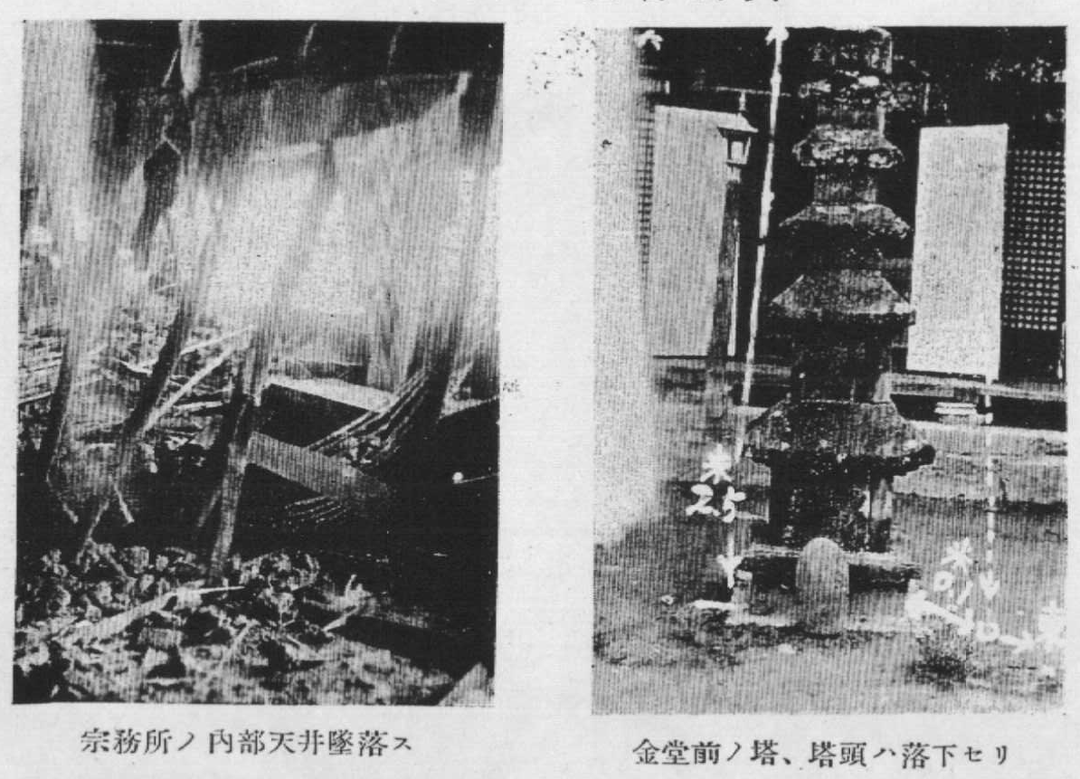
Damages were reported at the epicenter area
The ceiling was fallen.
The head of the tower was fallen.

Slide 4
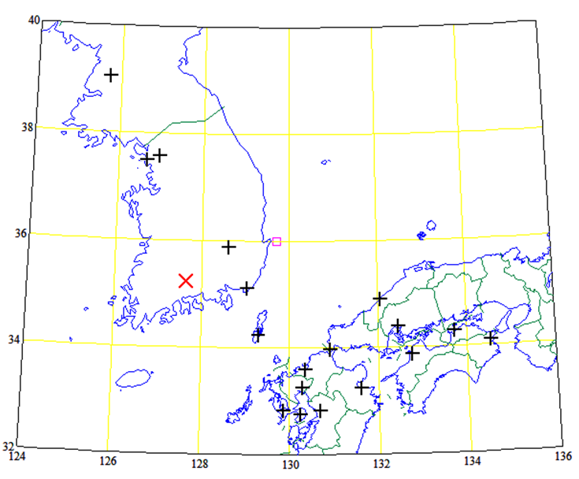
Hypocenter and stations
JMA
Notes:
JMA

Slide 5
Main factor of uncertainty
Each stations had each different clocks,
not controlled by one clock like telemeter system.
Clocks were corrected manually once a day.
Arrival times can't always be trusted.
We must choose reliable phase data.
As the time difference of one station is more reliable,
so S-P times were used to estimate hypocenters.
Other factor :
Magnifications of seismograms were low, arrival times
were sometimes miss-read.
Notes:
The clock was not

Slide 6
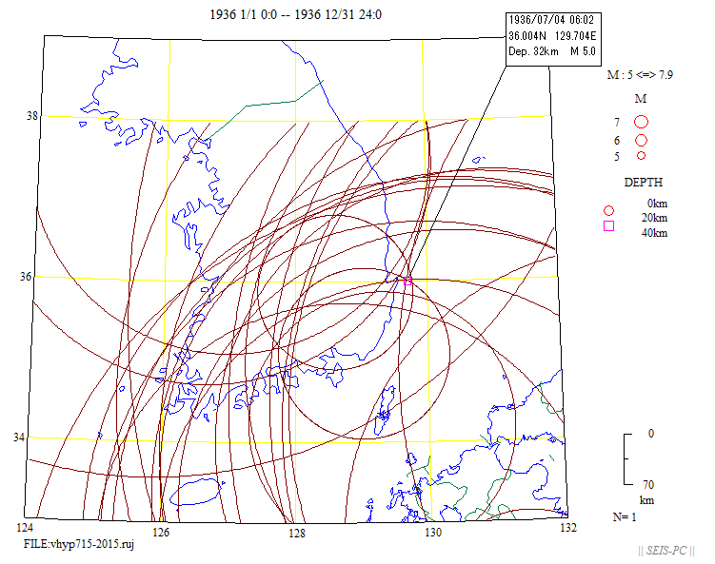
All S-P times
Assumptive Depth 6km
Travel time table JMA2001 was used.
Notes:
Travel time tabel JMA2001 was used.

Slide 7
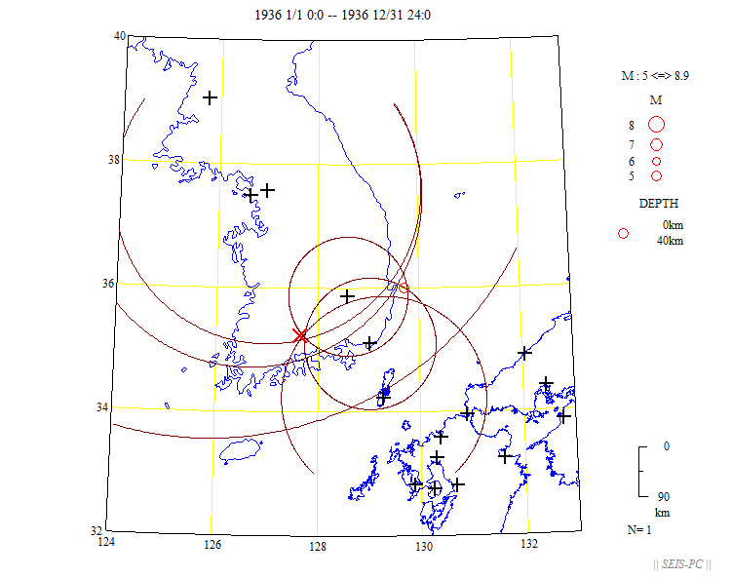
6 stations
Here is a realistic epicenter! ->
Notes:
Here is a realistic epicenter! ->

Slide 8
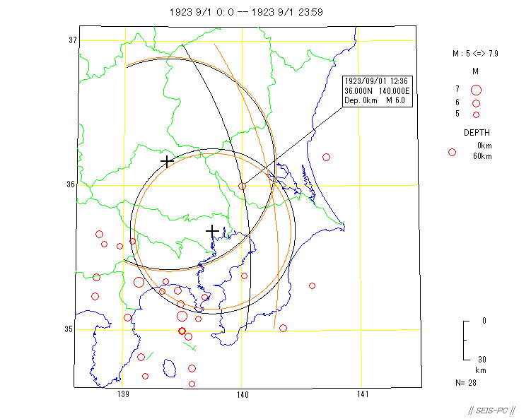
Ibaraki, Japan
Gifu
Kumagaya
JMA
depth
Black circle 0km
Tokyo
Brown circle 40km

Slide 9
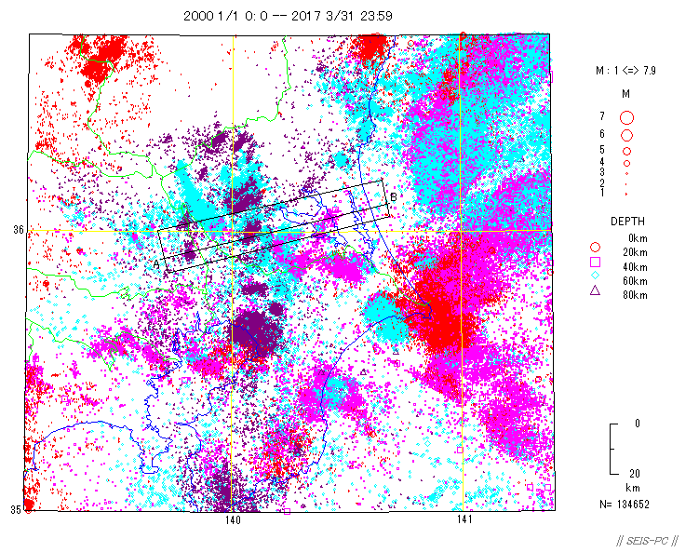
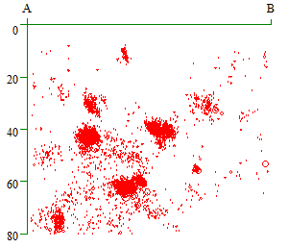
X
X
X

Slide 10
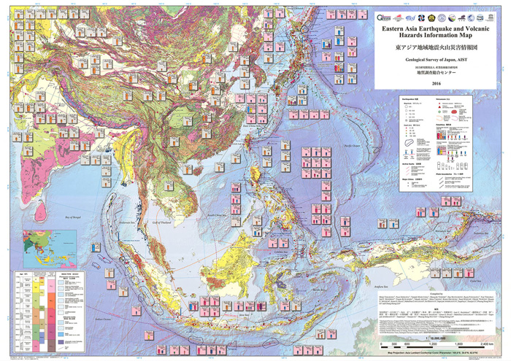
GSJ published
‘Eastern Asia earthquake and volcanic hazards information Map’.
We used ISC-GEM catalog in this map. ISC-GEM catalog is very useful.
Notes:
GSJ published ‘Eastern Asia earthquake and volcanic hazards information Map’.
We used ISC-GEM catalog in this map. ISC-GEM catalog is very useful.

Slide 11
Northern Yellow Sea
Many estimated hypocenters
1944 12/19 23:08: 38.0 124.0 M6.8 old JMA
1944 12/19 23:08:53 38.8328 124.0753 25km M6.8 JMA
1944 12/19 23:09: 38.0 124.0 0-30km
12/19 22:09 39.7 124.3 M6.8 Utsu
12/19 22:09:04 39.7 124.3 M6.75 China, ?
12/19 22:09:04 39.7 124.3 China,1971
12/19 39.8 124.1 China,1977
12/19 39.3 123.4 Liaoning,1985
12/19 40.0 124.0 ISS
1944/12/19 14:09:02 39.9980 124.2070 35.0km M6.7 ISC-GEM ver.4
+8:BJI +9:JST

Slide 12
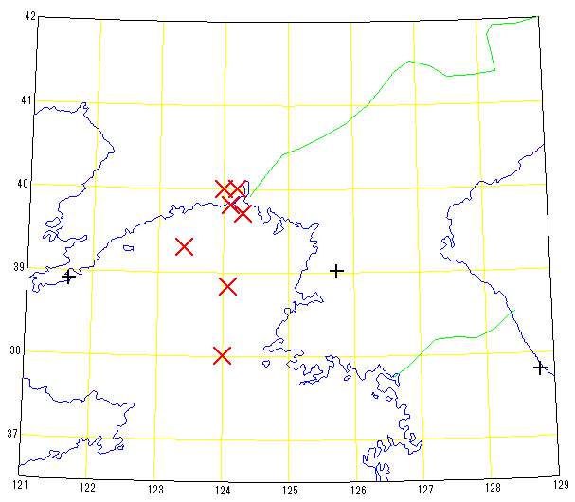
Hypocenters and stations
ISS
ISC-GEM
China1988
Utsu
Liaoning1985
3
3
Pyongyang
JMA
Dalian
2
Old-JMA
Kangnung
Notes:
Old-JMA3

Slide 13
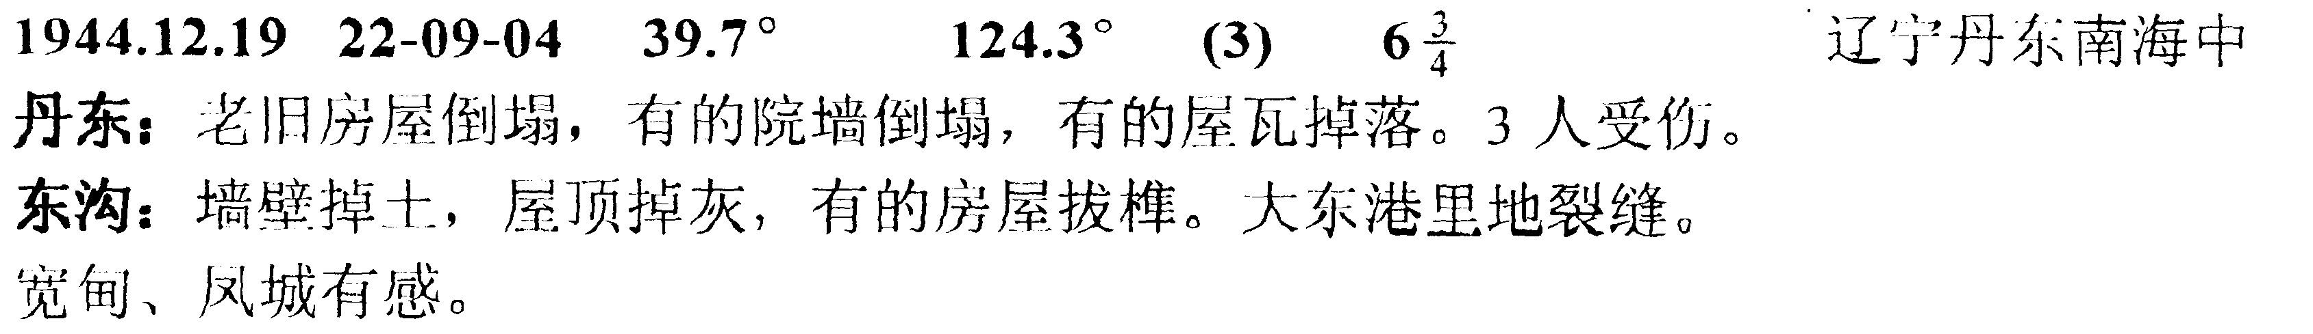
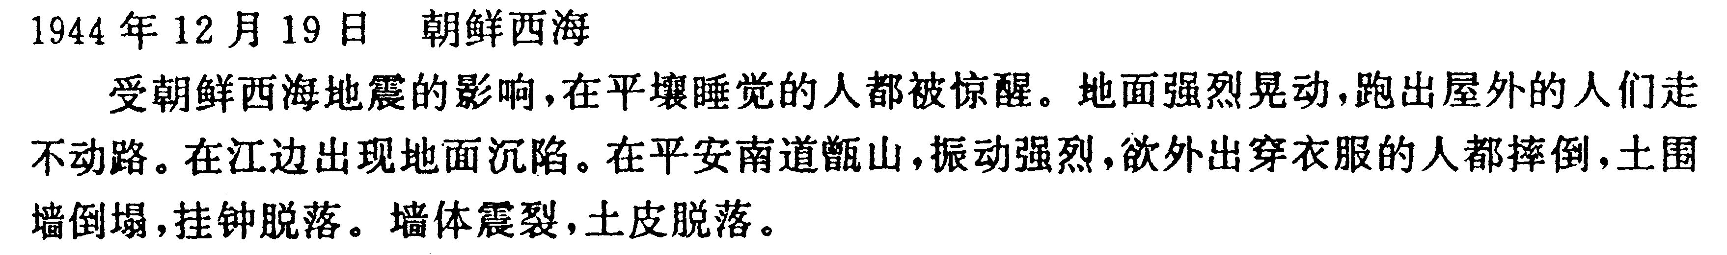
Kenshijiho reported
19th 23:09 Yellow Sea 38.0N 124.0E Depth 0～30km
Intensity III；Dalian, Pyongyang II；Kangnung in Korea
I；Kagoshima, Okayama, Omaezaki
Notes:
朝鮮半島地震史料摘編 呉ほか(1995)

Slide 14
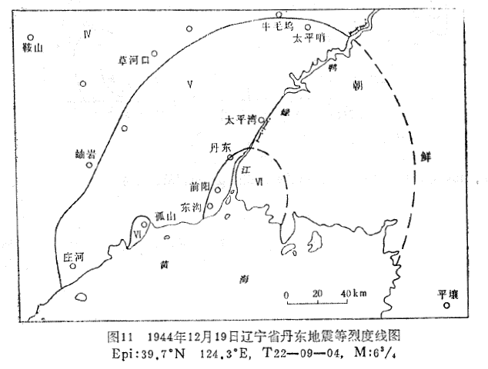
Intensity distribution Chinese intensity scale
4
China
5
Korea
6
=Ij4
6
Ij3
Yellow Sea
Notes:
Chinese intensity scale

Slide 15
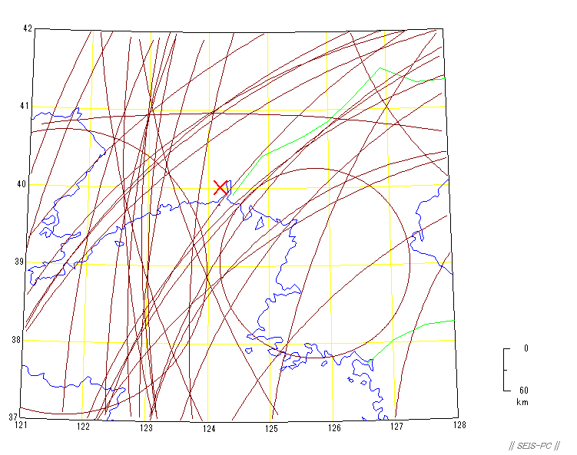
Assumptive Depth 0km

Slide 16
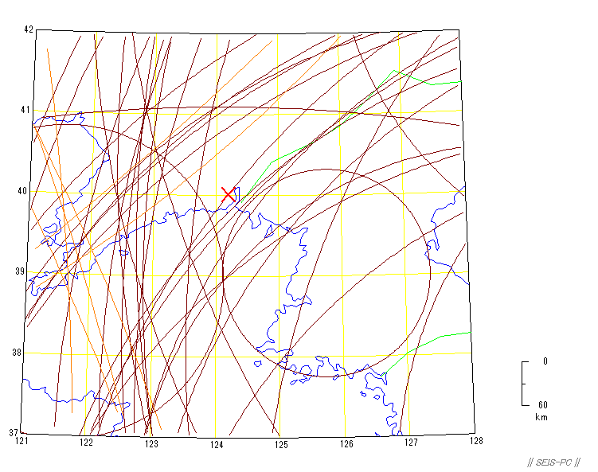
Assumptive Depth 20km
X
Notes:
X

Slide 17
Summary
1. The old hypocenter location of the 1936 Chirisan, Korea event is much better than new one by JMA,
2. The location of the 1923 SW Ibaraki, Japan event by JMA was mislocated.
3. The location of 1944 China-Korea border event may be in the northern Yellow Sea.
These were estimated from the figures of S-P time circles.
We had better determine old earthquakes not only P times and S times, but also S-P times, directions of P wave first motion, and intensity distribution.

Slide 18
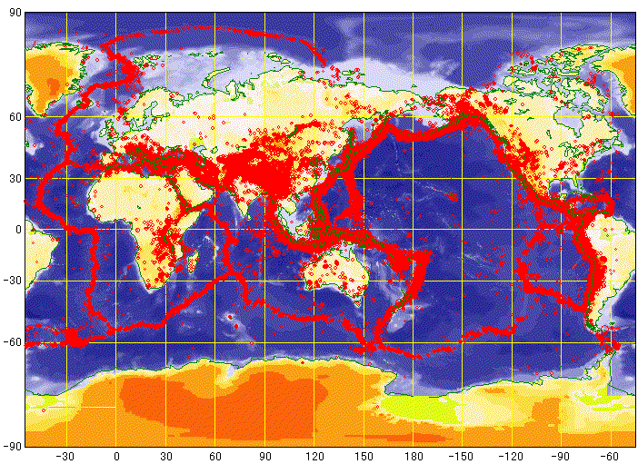
Thank you for your attention!

