Slide 1



British Seismology Meeting 2017
5th - 7th April
Reading Town Hall and Museum, UK
UPDATING OF A PSHA BASED ON BAYESIAN INFERENCE WITH HISTORICAL MACROSEISMC INTENSITIES
E. Viallet⁽¹⁾, N. Humbert⁽²⁾, P. Mottier⁽³⁾
⁽¹⁾ Earthquake Engineering Expert, EDF, Nuclear New Build Engineering Division
⁽²⁾ Civil Engineer, EDF, Hydropower Engineering Division,
⁽³⁾ Master-Research Engineer, POLYTECHNIQUE MONTREAL,

Slide 2
OUTLINE
INTRODUCTION & BACKGROUND
OBJECTIVE OF THE PAPER
PSHA UPDATING PROCESS
HISTORICAL OBSERVATIONS
RESULTS
CONCLUSIONS & PERSPECTIVES

Slide 3
INTRODUCTION & BACKGROUND
On the PSHA side
  Nowadays: well established and internationally used
      Site specific assessment, regional or continental scales …
  However: some discrepancies were observed during last decade (high uncertainties, lack of data & knowledge)
      Especially for areas with low to moderate seismicity
On the Bayesian theory side
  Developed in the second half of the 18th century
  Largely disseminated in a wide range of fields and applications since the second half of the 20th century
      Already used in many field of engineering and in some (or in some parts of) PSHA studies

Slide 4
OBJECTIVE OF THE PAPER
To apply Bayes theorem of conditional probabilities to the results of a PSHA considering actual observations
To extend previous work (considering instrumental seismicity), including historical seismicity
To provide with PSHA testing and/or updating tools
  As recommended by OECD/NEA
      That should be a necessary step in a state-of-the-art PSHA
And finally to reduce epistemic uncertainties in PSHA
Concerning Bayesian inference
      The question is not : “Is Bayes theorem applicable to PSHA ?”
      The question is : “How to implement Bayes theorem in PSHA ?”

Slide 5
PSHA UPDATING PROCESS
Preliminary consideration
  A PSHA usually provides:
    Median + Confidence levels
    Other information (UHS, deaggregation …)
    But also a large number of "single" hazard curves
      Output of the logic tree
      Not necessarily compatible to each other
  Then, consistency checking becomes a useful and necessary step

Slide 6
PSHA UPDATING PROCESS
Application
  Step 1: Prior PSHA
    Area is the French metropolitan territory
    The (prior) PSHA includes the propagation of a large range of random and epistemic uncertainties
      Especially on the GMPEs
        See [Humbert WCEE 2008]
    Output used for this paper
      42 hazard curves
        For illustration purpose only

Slide 7
PSHA UPDATING PROCESS
Application
  Step 2: Transformation of hazard curves from PGA to macroseismic intensities
  Use of PGA-to-Intensity relationships:
      Rate of exceedance of a given Intensity from a given hazard curve
      In practice: Hazard curve is discretized into Δ_{PGA} steps
      Exceedance rate is calculated over the completeness period of macroseismic Intensities (based on historical catalogues)

Slide 8
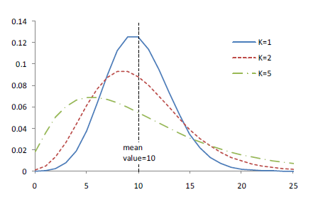
PSHA UPDATING PROCESS
Application
  Step 3: The updating process
    Applied to each single hazard curve
    of the prior PSHA (Ai)
    Updating process is performed at a regional scale
      Exceedance rate is cumulated among 19 sites
    Accounting for random occurrence of earthquakes
      If no correlation between stations: Poisson’s occurrence model
      In case of correlation: Negative binomial distribution
      And finally:
likelyhood
Likelihood becomes the updated weight of the hazard curve A_{i}

Slide 9
PSHA UPDATING PROCESS
Application
  Step 4: Logic tree developed for Bayesian updating
    6 PGA-to-Intensity relationships
    4 macroseismic Intensity ranges

Slide 10
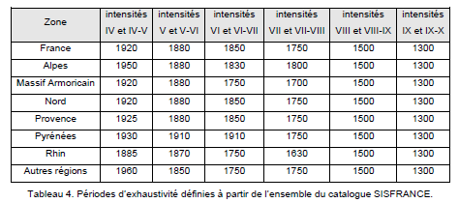
HISTORICAL OBservations
Application
  Step 5: Observations
    Historical earthquakes felt on sites
      Total amount of historical events felt on all EDF NPP sites location (19 sites)
        Based on historical seismicity investigations
        ~ Around 5000 years of
        observation
        (cumulated & independent)

Slide 11
RESULTS
Application
  Results

Slide 12
CONCLUSIONS & PERSPECTIVES
A state-of-the-art PSHA should include a testing phase against any available observation
    Consistent with OECD/NEA recommendations
Historical observations are useful data to assess the likelihood of any single branch of a prior PSHA (in addition to instrumental ones)
    Propagating all sources of random and epistemic uncertainties
Bayesian inference provides with an updated weight of any single branch of the prior PSHA through an objective process
    Allowing to reduce epistemic uncertainties through an objective process
Even no observation in a useful piece of information !
Next steps
    Updating a full scale PSHA (French metropolitan territory), using both instrumental and historical observations, and considering all branches
    Could include other types of observations (precarious rocks, stalagmites …)
    To be included in state-of-the-art methods and studies: GEM, SHARE, SSHAC

Slide 13
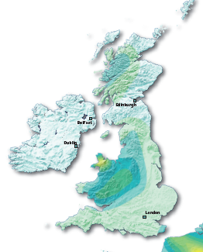
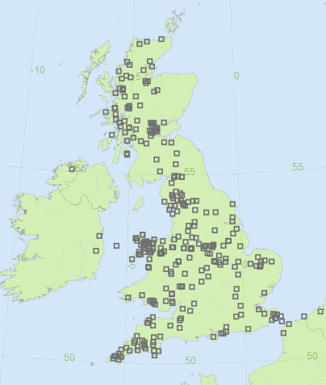
Thank you for your attention !
+
Just do it in UK !

