Slide 1
1, 2
1
2
Simone Mancini, Margarita Segou, Max Werner
British Geological Survey, The Lyell Centre, Edinburgh (UK)
School of Earth Sciences, University of Bristol (UK)
1
2
Physics-based modelling of the 2016 Amatrice
(central Italy) earthquake sequence
British Seismology Meeting
Reading, 5th-7th April 2017

Slide 2
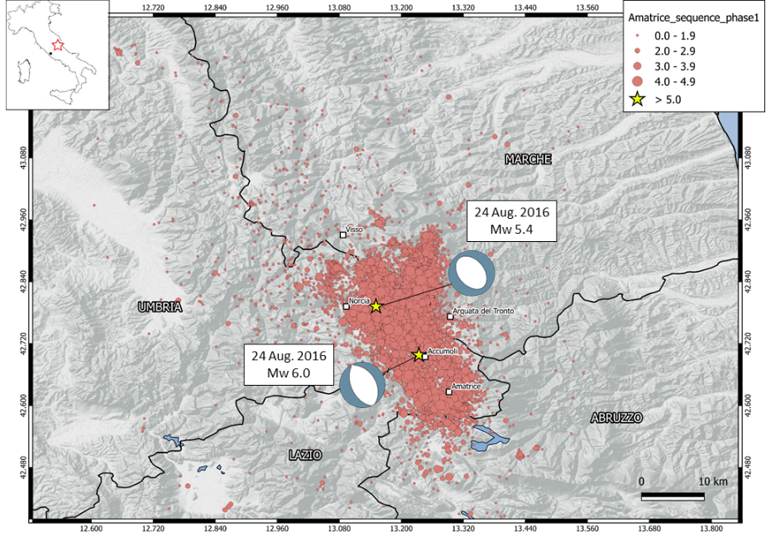
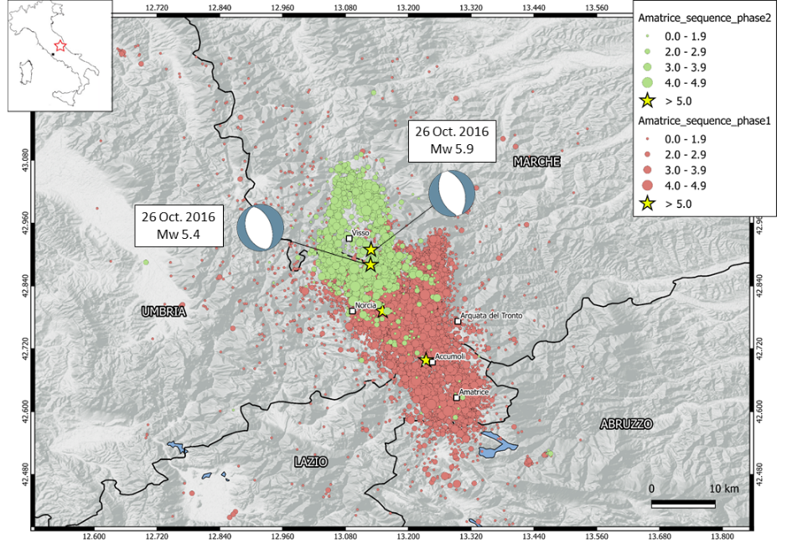
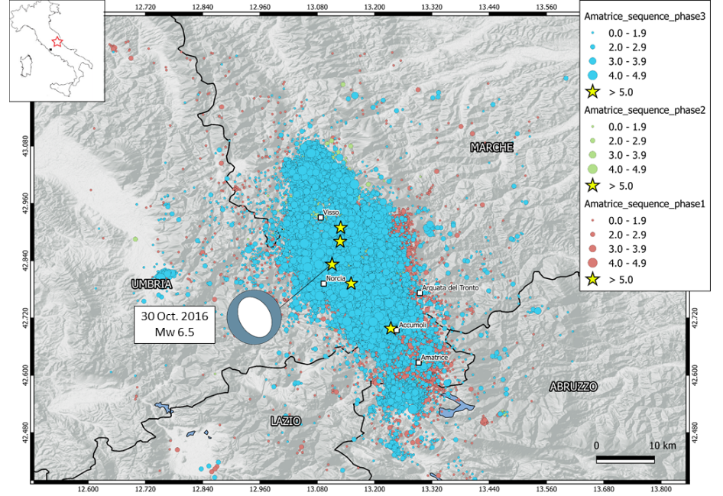
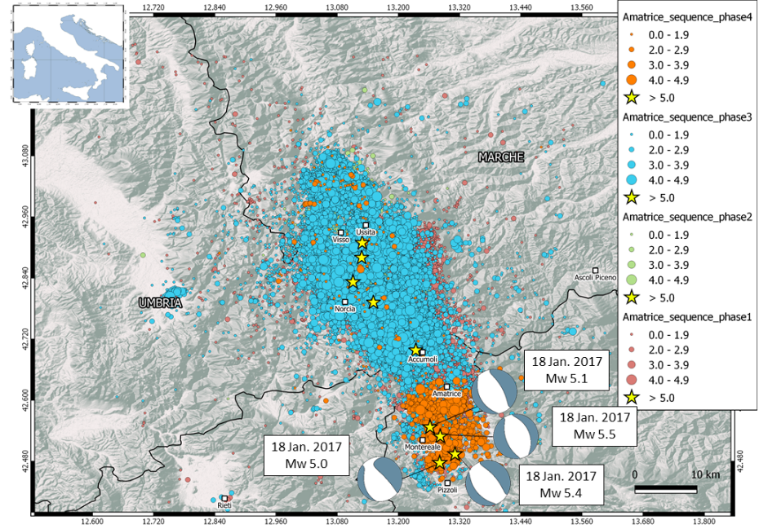
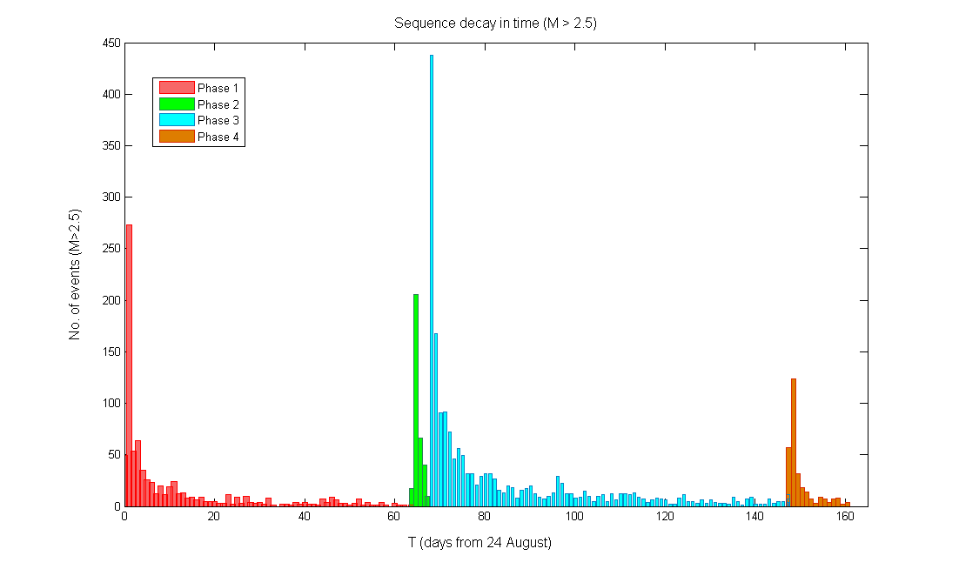
PHASE 1 - 24th Aug. (Mw 6.0) - 25th Oct.
PHASE 2 - 26th Oct. (Mw 5.9)- 29th Oct.
PHASE 3 - 30th Oct. (Mw 6.5) - 17th Jan.
No events M > 2.5
PHASE 4 - 18th January (Mw > 5) - Today
T (days after 24 Aug.)

Slide 3
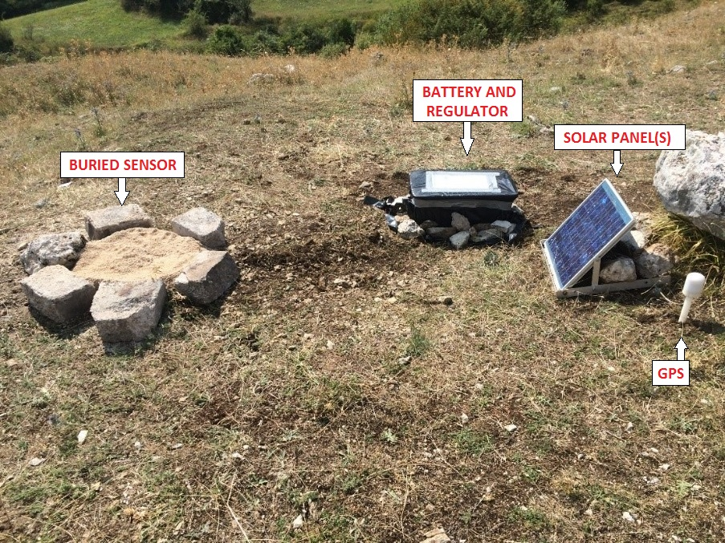
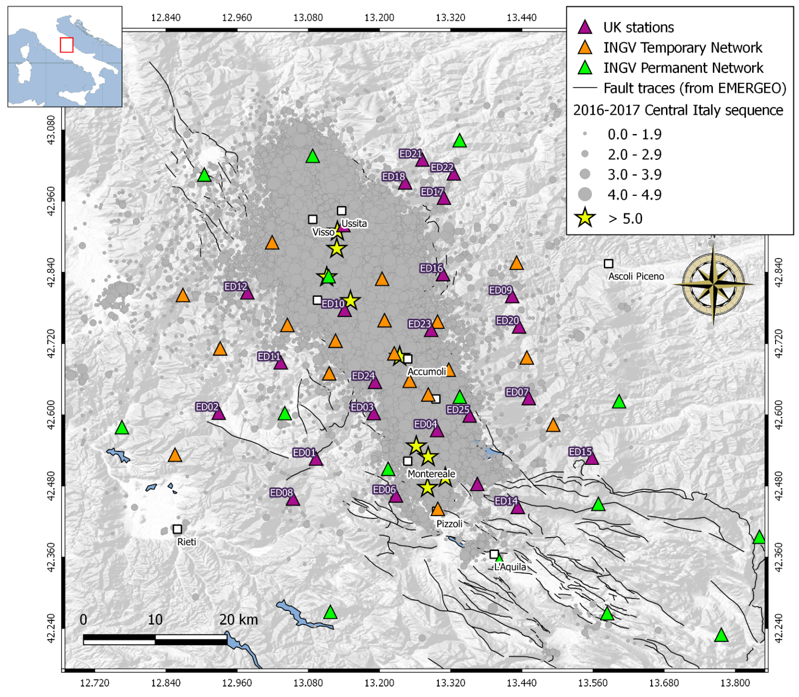
Emergency deployment of a
seismic network in Central Apennines
Installation of 25 broadband stations over an area of 2700 km2, integrating the existing Italian permanent and temporary networks.
The current deployment will stay for 1 year and it is currently collecting data continually. The outcome will be a high-resolution dataset and a seismic catalogue with a great regional coverage and improved magnitude sensitivity

Slide 4
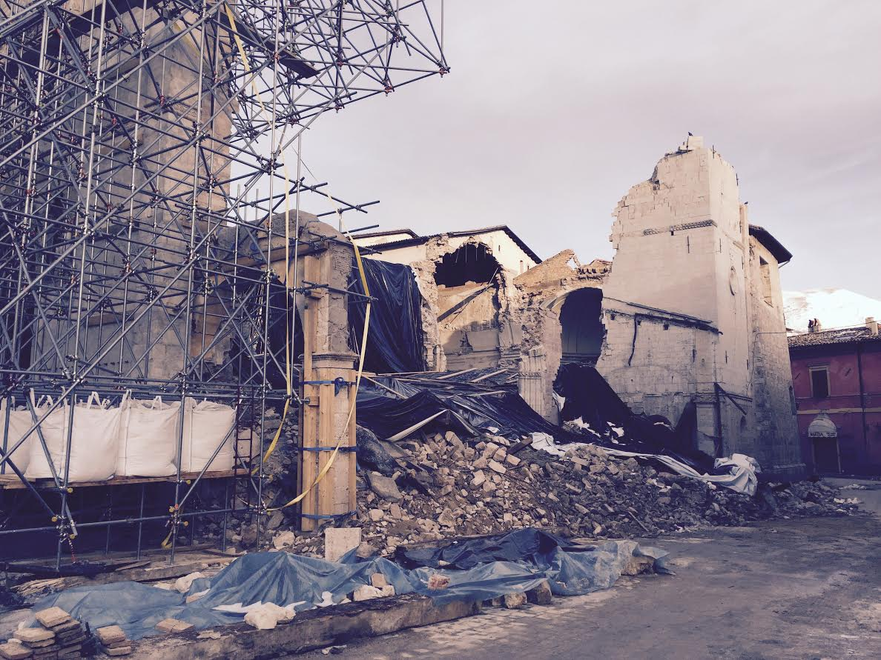
CREATING A PROTOCOL FOR OPERATIONAL EARTHQUAKE FORECASTING
Operational Earthquake Forecasting (OEF) “comprises procedures for gathering and disseminating authoritative information about the time dependence of seismic hazards to help communities prepare for potentially destructive earthquakes.”
(Jordan et al, 2011)
The 2016 Central Italy sequence is a long and complex sequence consisting of multiple damaging earthquakes, which occurred from days to months after the first devastating event. This shows the importance of capturing the time dependence in the seismic rate so as to provide more accurate information about seismic risk.
In order to improve any future operational efforts, a timeline should be defined for the development of time-dependant and testable forecast models.
Depending on the quality of available data, we can perform:
“Preliminary knowledge” models (using data available from minutes to few hours after a main event)
“Intermediate knowledge” models (using intermediate data updates that bring refinements to the first estimations)
“Advanced knowledge” models (using data of the best quality)

Slide 5
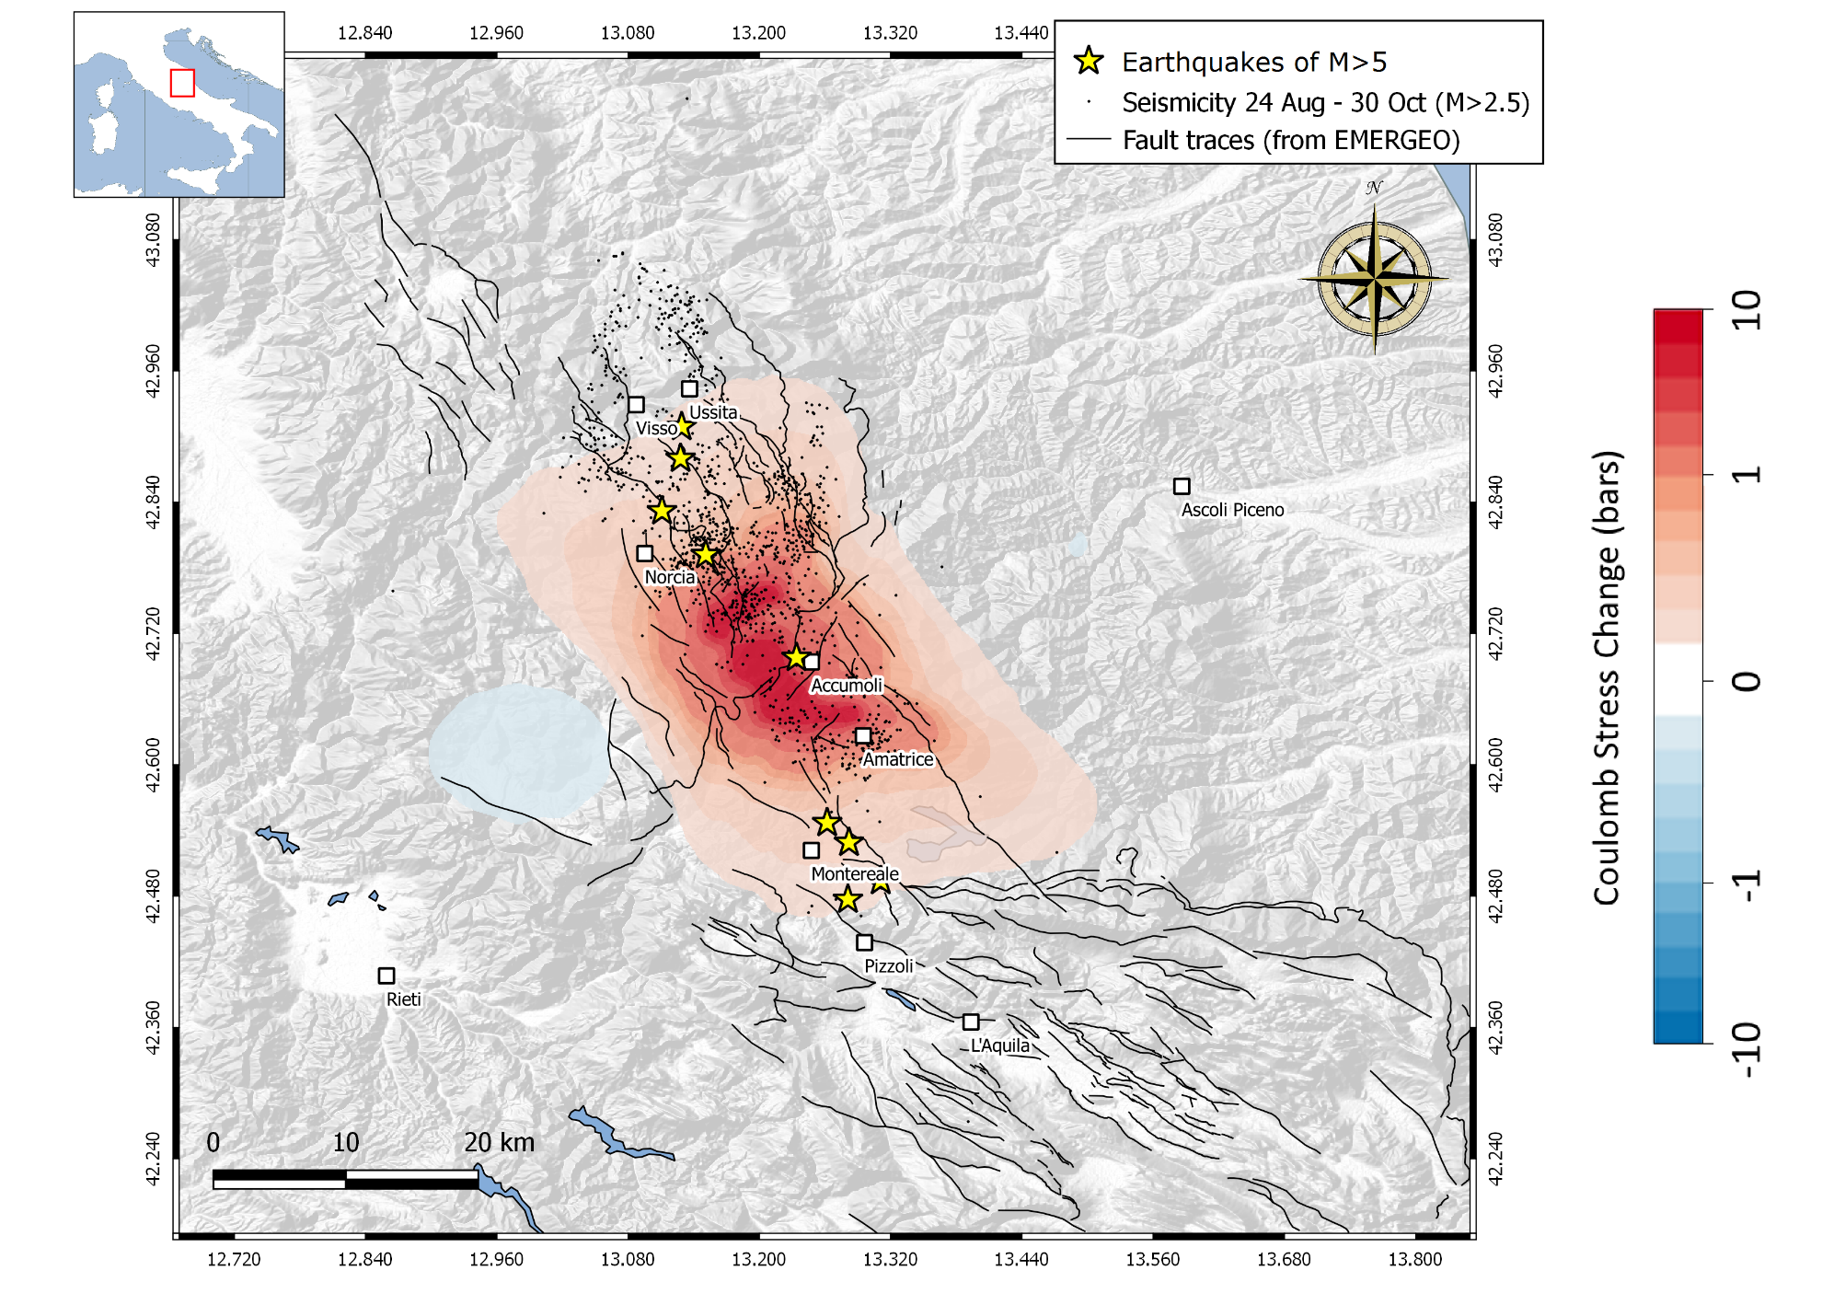
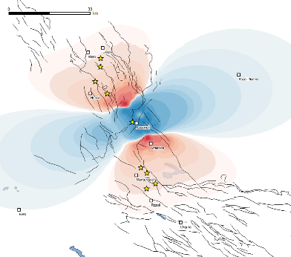
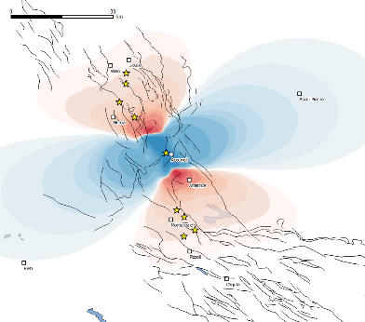
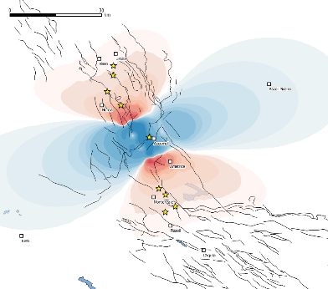
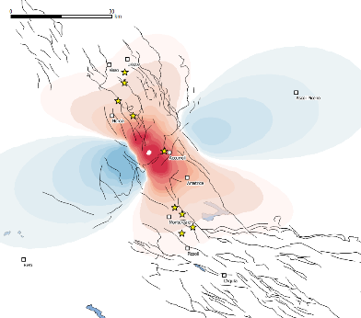
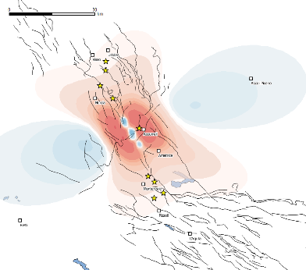
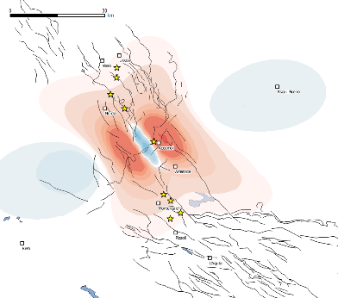
MODEL A – “PRELIMINARY KNOWLEDGE”
Mw 6.0 Amatrice – Coulomb stress change
- Preliminary ML, depth and focal mechanism;
- Uniform slip model
- Receivers modelled with the same geometry of the source and unknown reference depth
2 km
4 km
6 km
8 km
Z = 2 – 12 km
$μ$ = 0.2 – 0.8
10 km
12 km

Slide 6
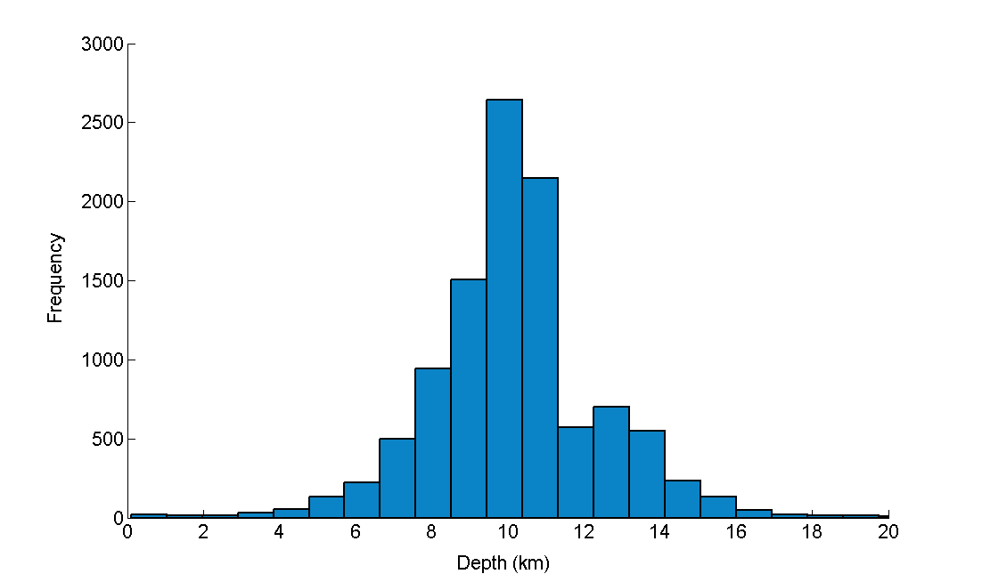
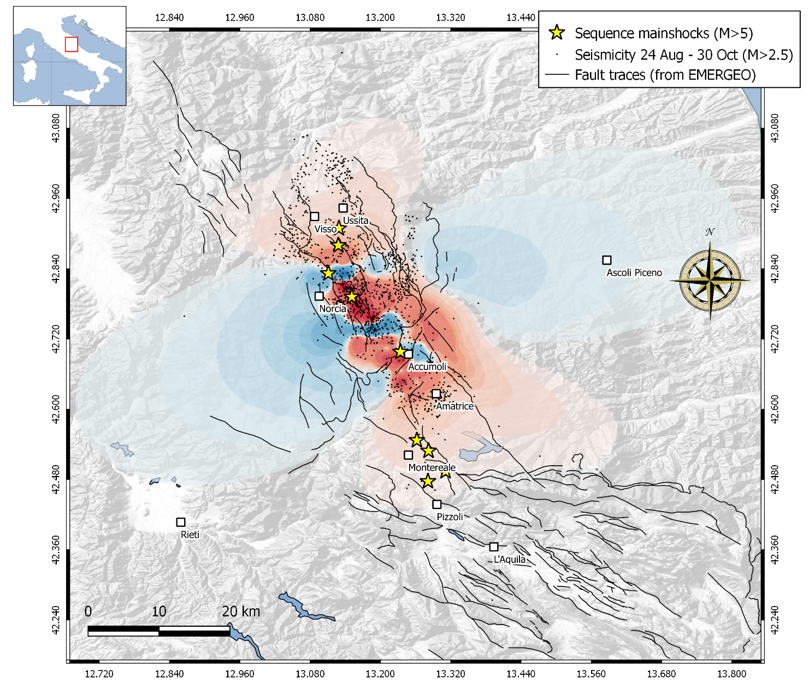
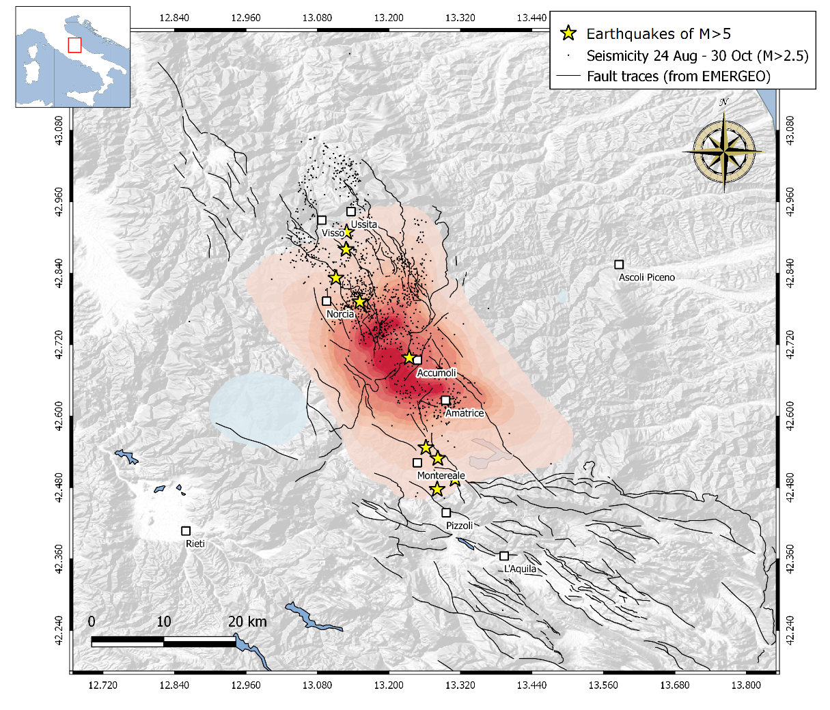
- Final estimation on Mw, depth, focal mechanism and fault dimensions.
- Best available version of the slip model;
- Receivers modelled with the same geometry of the source and with weighted reference depths between 2-12 km
MODEL C
the stage of
“ADVANCED KNOWLEDGE”
Mw 6.0 Amatrice – Coulomb stress change
Z = 10 km

Slide 7
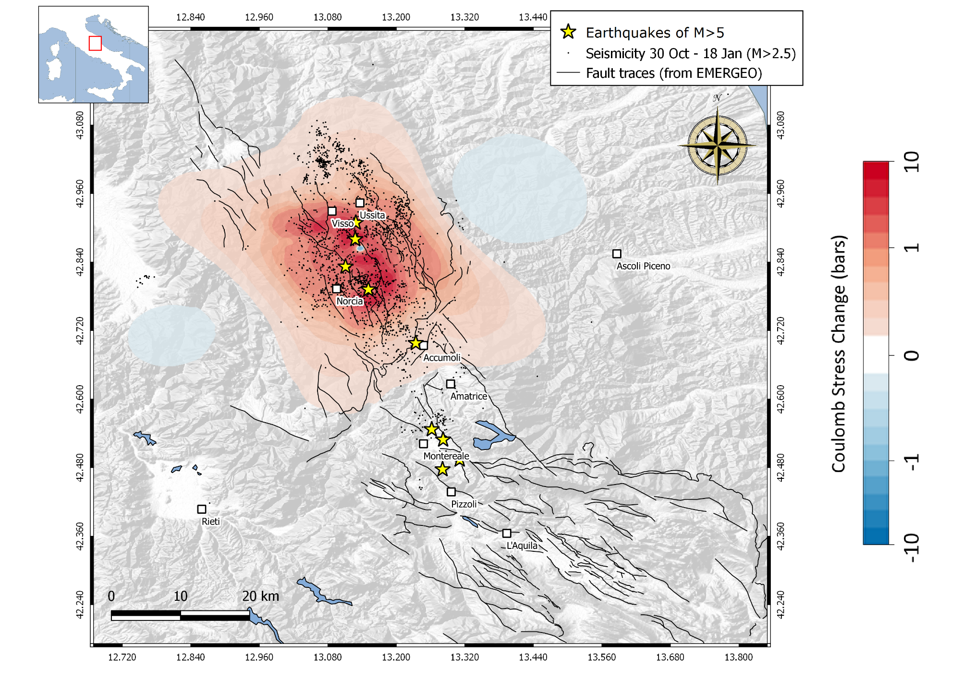
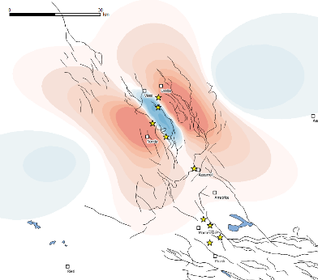
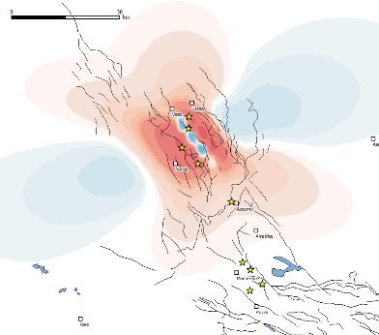
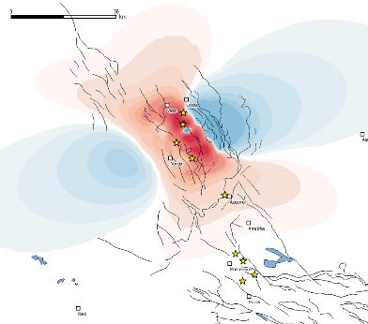
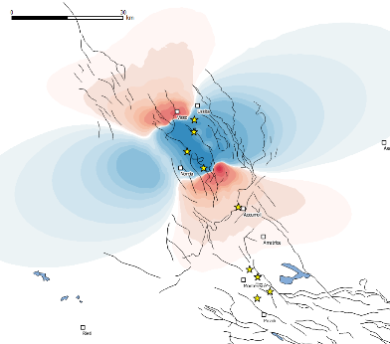
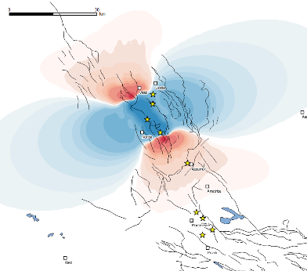
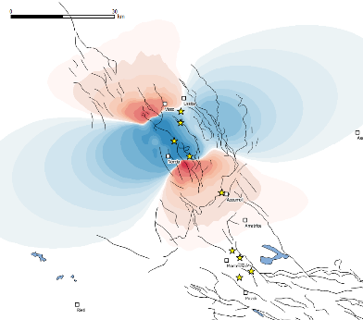
MODEL A – “PRELIMINARY KNOWLEDGE”
Mw 6.5 Norcia – Coulomb stress change
- Preliminary ML, depth and focal mechanism;
- Uniform slip model
- Receivers modelled with the same geometry of the source and unknown reference depth
2 km
4 km
6 km
8 km
Z = 2 – 12 km
$μ$ = 0.2 – 0.8
10 km
12 km

Slide 8
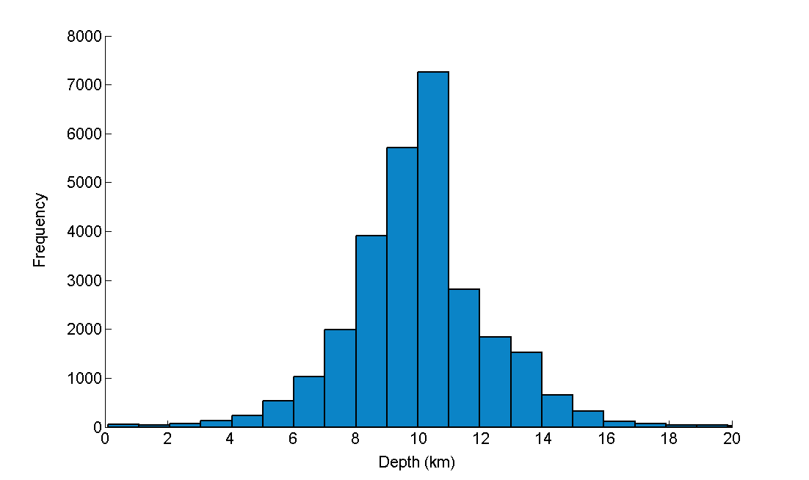
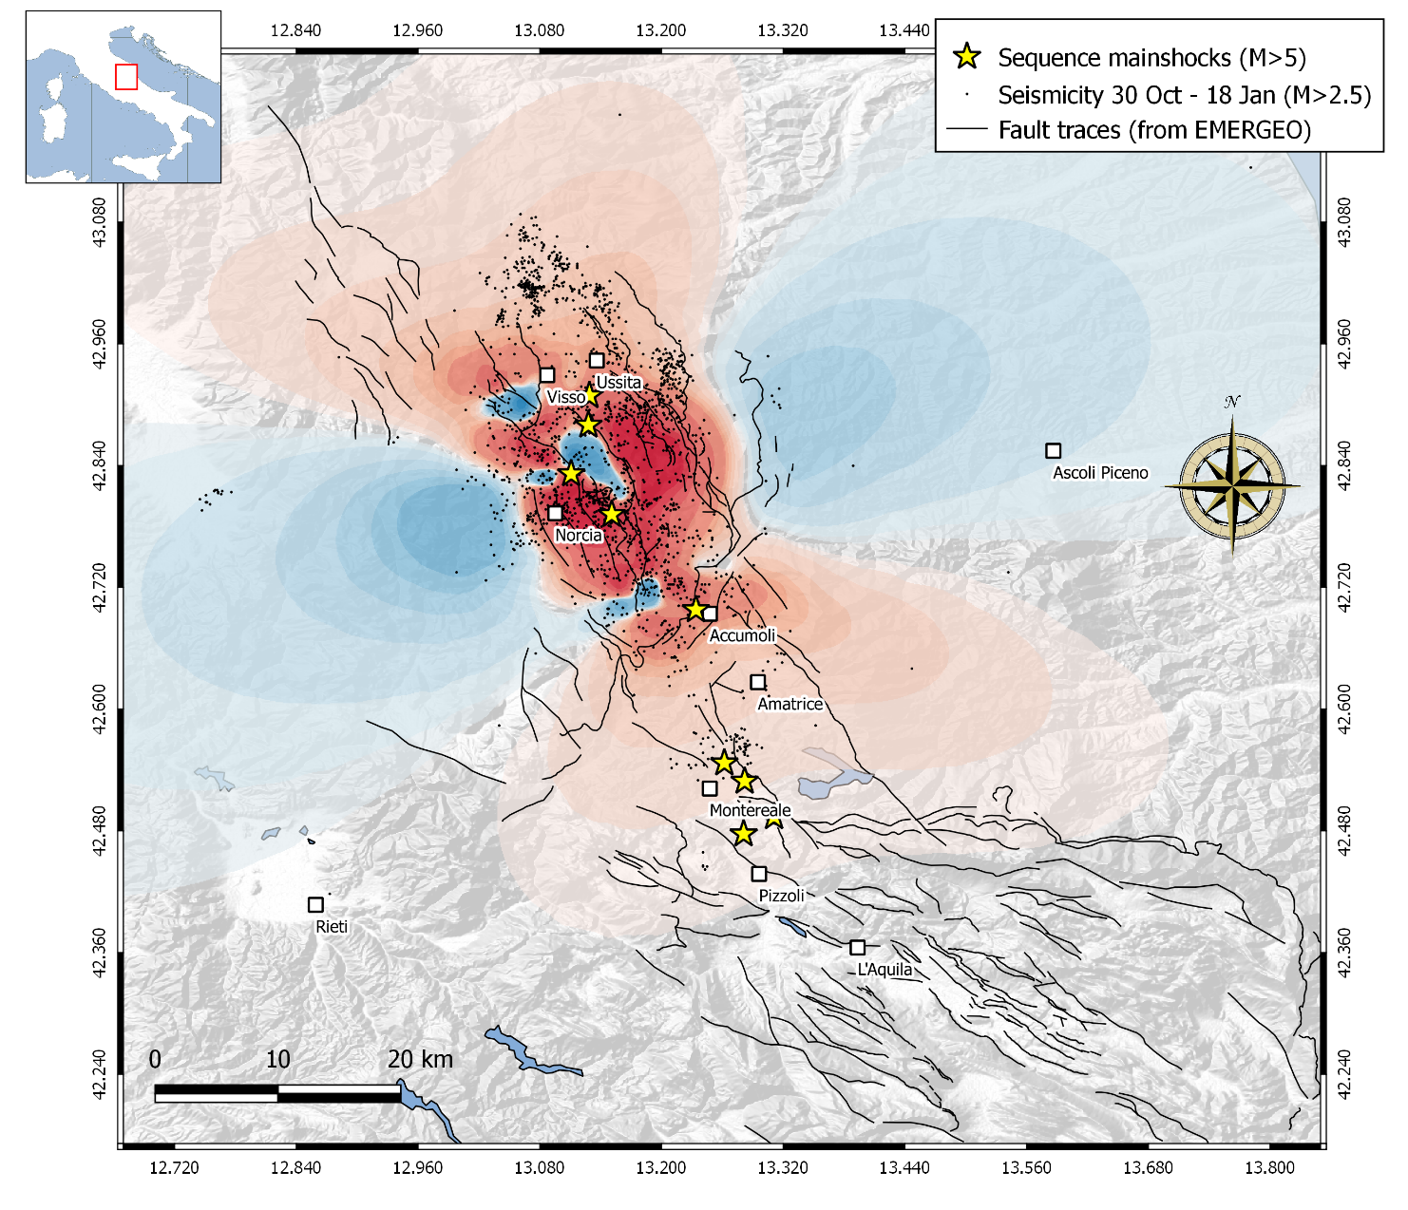
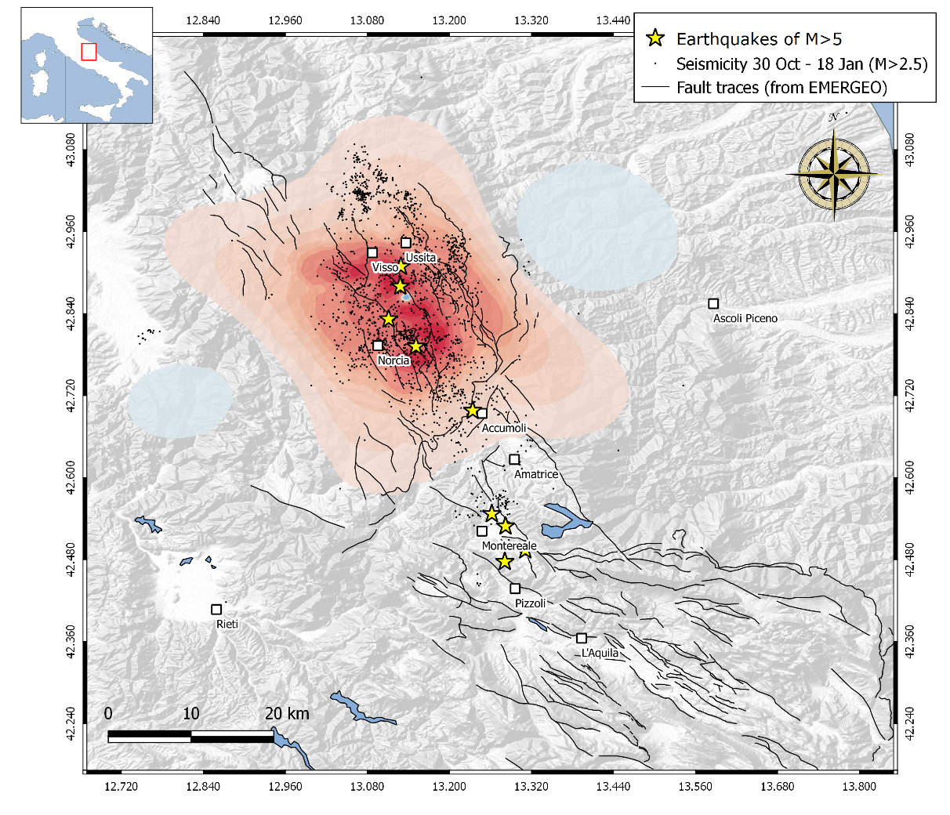
- Final estimation on Mw, depth, focal mechanism and fault dimensions.
- Best available version of the slip model;
- Receivers modelled with the same geometry of the source and with weighted reference depths between 2-12 km
MODEL C
the stage of
“ADVANCED KNOWLEDGE”
Mw 6.5 Norcia – Coulomb stress change
Z = 10 km

Slide 9
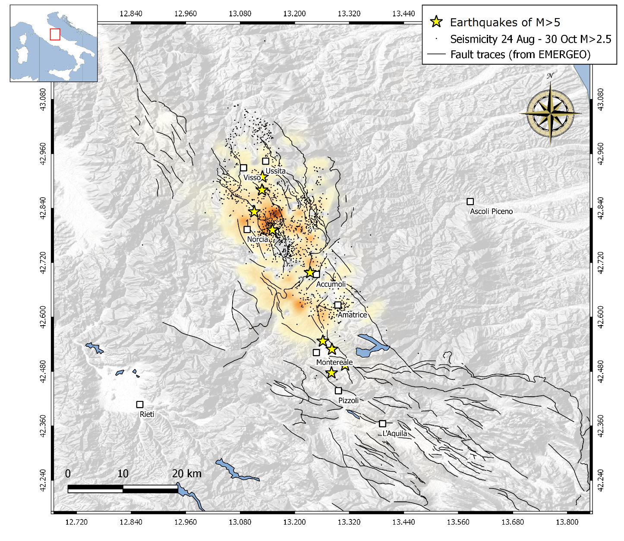
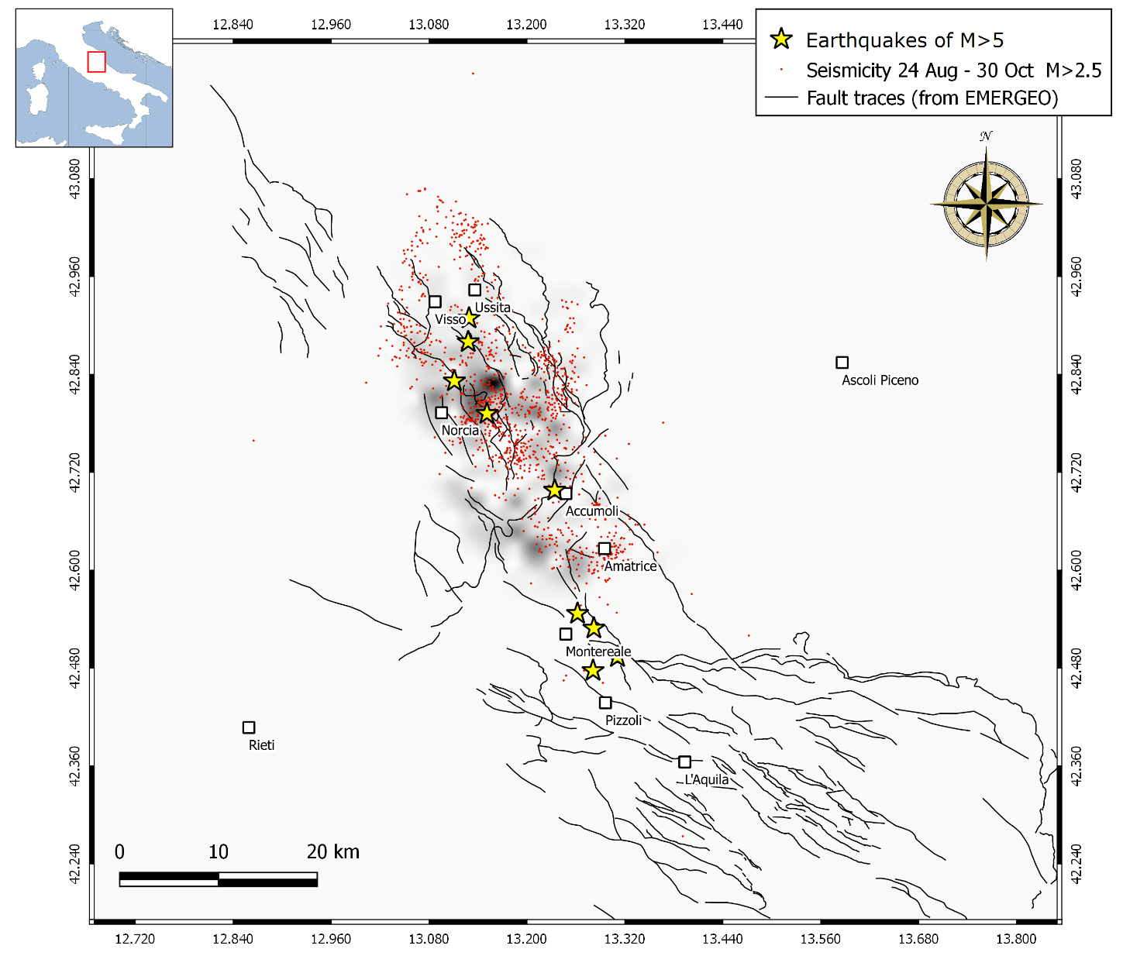
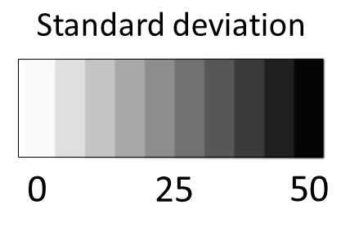
MODEL A - Forecast from 24th August to 29th October (Rate-and-State friction theory)
Reference rate evaluated from 1990 to 2016 with magnitude of completeness = 2.5, on a 2x2 km spatial grid;
Wide range of 10 possible shear stressing rate taken from literature
Normal stress = 0.1 MPa/year;
60 +/- 50 forecasted
events of M>2.5

Slide 10
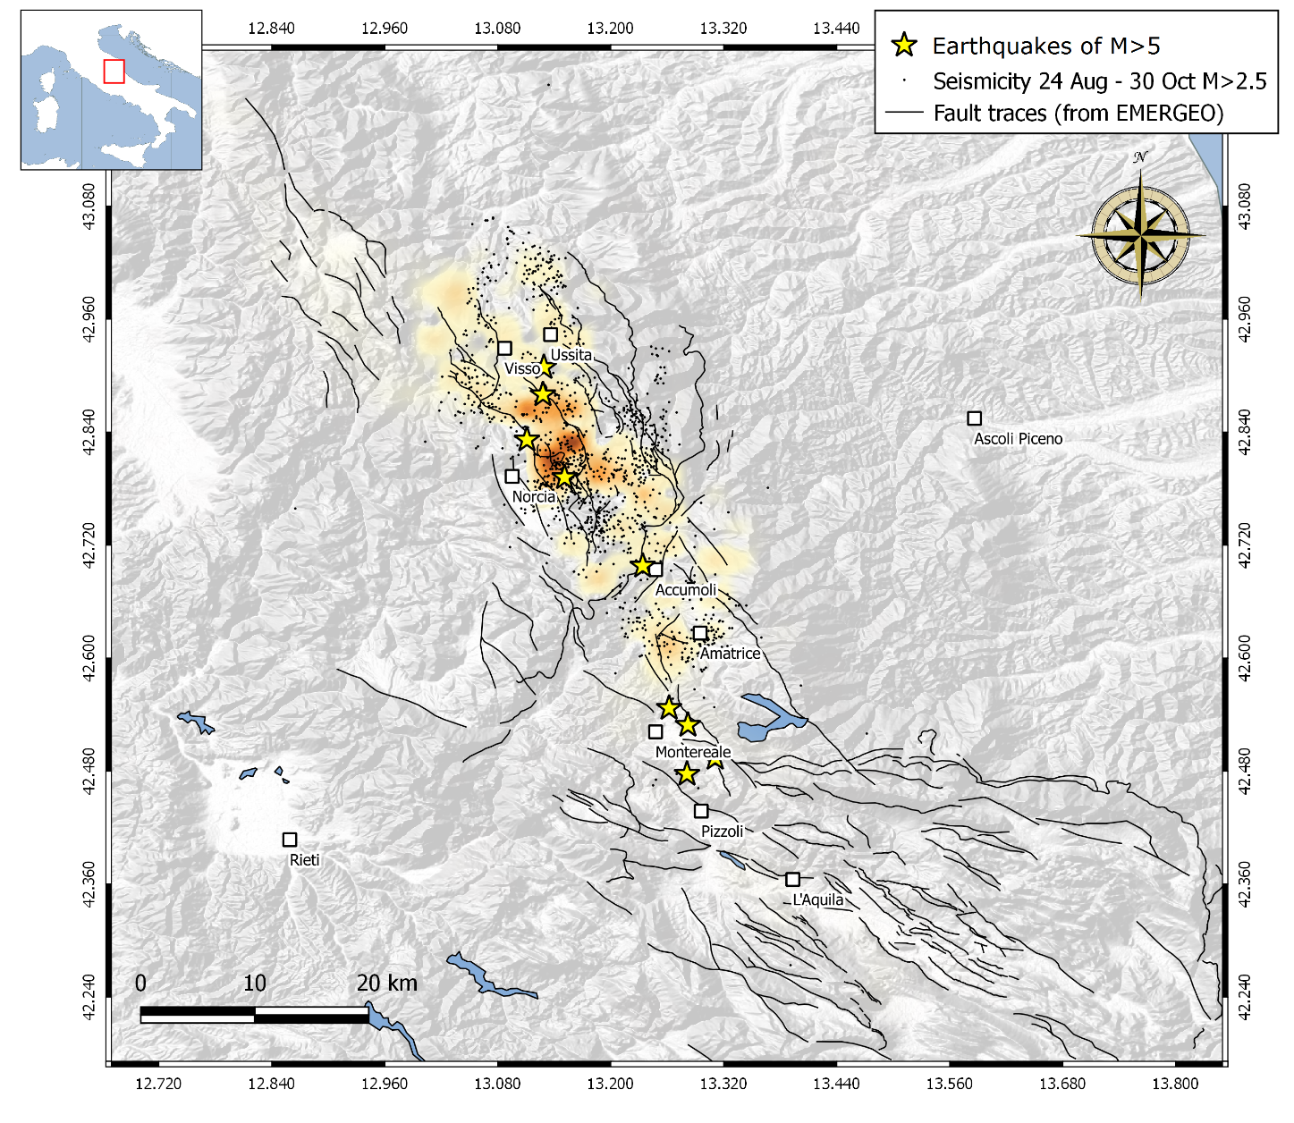
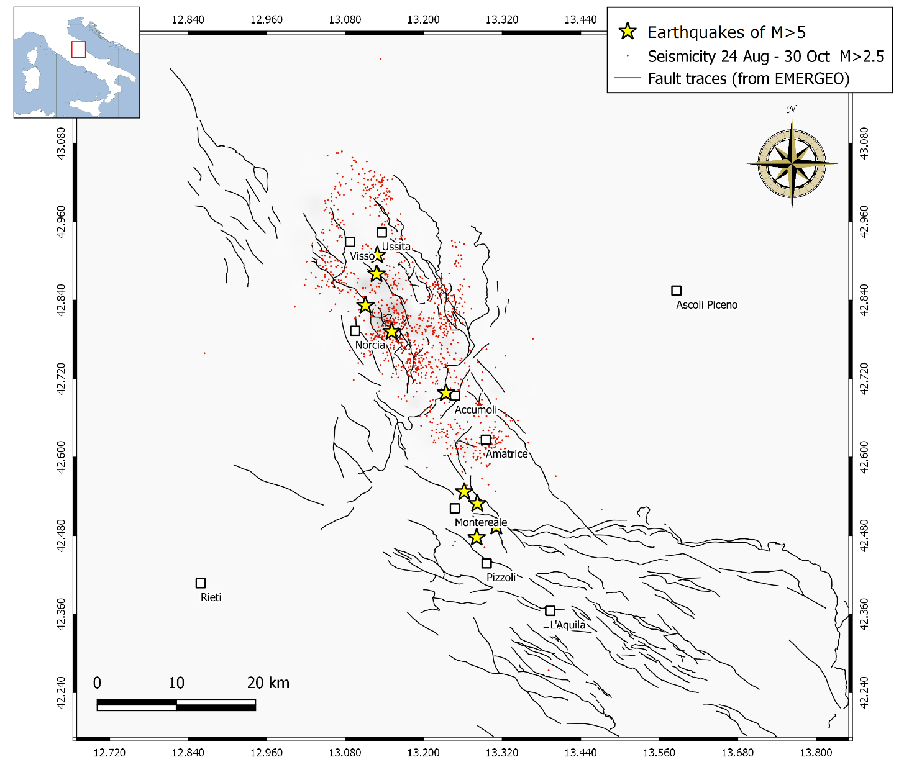
MODEL C - Forecast from 24th August to 29th October (Rate-and-State friction theory)
Reference rate evaluated from 1990 to 2016 with magnitude of completeness = 2.5, on a 2x2 km spatial grid;
Shear stressing rate retrofitted using the observed seismicity;
Forecast weighted by the depth of the observed seismicity.
60 +/- 9 forecasted
events of M>2.5

Slide 11
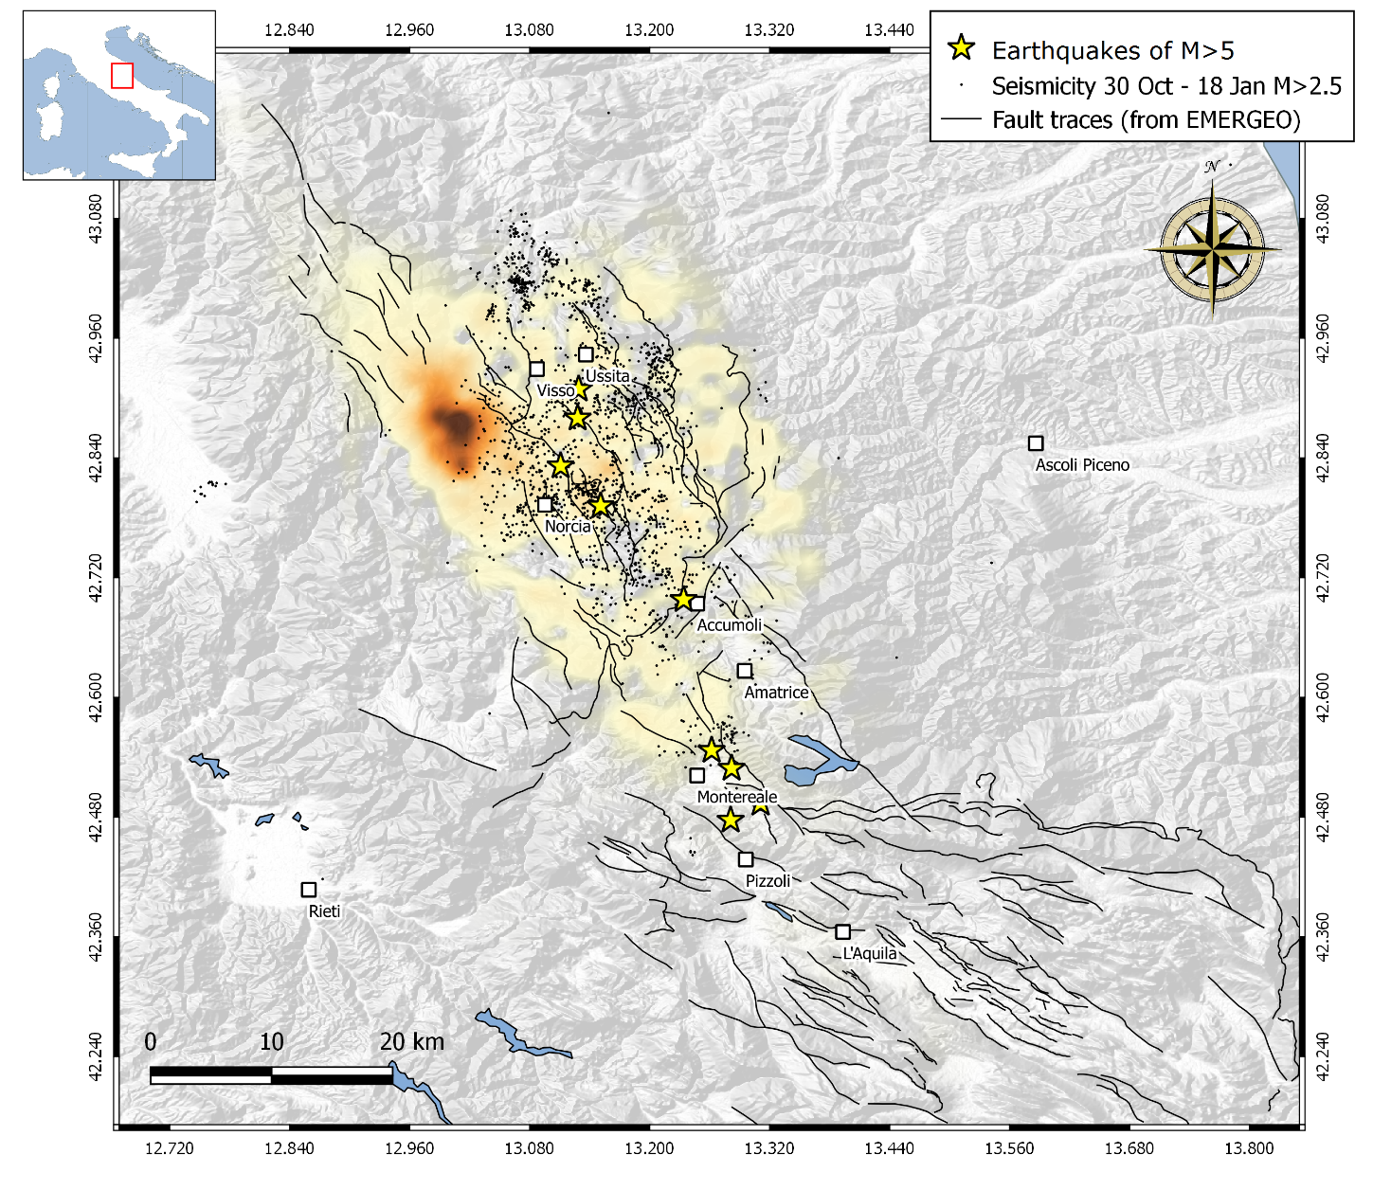
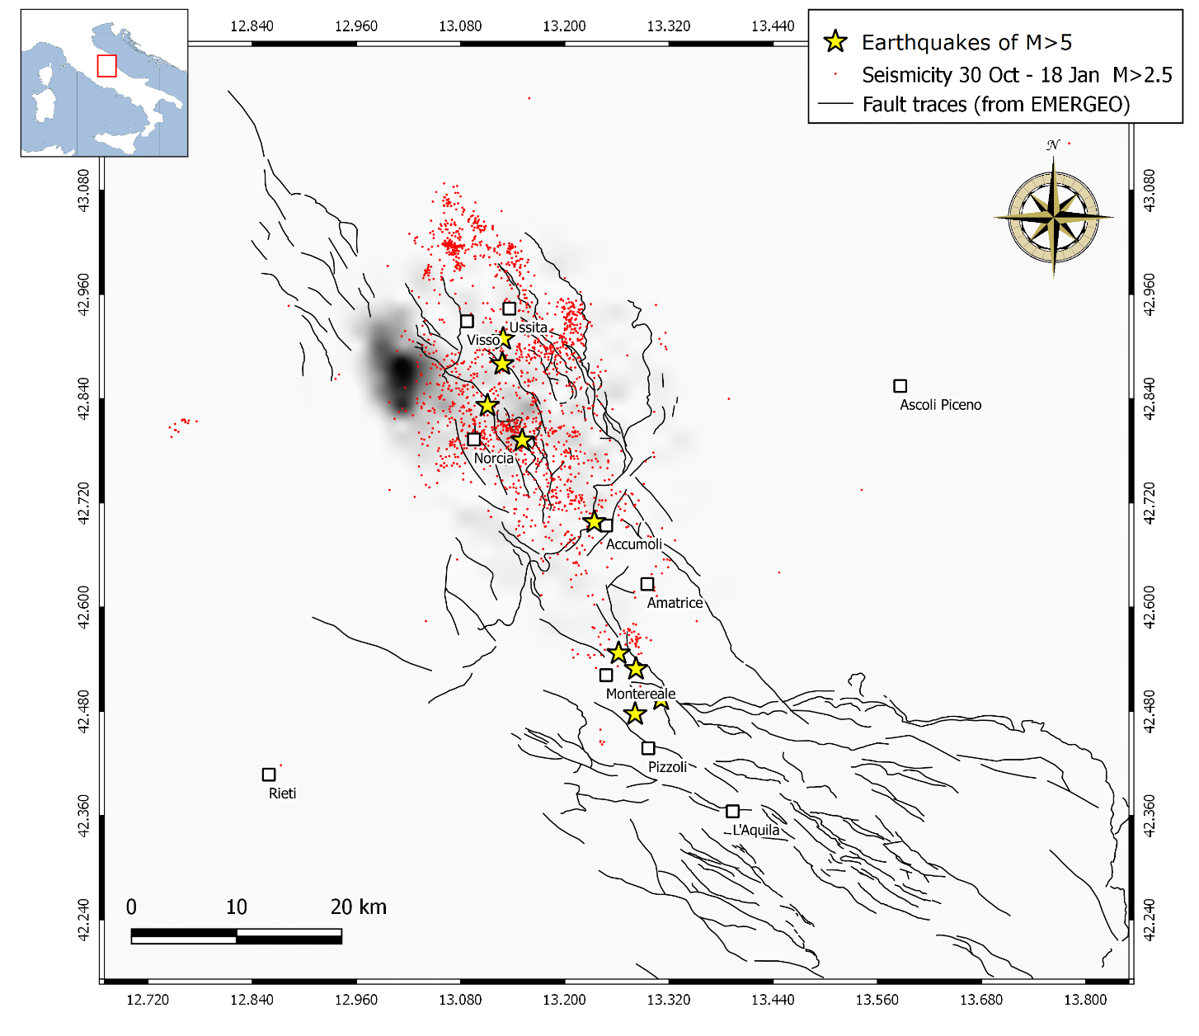
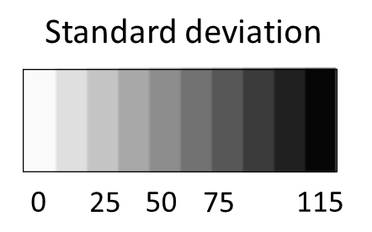
MODEL A - Forecast from 30th October to 17th January (Rate-and-State friction theory)
Reference rate evaluated from 1990 to 2016 with magnitude of completeness = 2.5, on a 2x2 km spatial grid;
Wide range of 10 possible shear stressing rate taken from literature
Normal stress = 0.1 MPa/year;
140 +/- 115 forecasted
events of M>2.5

Slide 12
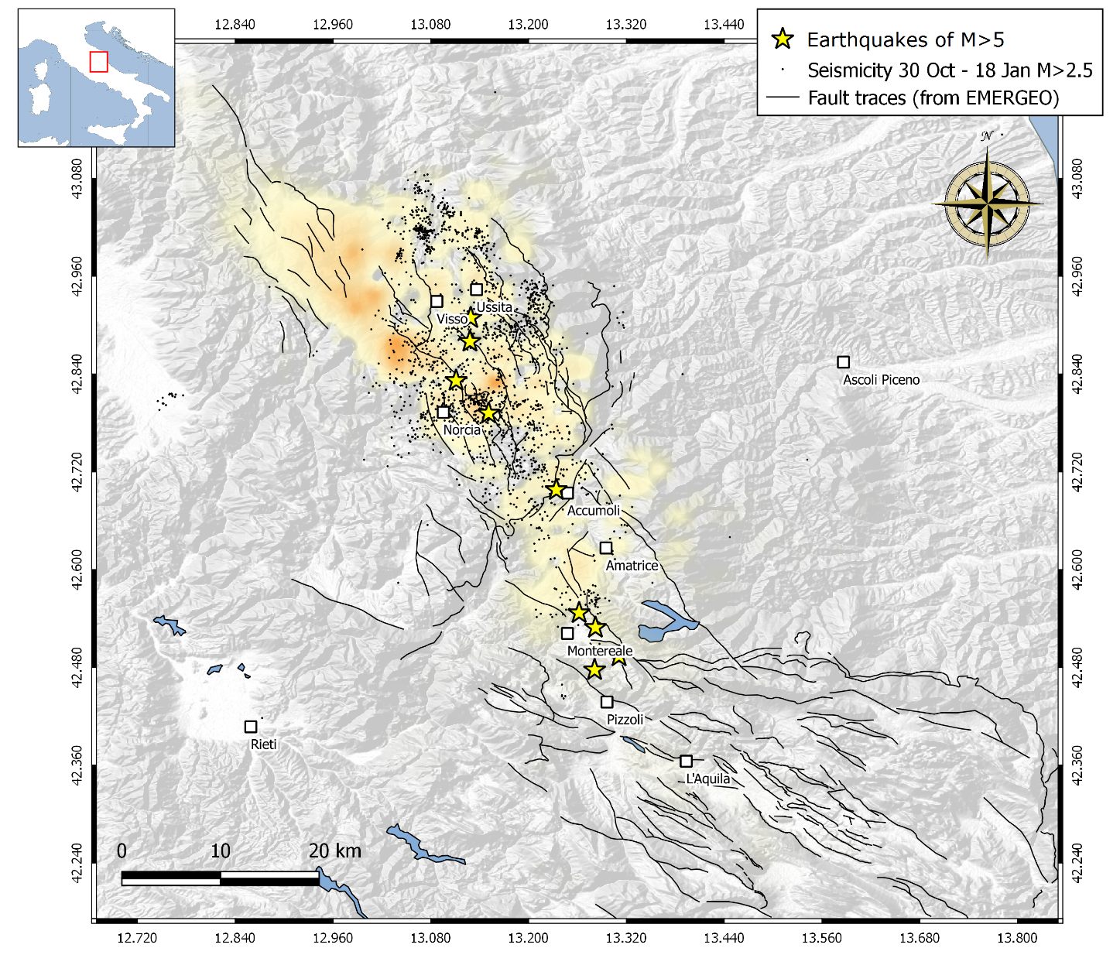
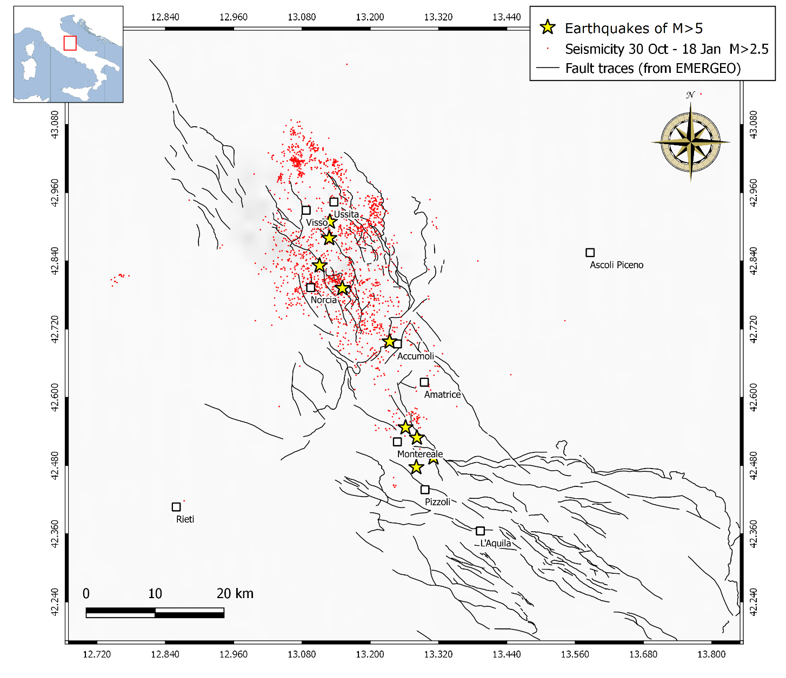
MODEL C - Forecast from 30th October to 17th January (Rate-and-State friction theory)
Reference rate evaluated from 1990 to 2016 with magnitude of completeness = 2.5, on a 2x2 km spatial grid;
Shear stressing rate retrofitted using the observed seismicity;
Forecast weighted by the depth of the observed seismicity.
140 +/- 9 forecasted
events of M>2.5

Slide 13
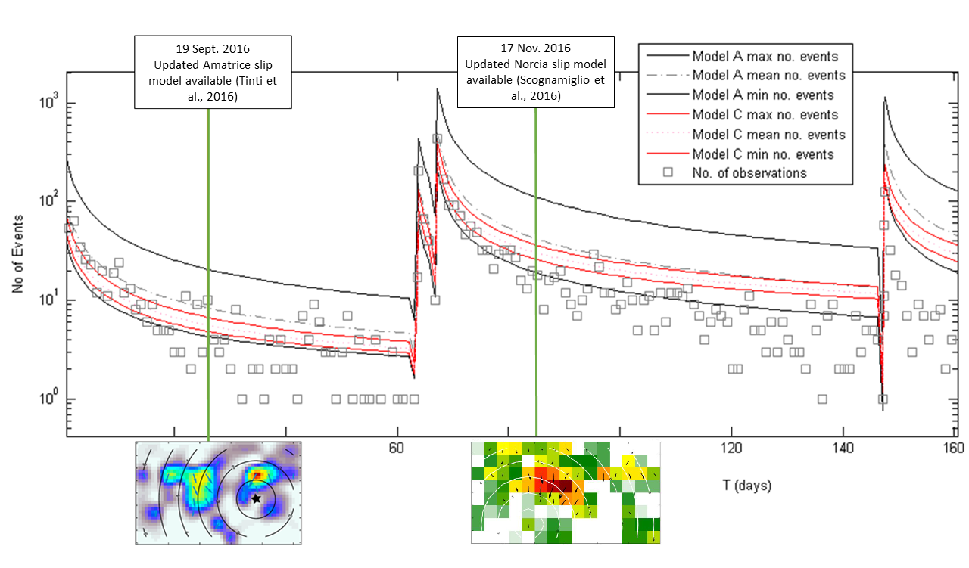
Uncertainty changes as new data are available

Slide 14
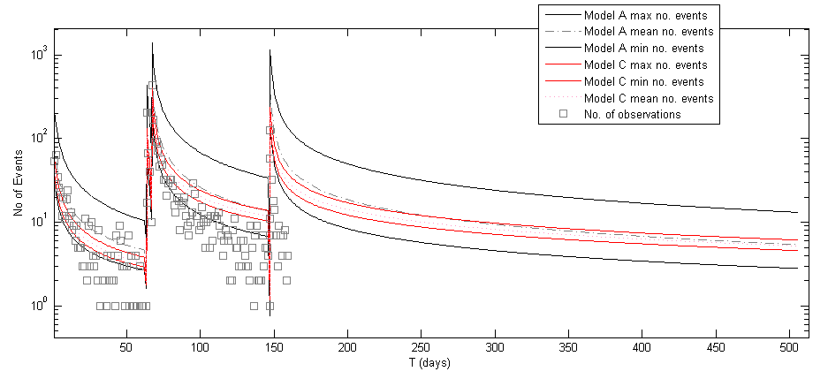
Uncertainty changes as new data are available
PROSPECTIVE until 31st January 2018

Slide 15
Concluding remarks
And future developments
The case study of the last Central Apennines sequence is ideal to quantify the influence of data quality in preliminary forecast efforts in a well-instrumented region;
During the early post-disaster phases, our preliminary forecasts are affected by limitations and high uncertainty;
As soon as we can use updated geological and seismological data, we can compute more informed models which reduce the uncertainty of our forecasts. However, the comparison with the observations indicates that the forecast is sharper, but it's overconfident, because it clearly over-predicts.
Expected developments:
Inclusion of intermediate models (“models B”) to better observe the evolution of the uncertainty with time, as well as at least one more informed model (“model D”) which takes into account a real geological model for the receivers of the DCFF calculations and that allows the stressing rate to be retrofitted daily during the Rate-State computations.
Statistical evaluation of the models and comparison with empirical/statistical models (i.e. ETAS);

Slide 16
THANK YOU FOR YOUR ATTENTION
ANY QUESTIONS?

