Slide 1
Bolide airbursts as a seismic source for the 2018 Mars InSight mission
Jenny Stevanovic
N. Teanby, J. Wookey, N. Selby et al.

Slide 2
Background
What is InSight?
Single station lander mission to Mars
Geophysical measurements
To determine internal structure and impact rate
Why airbursts?
Source of seismo-acoustic energy
Potential for local detection
Evidence of occurrence on Mars

Slide 3
What is an airburst?
Sources of observable energy:

Slide 4
Are they a good source?
Many observed on Earth
Oregon bolide
Chelyabinsk
Evidence that they occur on Mars
Radial blast zone
No crater!

Slide 5
How are they distinguished?
Presence of both seismic precursor signals and an airwave
Co-located atmospheric pressure sensor
P/S amplitude ratio
First motion expected to be isotropically compressive
Emergent pulse envelope

Slide 6
How are they distinguished?
Airwave group velocity

Slide 7
How are they distinguished?
Amplitude ratio

Slide 8
How are they distinguished?
First motion as rejection criterion

Slide 9
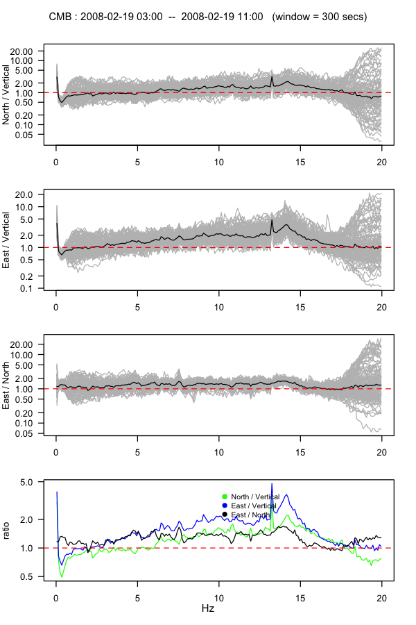
Estimating distance from frequency

Slide 10
Estimating distance from frequency
First need to remove site effect
Local conditions add noise
Characterise using the HVSR method
Invert these ratios to create a filter
Apply a site specific correction
In this case a spurious noise peak at ~13Hz which may have dominated frequency content

Slide 11
Estimating distance from frequency
Is then possible to determine f_{P}
Data windowed on each arrival
Hanning taper applied
Frequency spectra calculated
Dominant frequency recorded
Data plotted against source-receiver distance
Regression calculated

Slide 12
Estimating the number of events
Characterise a source population using:
Observed crater population
Earth impactor population (scaled)
Comparison to other studies
Note roll-off caused by observation bias and difficulty resolving small craters

Slide 13
Estimating the number of events
Once you have a SFD:
Model how dynamic pressure changes with altitude for bolides of different diameters
Where this intersects material compressive strength, deformation begins
Airburst when D > 7D₀ occurs above planetary surface

Slide 14
Estimating observable events
Yield -vs- altitude (diameter dependent)
High and low
noise models
Yield -vs- frequency
Number of detectable events per year as a function of yield
Atmospheric attenuation component
Result: We predict 10-200 detectable events per year for InSight

Slide 15
Summary
Airburst characteristics
Airwave arrival
P/S amplitude ratio
First motion
Emergent pulse envelope
Estimating distance from frequency
Important to remove site effect
Data shows expected decrease with distance
Attenuation plays key role
Estimating number of observable events for InSight
Need to understand the source population
Physics of deformation
Atmospheric attenuation
Instrument capability at high and low noise
We predict 10-200 detectable events per year for InSight

Slide 16
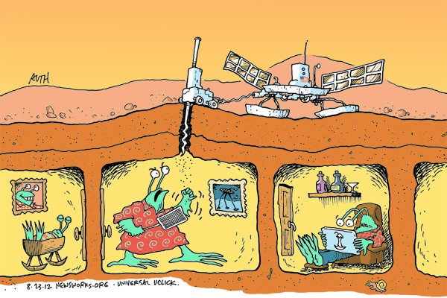
Thank You!
Illustration by Tony Auth (http://www.newsworks.org/index.php/local/behind-the-lines/43311-coming-soon-to-mars-nasas-insight)

