Slide 1






Induced seismicity for geothermal energy production: a new synthesis
Xun Li^{1,2}, Ian Main¹ and Andrew Jupe³
Thanks to , SED,
1
2
3

Slide 2
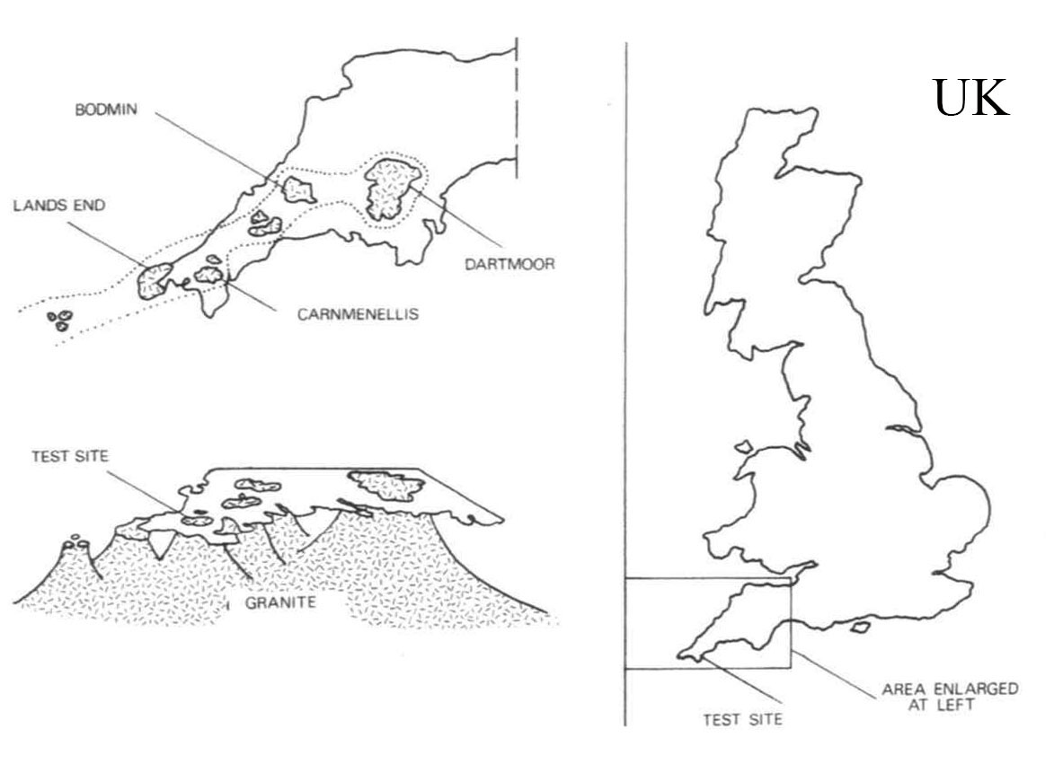
Introduction—Site Location
Rosemanowes Quarry
Carnnenellis granite—Hercynian period
Gravity: >10km depth

Slide 3
Fluid Injection History – Phase 2A

Slide 4
Induced Seismicity – cumulative seismic moment

Slide 5
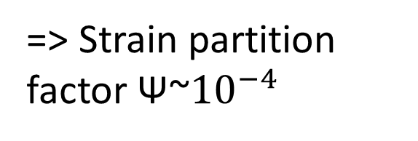
Apparent shear modulus v. injected volume
=> Strain partition factor Ψ~${10}^{−4}$
ΔBIC=41.3

Slide 6
Frequency-magnitude distribution – Phase 2A

Slide 7
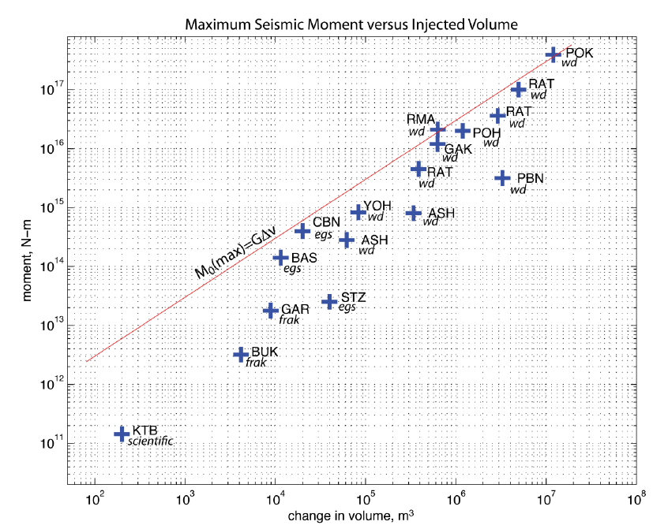
Seismic moment budget
Adapted from McGarr 2013
Rosemanowes Phase 2C
ML 2 event

Slide 8
Seismicity Cloud Diffusion? R~t^{H}
H~0.38 (c.f. H~0.1 for earthquake-earthquake triggering, Huc & Main, 2003)

Slide 9
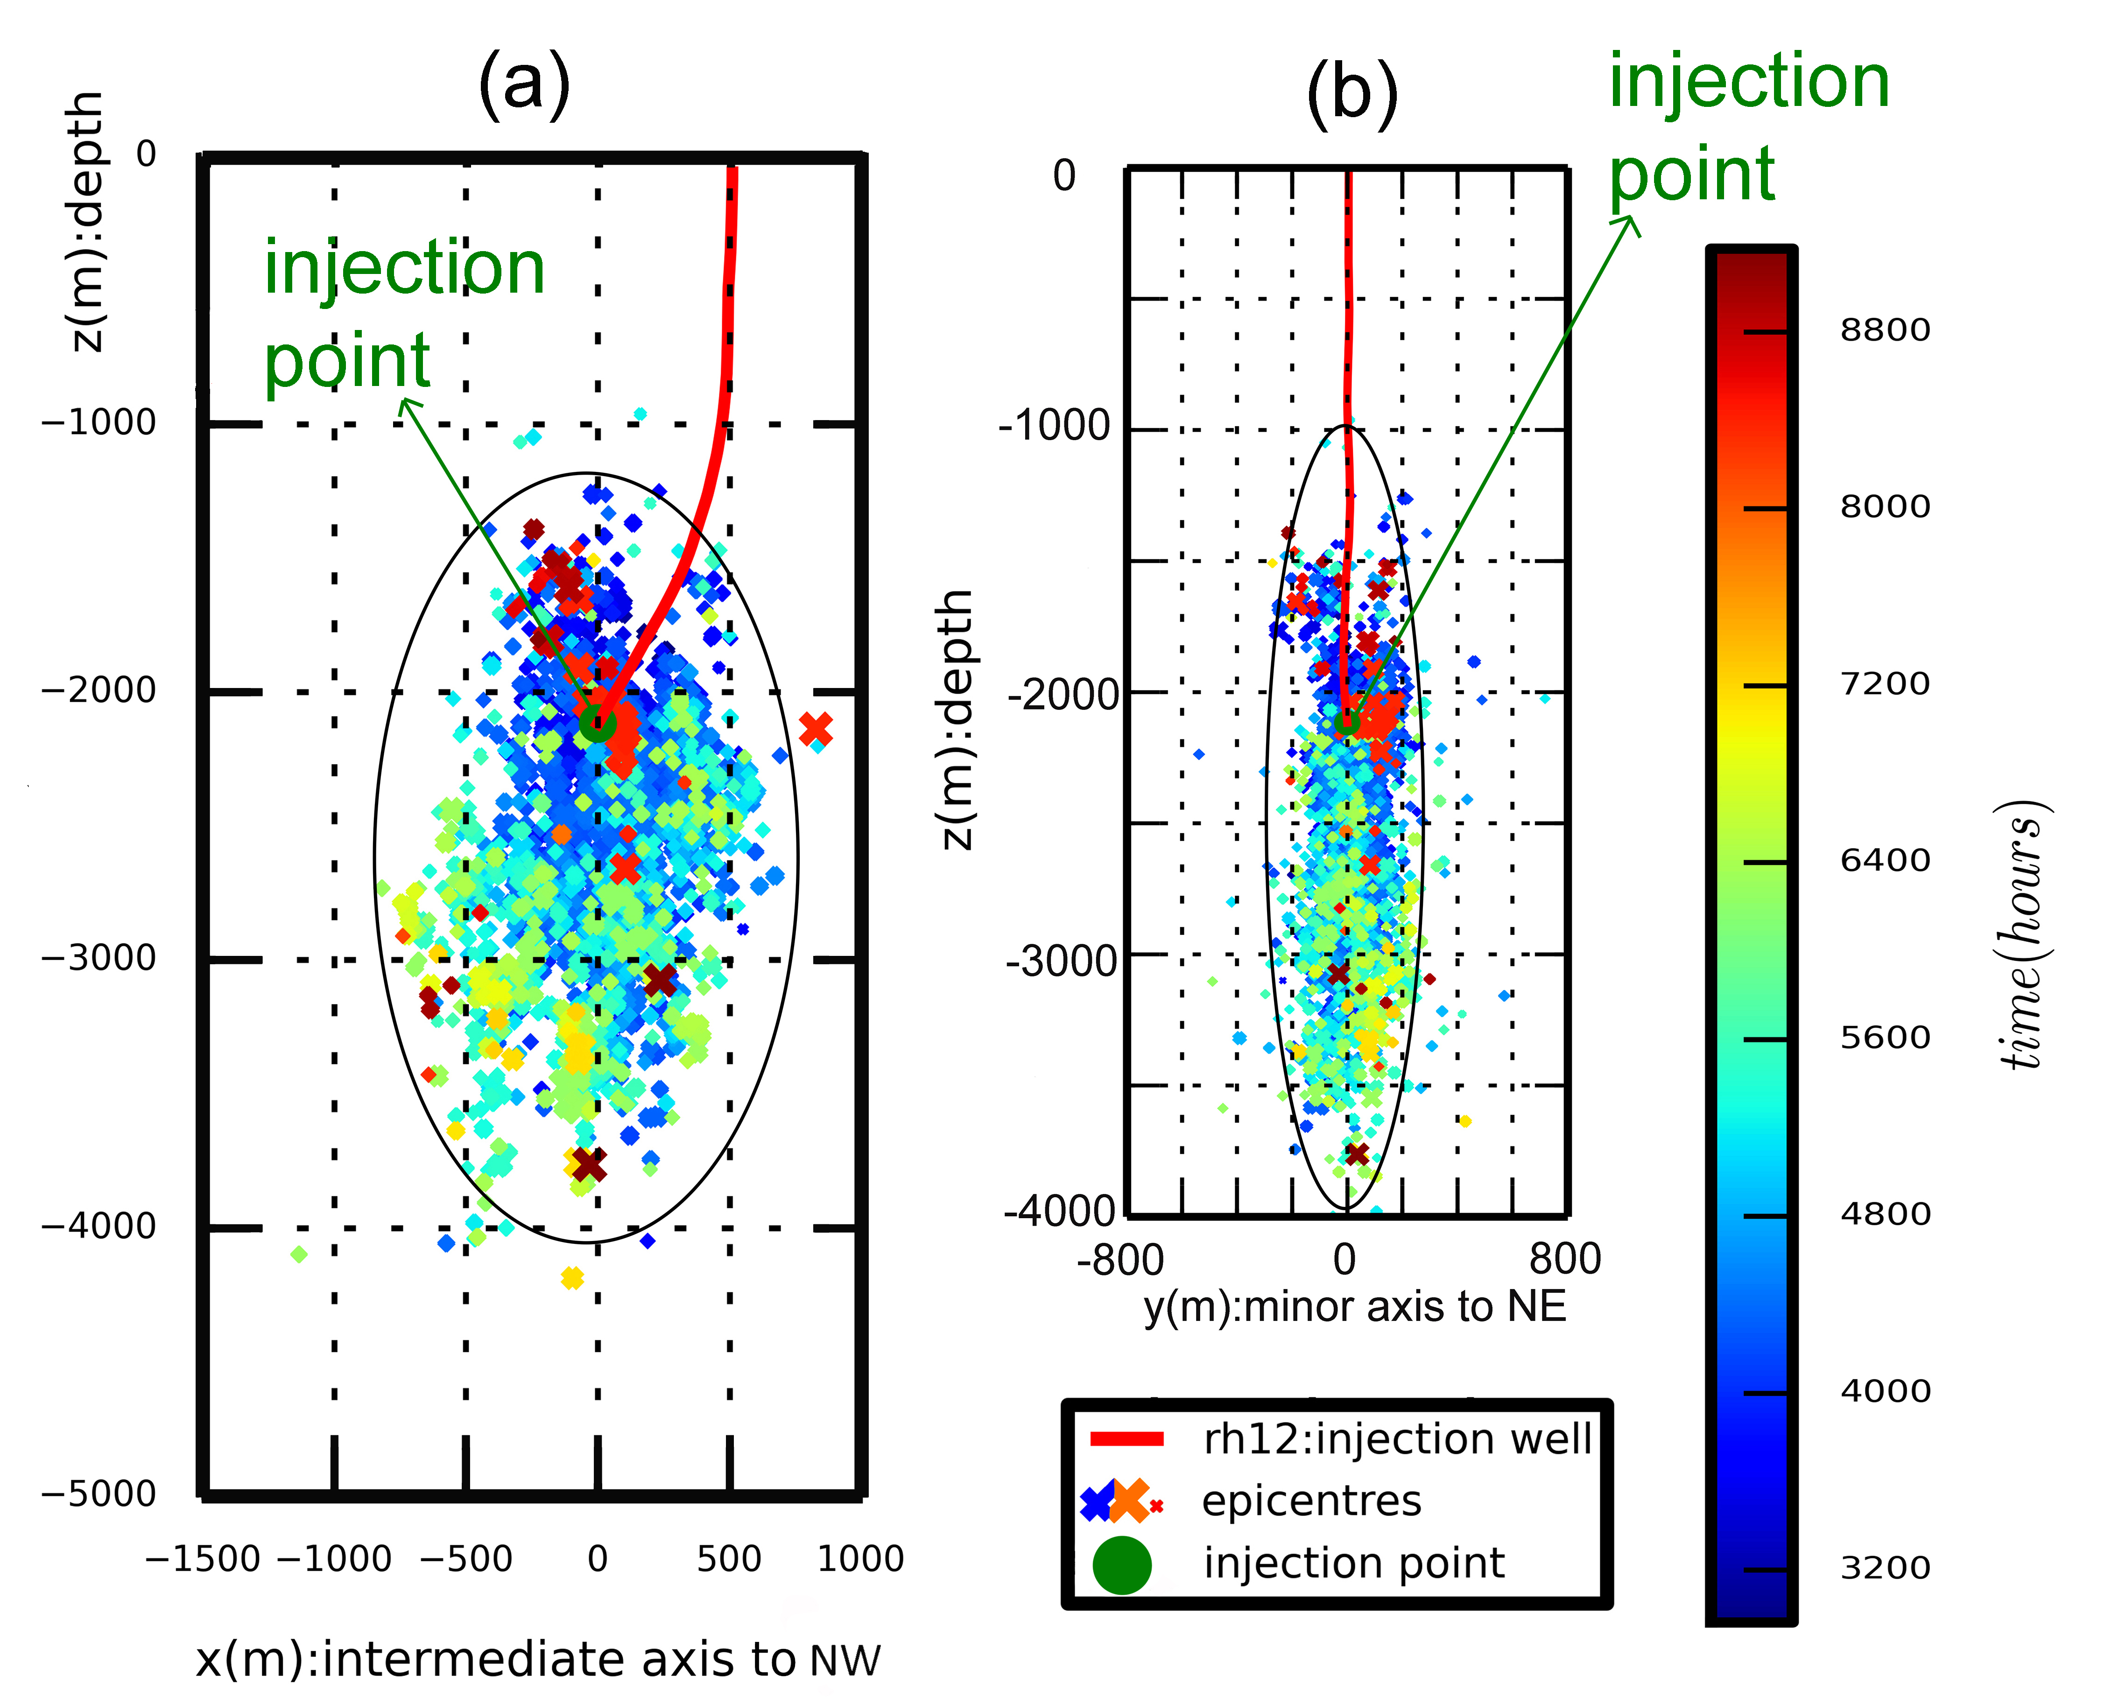
Seismicity cloud alignment, stress anisotropy, and pre-existing fracture orientation

Slide 10
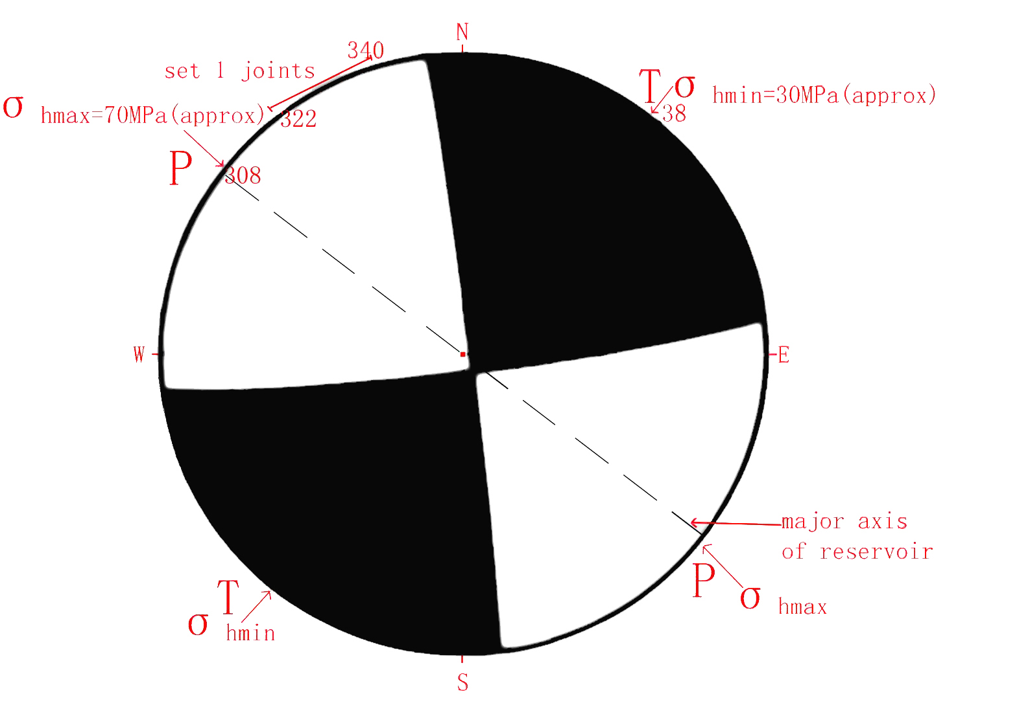
Composite Focal Mechanism
Dominated by small events

Slide 11
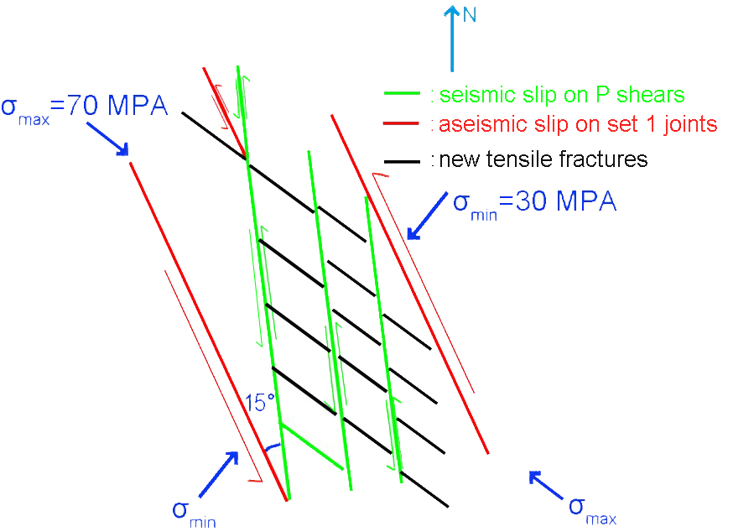
Possible model of fracture network
opening tensile fractures

Slide 12
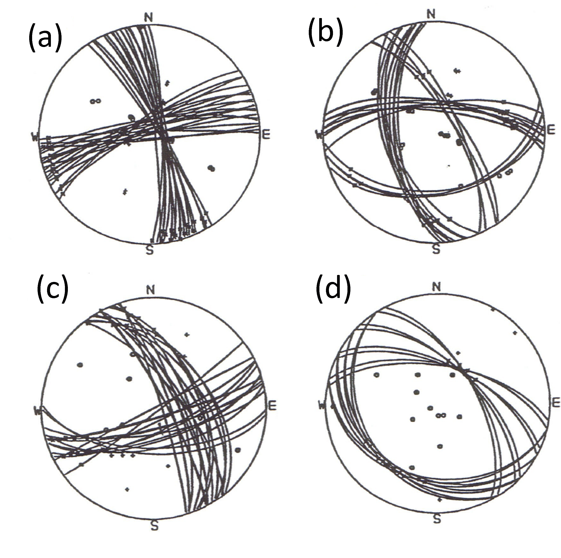
Variability of compatible focal mechanisms for individual events
- scaling with size
Larger events have a greater normal component on NW/SE striking faults

Slide 13
Conclusion
The reservoir is highly compliant – only a tiny fraction (0.01%) of the total available strain is released seismically
The strain partition coefficient reduces with ongoing injection
The induced seismicity cloud evolution is best described by ‘non-Fickian’ diffusion with an exponent of ~0.38
The most likely cause is permeability anisotropy, with best-fit ellipsoid axes closely aligned with the present-day stress field
The composite focal mechanism is consistent with reactivation of local pre-existing fractures in Riedel (P) shear at high angle, in turn due to aseismic slip on more optimally-oriented faults

