Slide 1
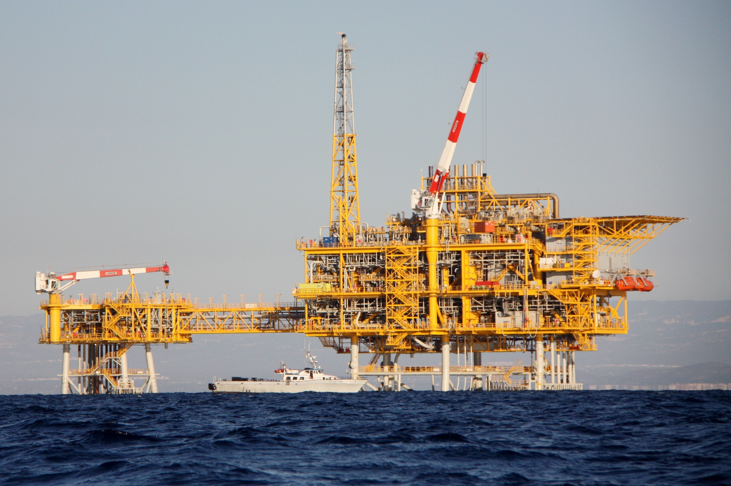
Focal depths and mechanisms of induced earthquakes in the 2013 seismic sequence near the CASTOR UGS, northeast coast of Spain
Antonio Villaseñor, Robert B. Herrmann, Beatriz Gaite, and Arantza Ugalde
Institute of Earth Sciences Jaume Almera (ICTJA-CSIC)
Barcelona, Spain

Slide 2
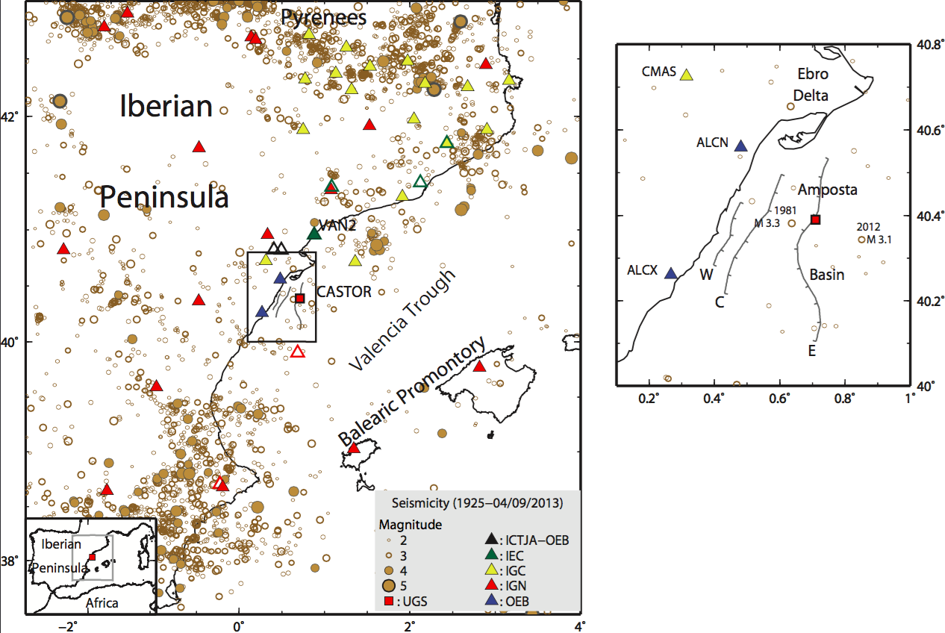
Location of the CASTOR underground gas storage

Slide 3
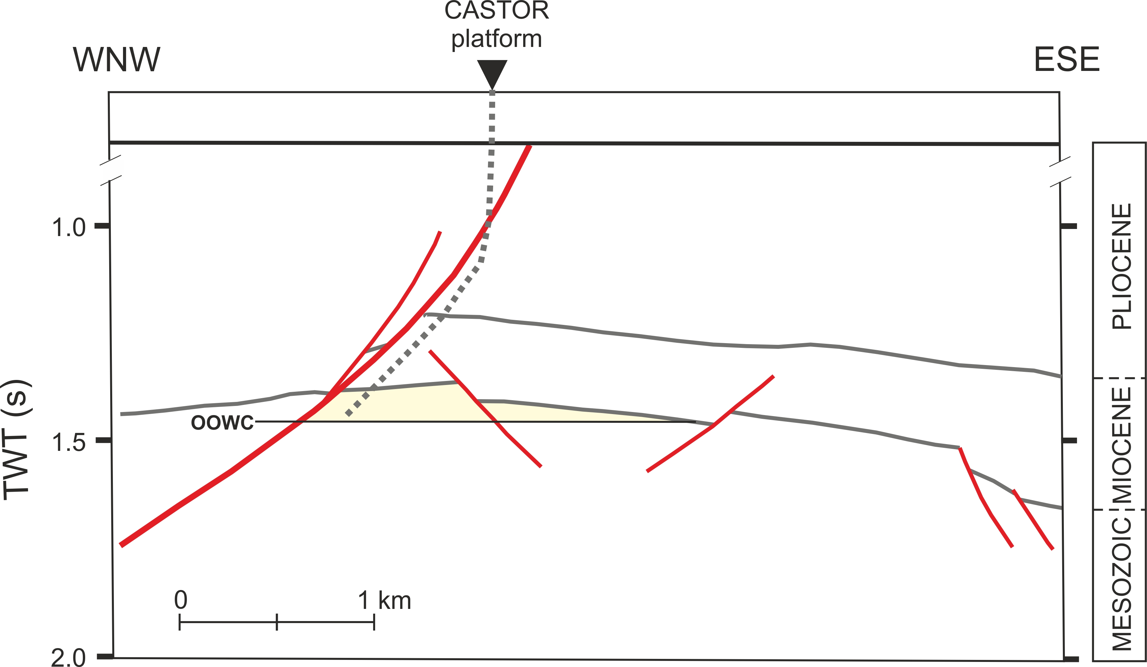
Geometry of the depleted Amposta oil field

Slide 4
Timeline
Earthquake location using 3D model and picks from cross-correlation of similar events
Moment tensor from waveform inversion
Waveform modeling of S-wave reverberations

Slide 5
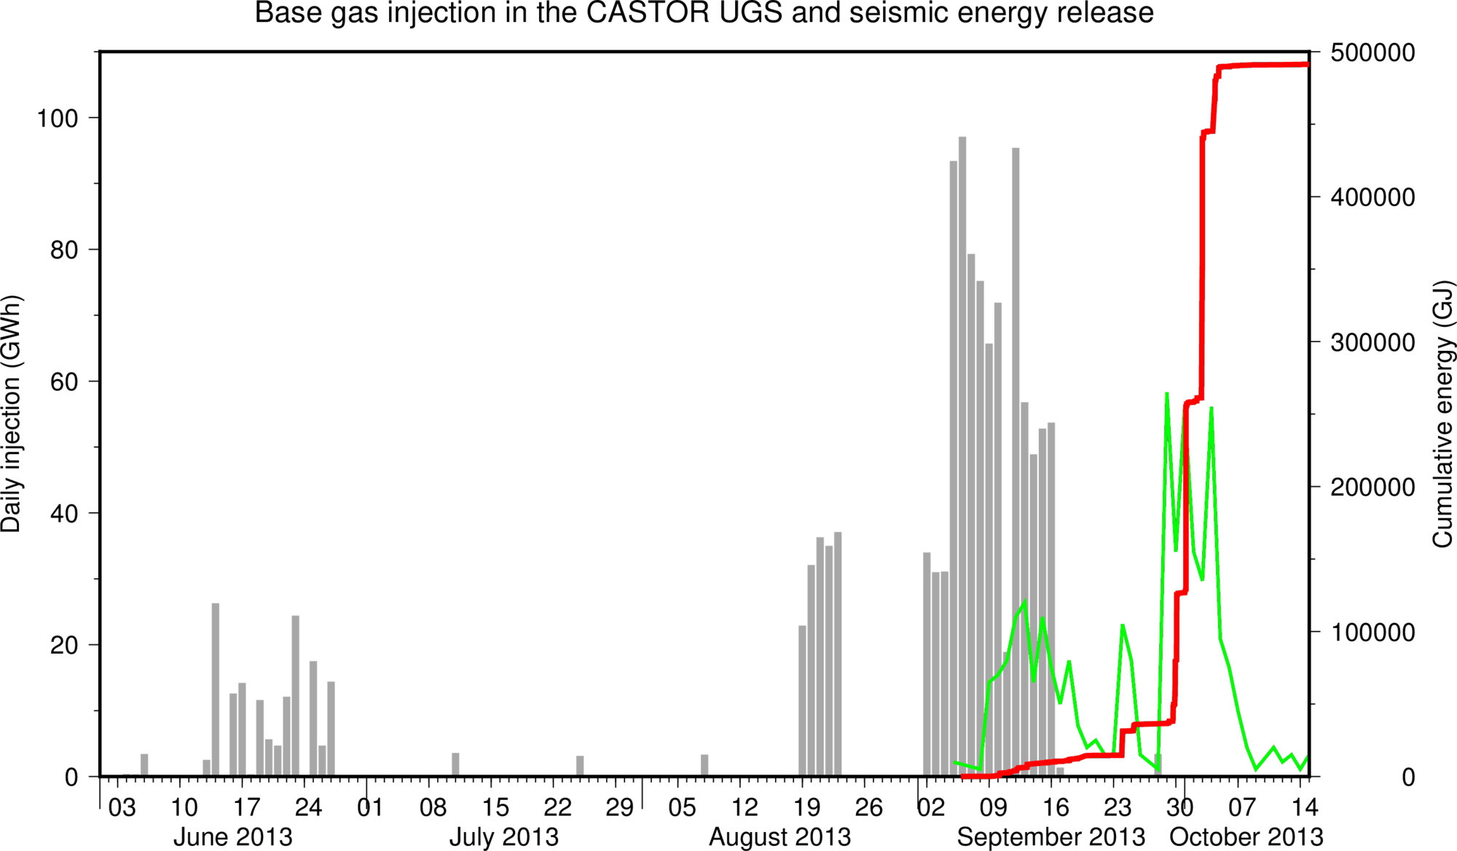
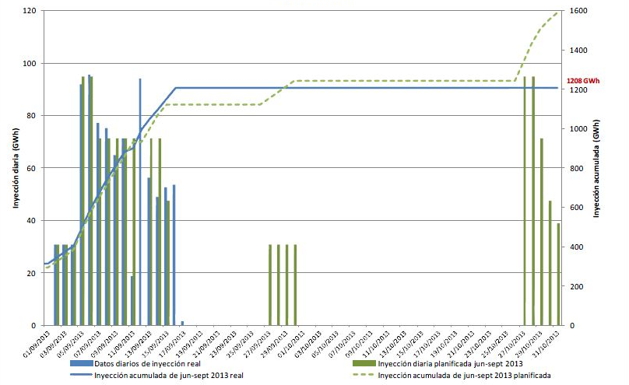
Source: GTS

Slide 6
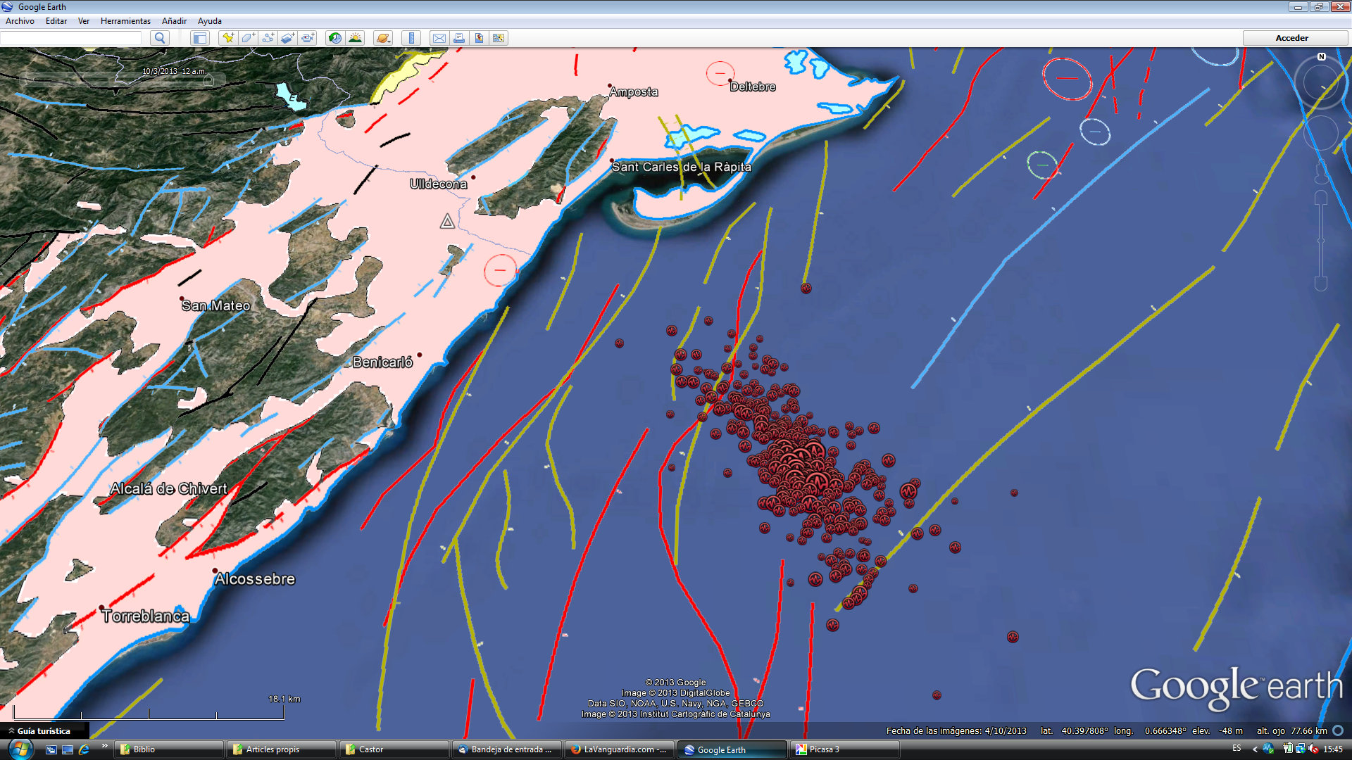
Difficulty to identify reactivated fault(s) using routine earthquake locations
Source: Instituto Geográfico Nacional (IGN)

Slide 7
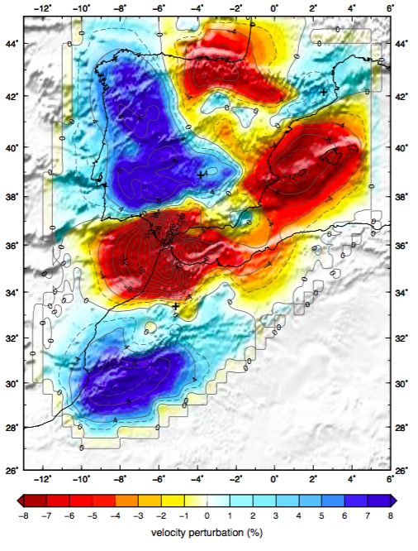
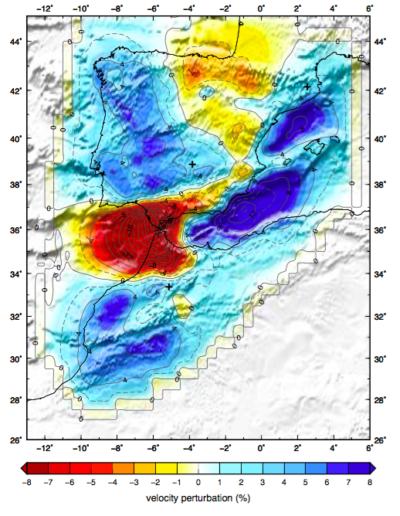
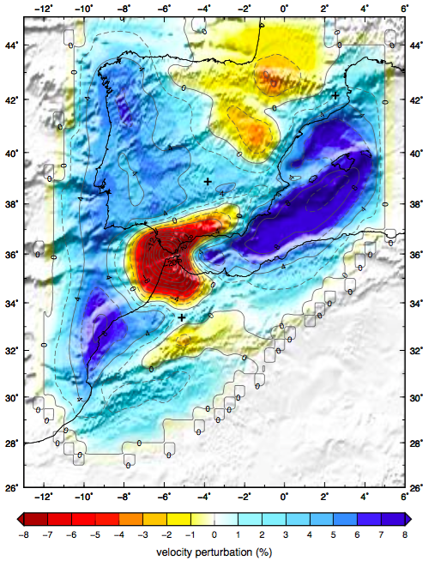
Surface wave dispersion measurements to obtain a regional 3D model:
Phase velocity maps of Rayleigh waves obtained from ambient noise tomography
6 seconds
12 seconds
20 seconds
Gaite et al., PEPI (2016)

Slide 8
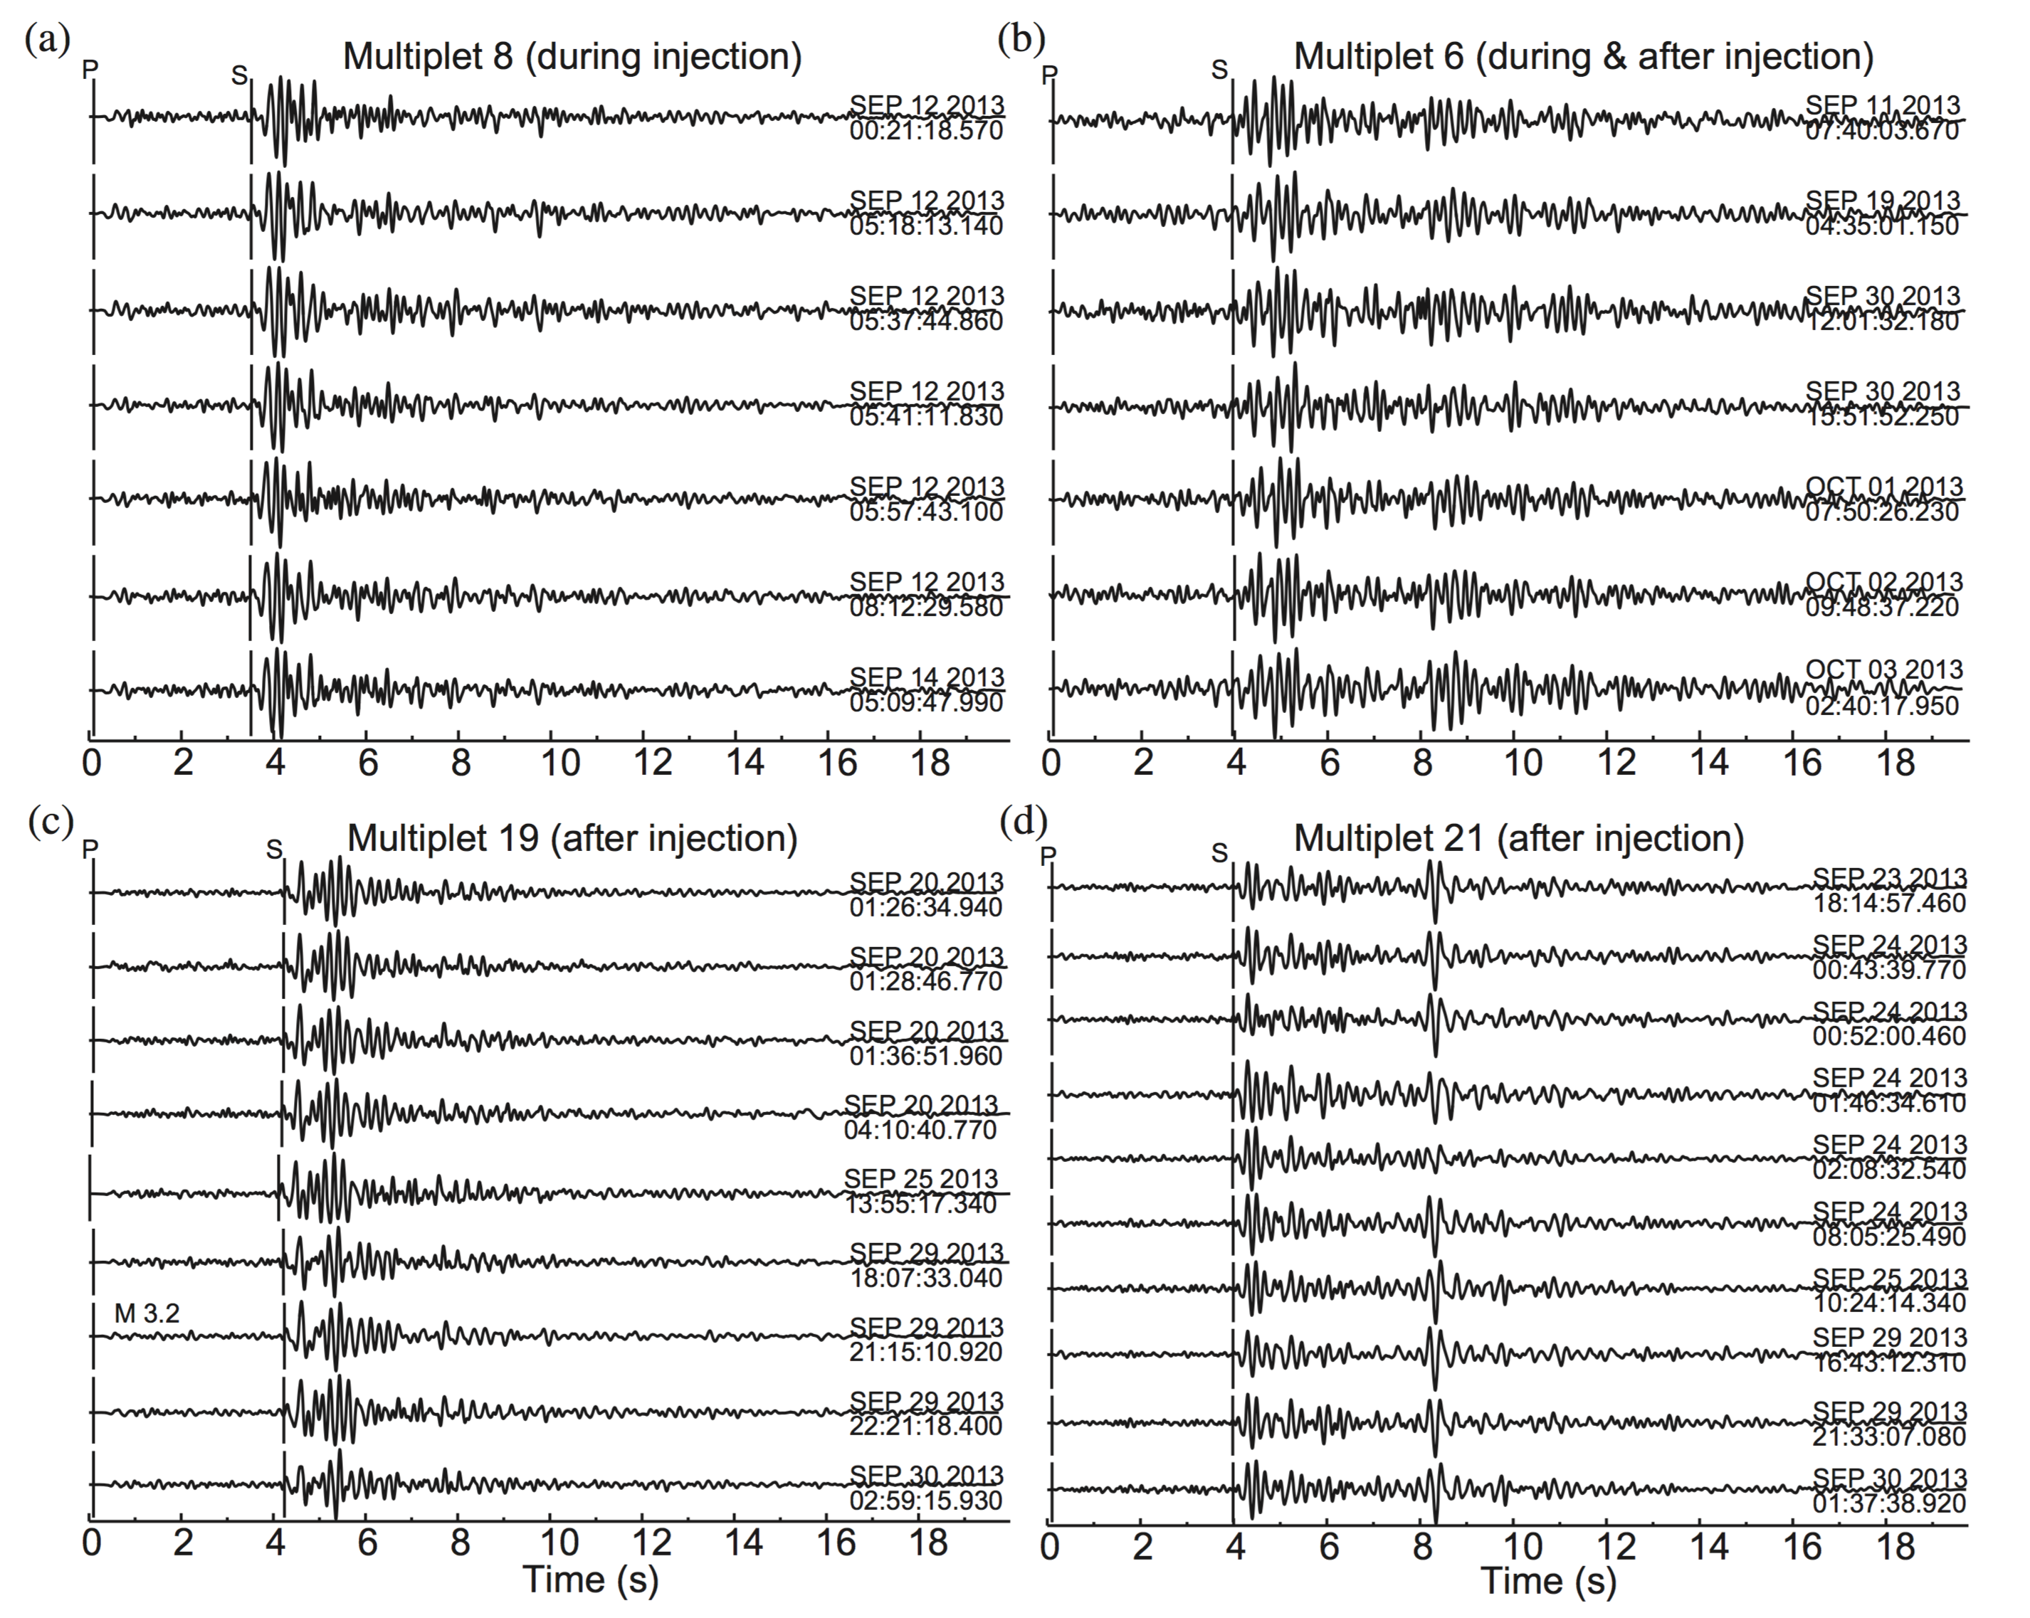
Families of similar events and cross-correlation picks
Gaite et al., PEPI (2016)

Slide 9
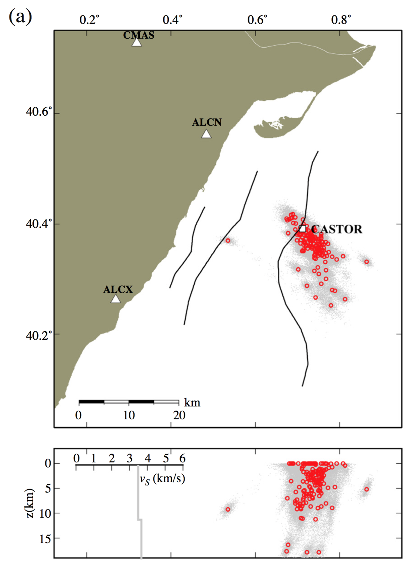
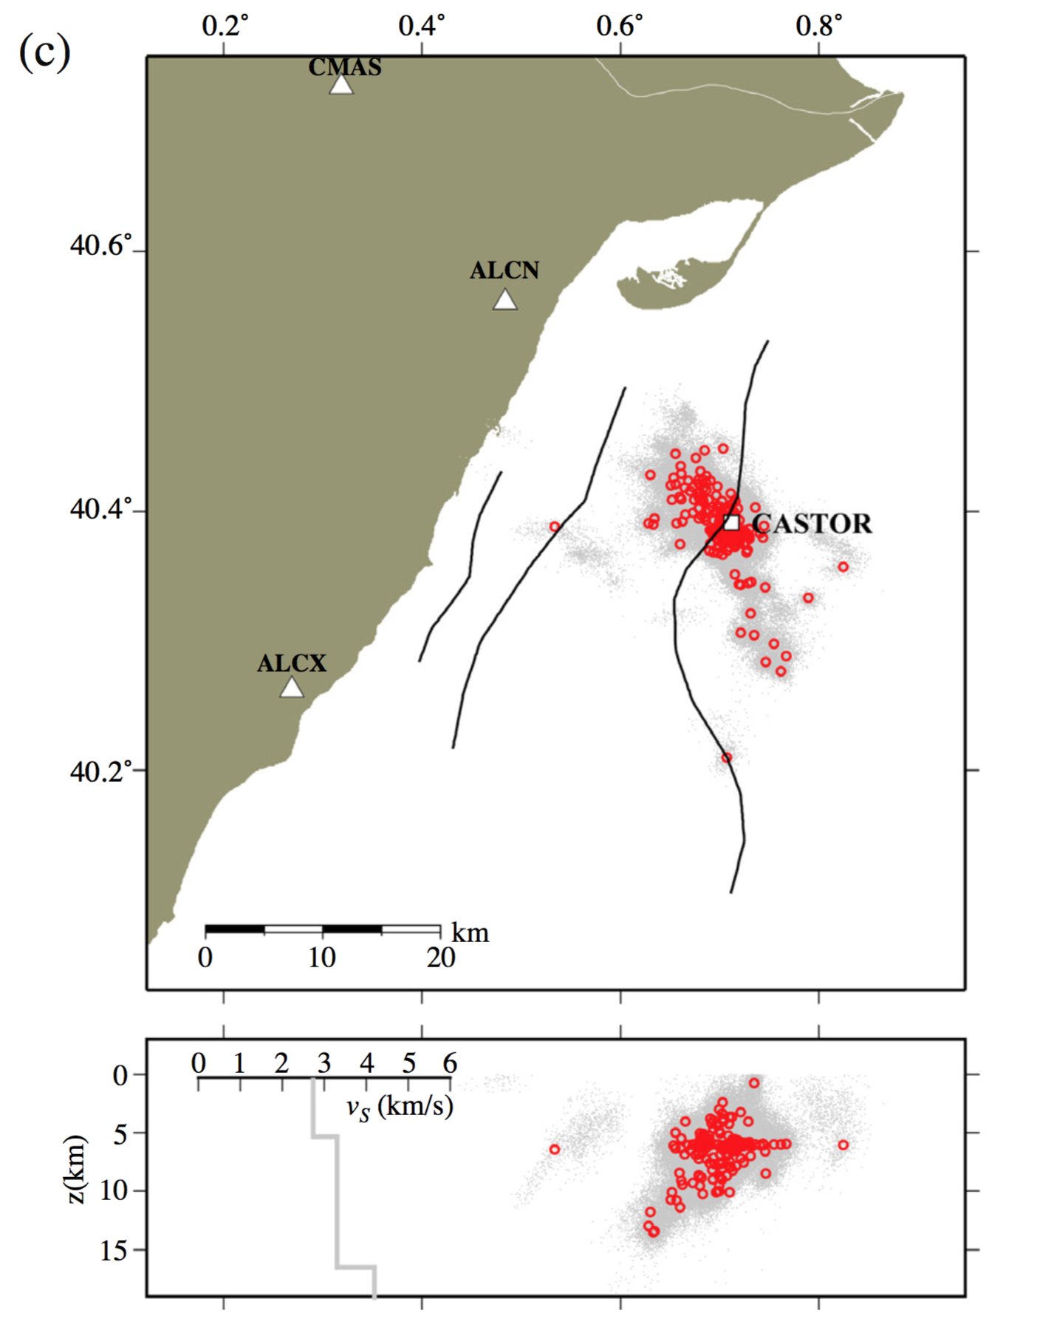
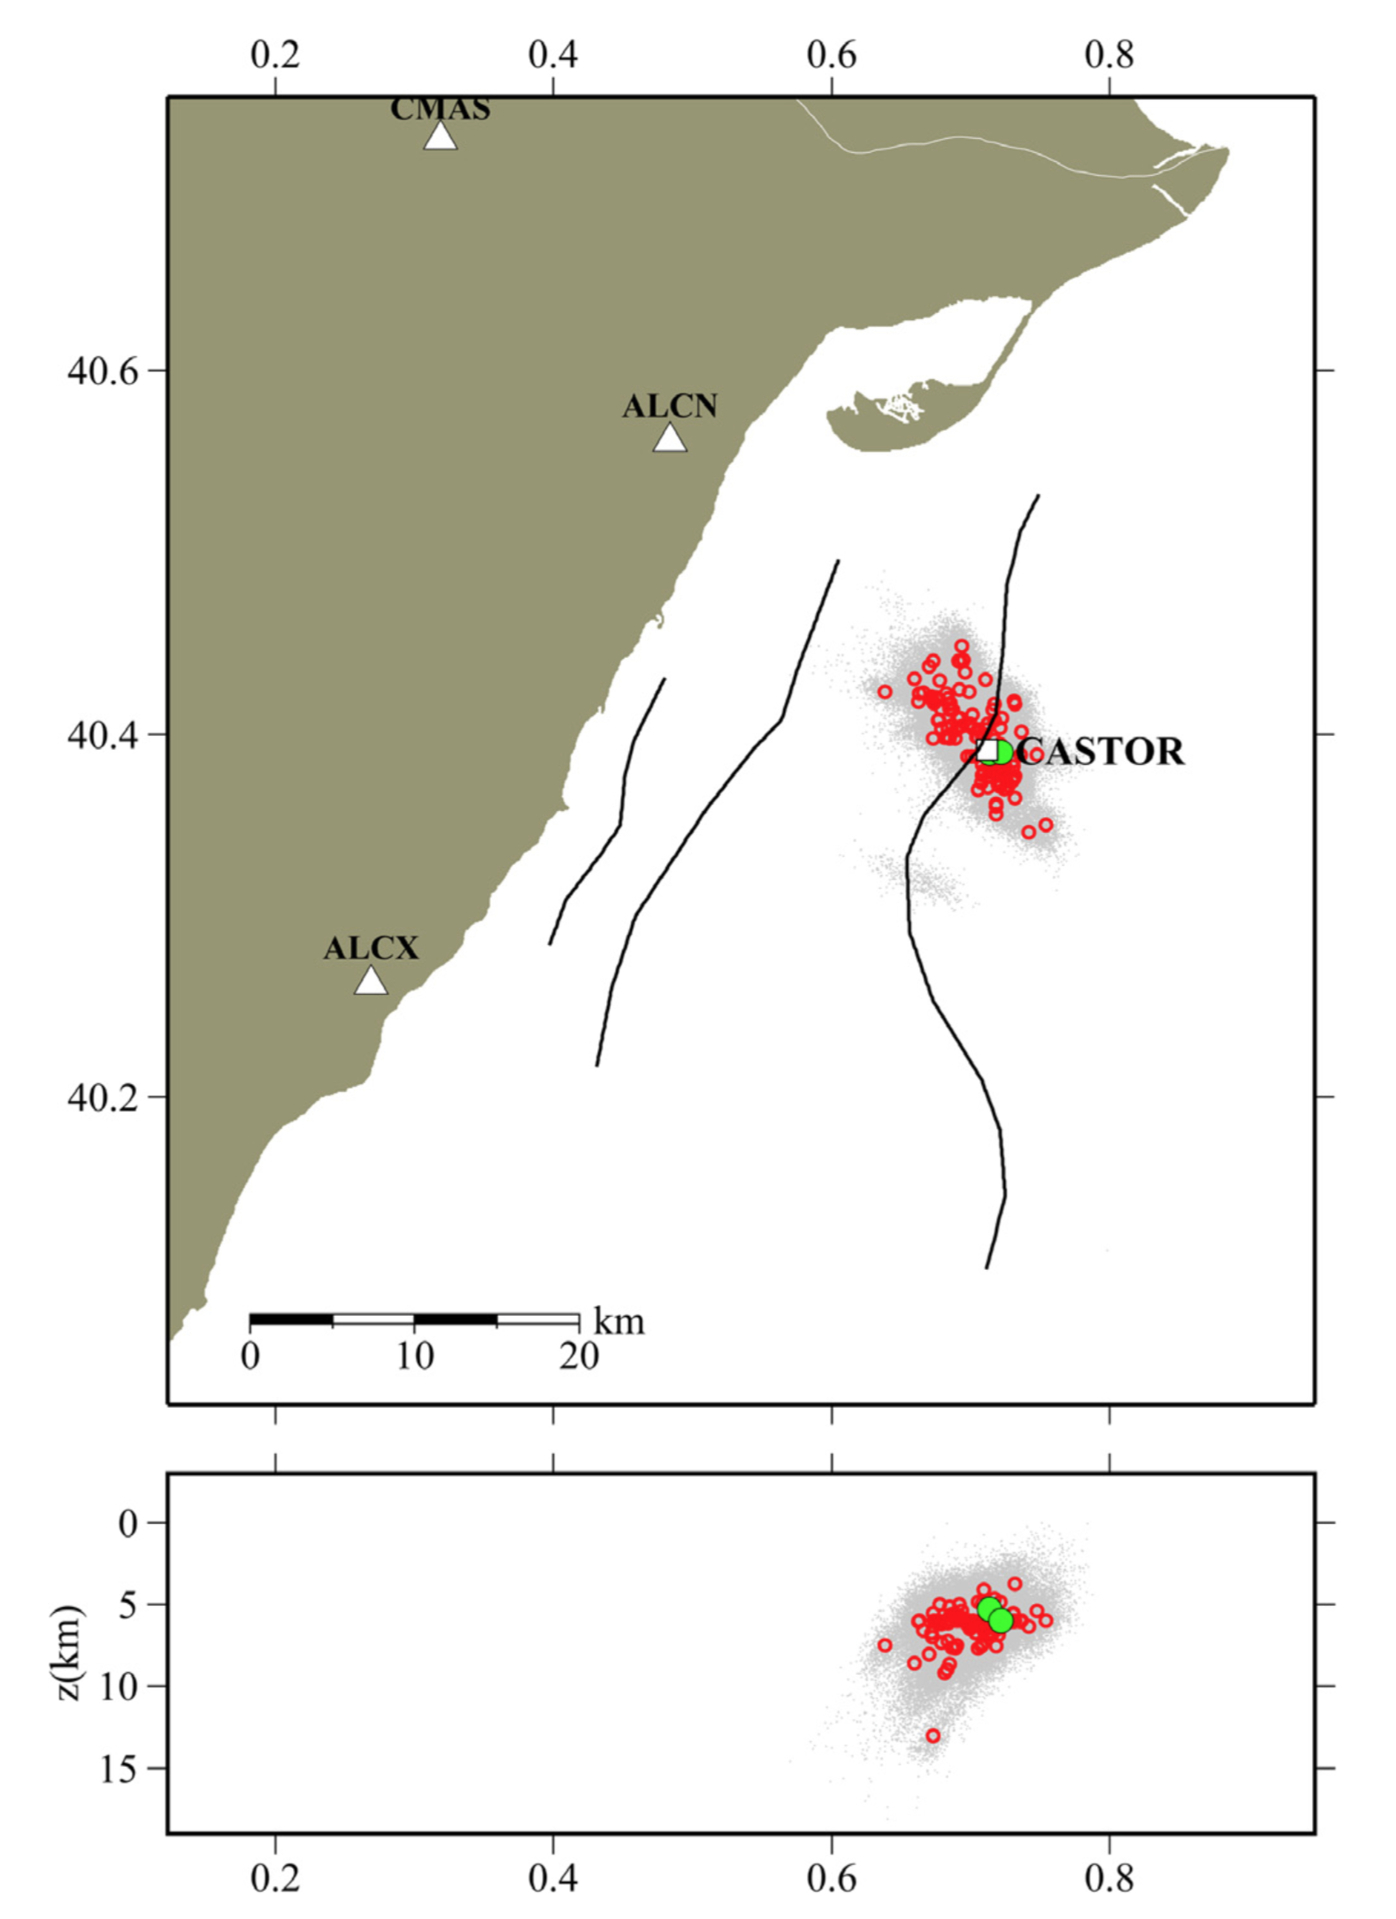
Comparison between original locations and final relocations
IGN
3D model
3D model + new picks
Gaite et al., PEPI (2016)

Slide 10
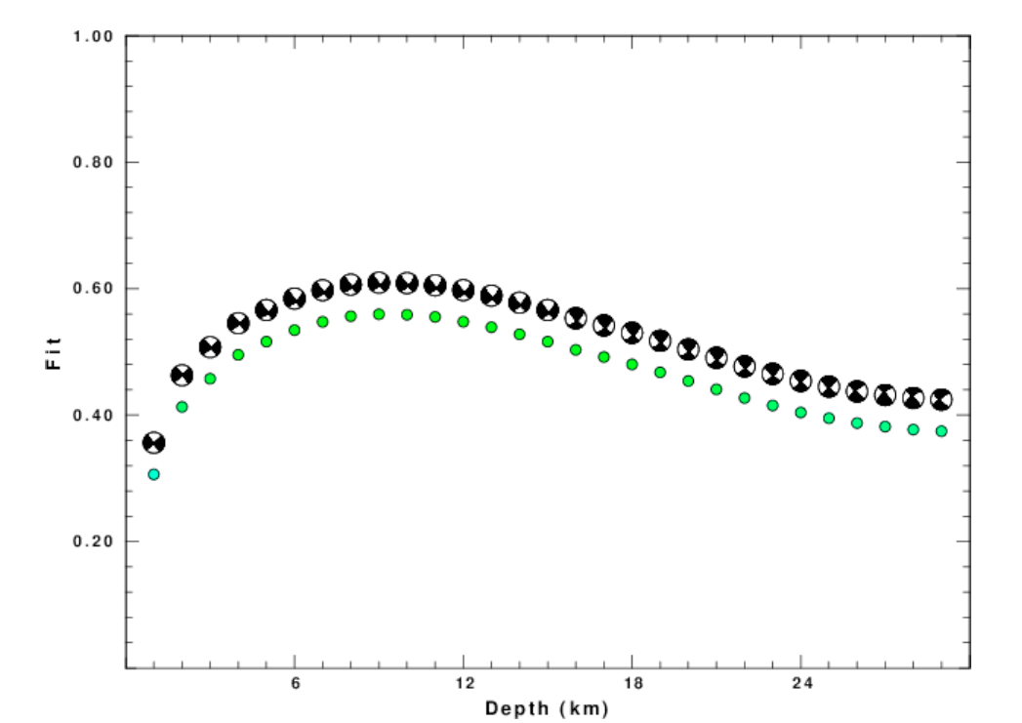
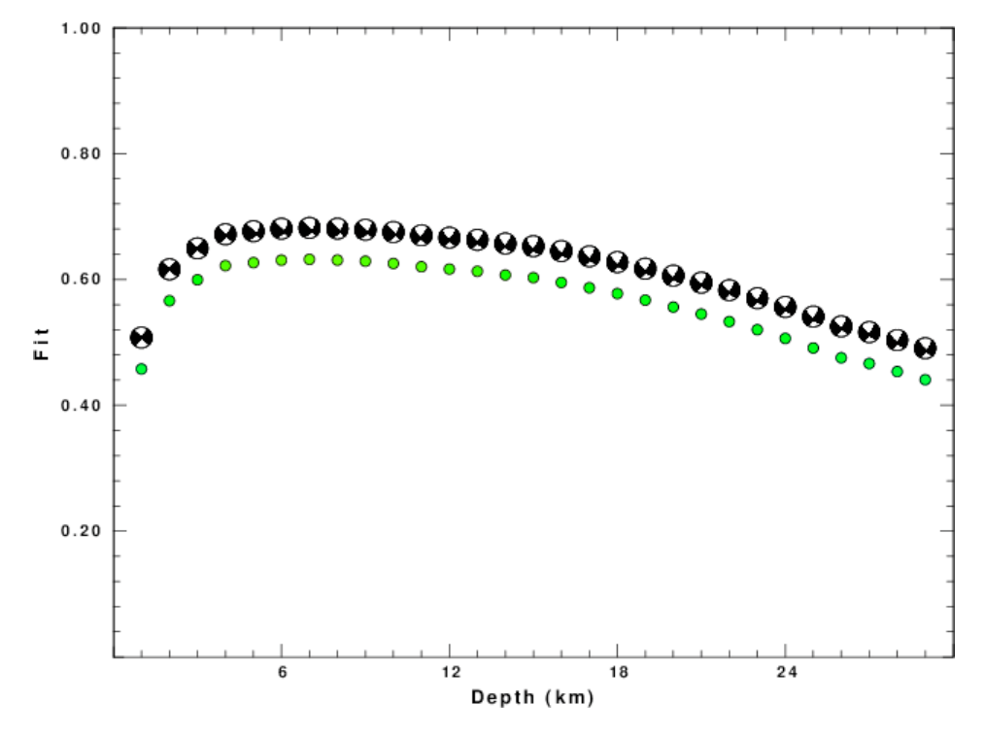
Grid search results for focal depth
0.02-0.10 Hz (50-10 s)
0.02-0.06 Hz (50-16 s)

Slide 11
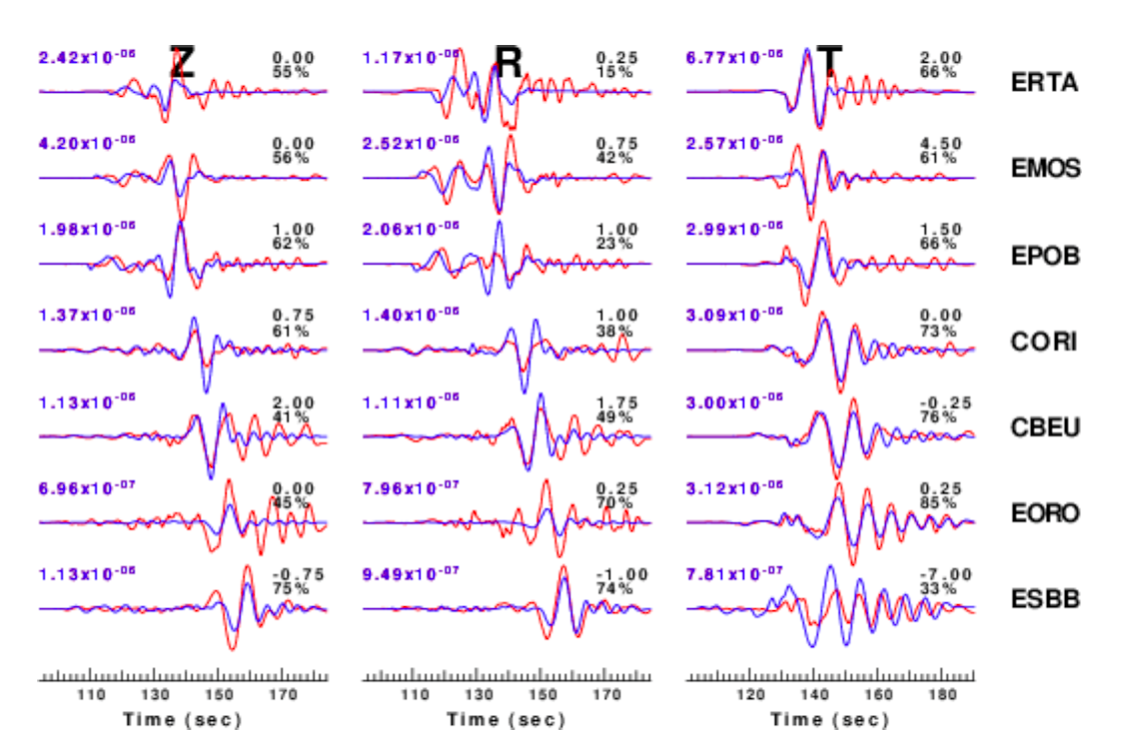
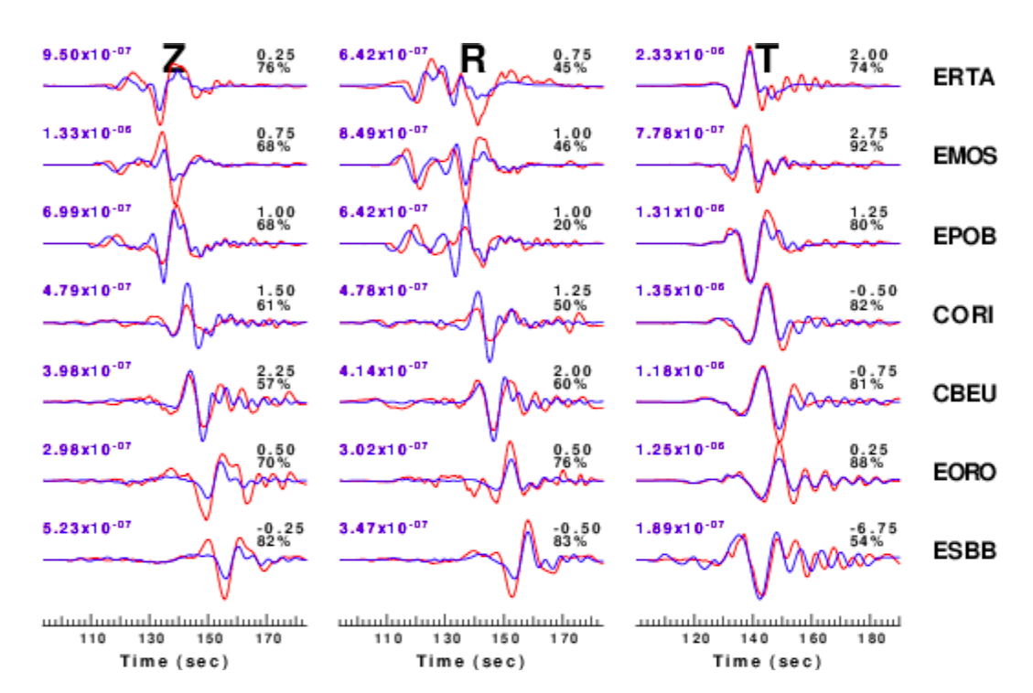
Waveform data fit
Data: red; Synthetics: blue
0.02-0.10 Hz (50-10 s)
0.02-0.06 Hz (50-16 s)

Slide 12
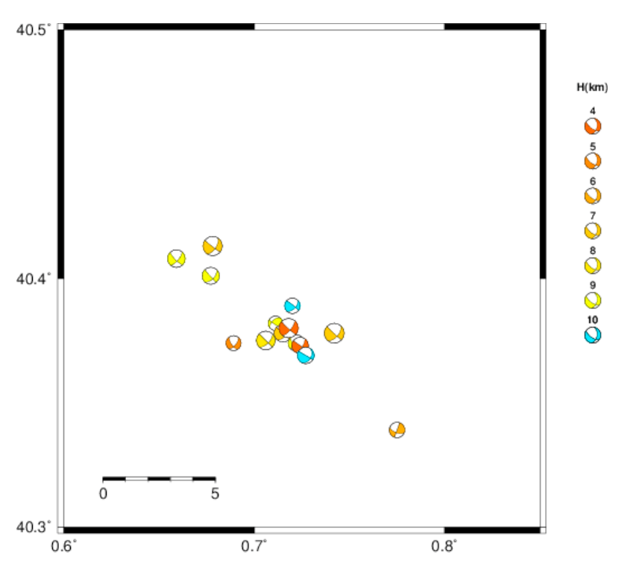
Distribution of focal mechanisms and relocated epicenters
Cesca et al. (2014)

Slide 13
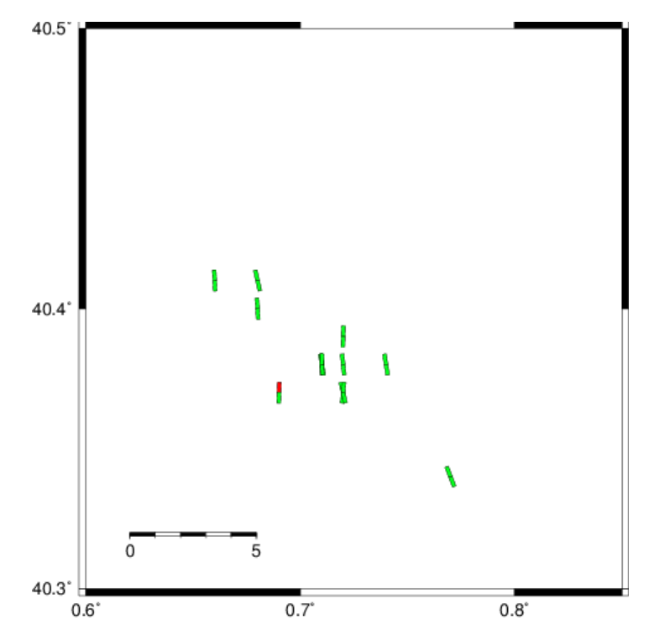
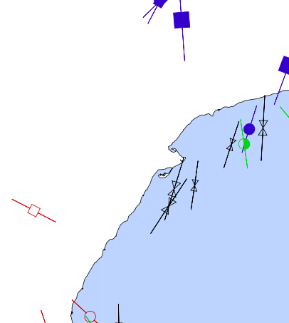
Maximum compressive stress and comparison with WSM

Slide 14
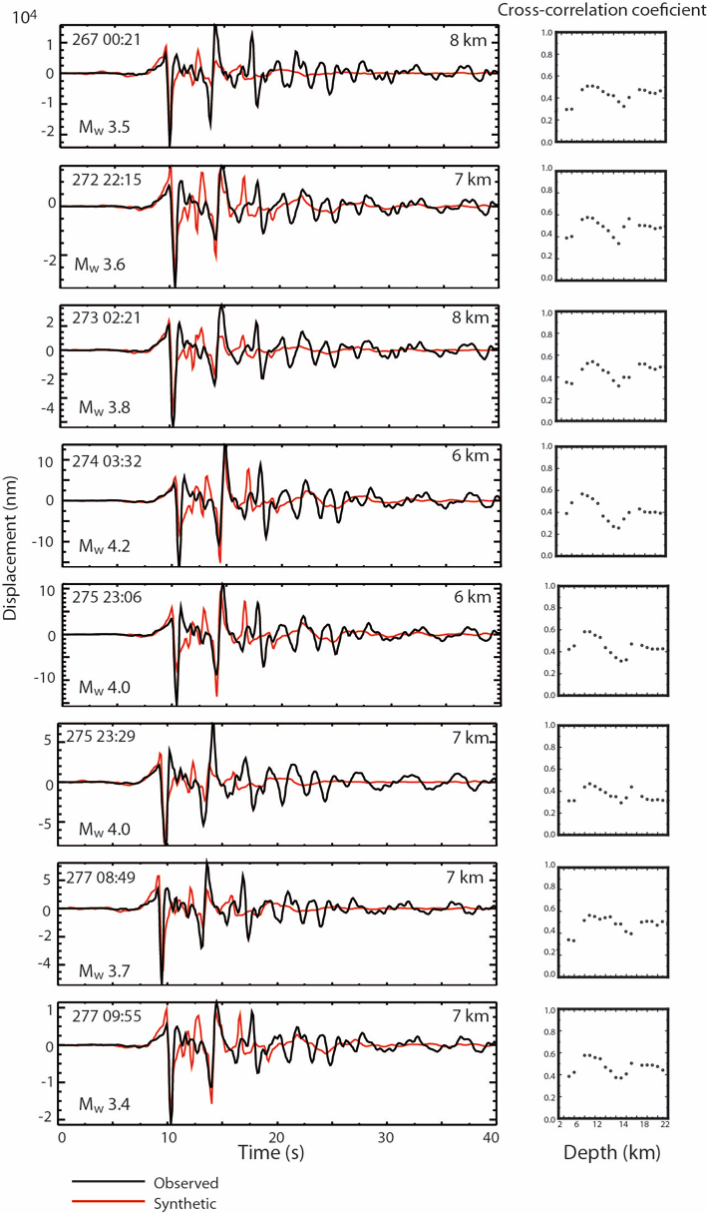
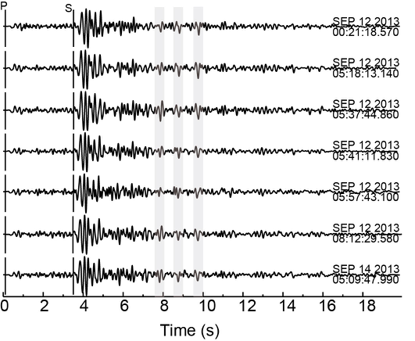
Waveform modeling of short period S-wave reverberations

Slide 15
Conclusions
Poor seismic monitoring and no TLS for induced seismicity
3-D model and new picks from cross correlation result in locations with a NW-SE trend
3 approaches suggest deep (~ 6 km) hypocenters:
Traditional earthquake location
FWI inversion mechanisms
S-wave reverberations
Suggested scenario is the reactivation of an unmapped NW-SE fault in the crystalline basement

Slide 17
Evidence for NW-SE oriented structures in the Ebro delta region
November 2014
April 2015

Slide 18
